Slide 1
Laboratory Module:
BACTERIOLOGY
Spore Forming
Gram Positive Bacilli
Philippine Society for Microbiology & Infectious Diseases
Standing Committee on Training & Curriculum Development
Notes:
Good day, colleagues. In this module, we will be discussing the bacteriology of spore forming and non spore forming gram positive bacilli

Slide 2


SPORE FORMING GRAM
POSITIVE BACILLI
Notes:
Let us start the module with our spore forming gram positive bacilli

Slide 3

BACILLUS
Notes:
Beginning with the BACILLUS species, particulary the most common among the group which is Bacillus anthracis

Slide 4
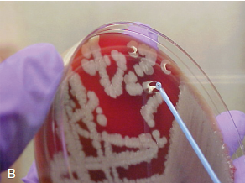
Bacillus anthracis: Microbiology
Gram positive bacilli
Large (1-1.5 μm x 3-8 μm) size
Non-hemolytic on Blood Agar
Colonies
  “Medusa’s head appearance” or “comet tail” – slightly curved at periphery
  White or gray-white colonies or “whipped egg white appearance” – tenacious when loop is passed through a colony
Notes:
Bacillus anthracis is a gram positive bacilli that appears as non-hemolytic colonies on BAP. Macroscopically, the colonies can be described to have a medusa’s head appearance or comet tail being slightly curved at the periphery. They appear white or gray-white with a whipped egg white appearance when a loop is passed through a colony.

Slide 5
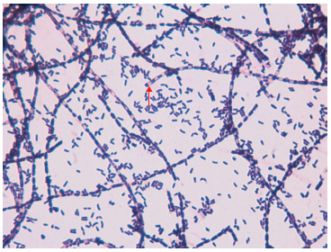
Bacillus anthracis: Microbiology
Gram stain:
  From culture – long chains with prominent central or paracentral oval spores
  From infected tissue – bacilli occur singly or in short chains with no spores
Forms poly-d-γ-glutamic acid capsule in the presence of carbon dioxide or bicarbonate
Catalase-positive
Non-motile
Notes:
Gram stain from cultures will show long chains with prominent central or paracentral spores. If directly from a specimen, the bacilli will be smaller with no spores. They are capsulated in the presence of carbon or bicarbonate. They are positive for catalase and are usually non-motile.

Slide 6
Bacillus anthracis: Pathogenesis
Sporulation does not occur in viable tissues until they are exposed to atmospheric levels of oxygen
Spores may remain viable for years and may remain dormant but viable for at least 100 days
2 main virulence factors:
  poly-d-γ- glutamic acid capsule
  2 exotoxins encoded on pX01 plasmid
Notes:
Spore formation does not occur until the bacilli are exposed to atmospheric levels of oxygen and the spores remain viable for many years and may remain dormant. The 2 main virulence factors are the capsule and the 2 exotoxins encdoded on its plasmid

Slide 7
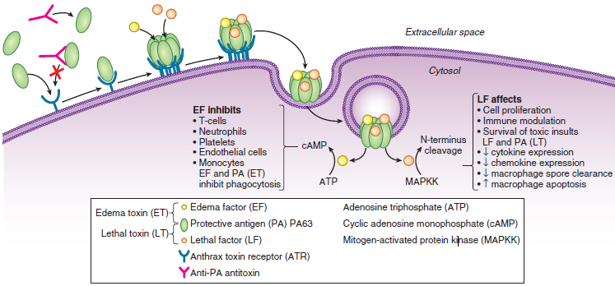
Bacillus anthracis: Pathogenesis
pX01 plasmid encodes 3 toxin components:
  Protective antigen (PA)
  Edema factor (EF) – adenylate cyclase which increases intracellular cyclic AMP
  Lethal factor (LF) – calmodulin-dependent zinc metalloprotease
Notes:
The pX01 plasmid encodes 3 different toxin components: the protective antigen (PA), edema factor (EF) or adenylate cyclase and the lethal factor (LF) or calmodulin-dependent zinc metalloprotease.

Slide 8
Bacillus anthracis: Pathogenesis
Toxin effects
  Impair neutrophil chemotaxis, phagocytosis, superoxide production, macrophage, T and B lymphocyte functions, dendritic cell function
  Results in increased vascular permeability and edema
Notes:
These toxins impair the ff functions: neutrophil chemotaxis and phagocytosis, production of superoxide, macrophage, lymphocytes and dentritic cell functions. Collectively, these all result in increased vascular permeability and edema.

Slide 9
Bacillus anthracis:
Clinical Manifestations and Diagnosis
3 main forms depending on route of exposure:
  Cutaneous
  Gastrointestinal
  Inhalational
Notes:
The 3 main forms of pathology depending on the route of exposure caused by bacillus anthracis are cutaneous, gastrointestinal, and inhalational.

Slide 10
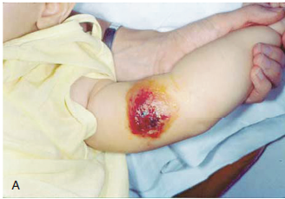
Cutaneous Anthrax
95% of cases
Mortality rates decrease to <5% after penicillin treatment
Anthrax spores are introduced into the skin often by trivial trauma
Incubation period 2 to 5 days
Initial lesion – small pruritic papule at site of inoculation
After 1 to 2 days, vesicles (with serosanguinous fluid) form around the lesions
  Gram stain may reveal numerous bacilli without WBC
  Culture of the fluid will reveal B. anthracis
  Lesion is painless unless with secondary infection
Notes:
The most common is cutaneous anthrax which comprises 95% of cases. Mortality rates decreased to less than 5% after penicillin was introduced. The spores are inoculated into the skin due to trivial trauma. Incubation period ranges from 2-5 days although it can be as long as 19 days. The initial lesion at the site of inoculation is a small pruritic non-tender nodule. This will then develop into vesicles with serosanguinous fluid after 1-2 days. The fluid when cultured will reveal numerous bacilli and cultures can yield bacillus anthracis.

Slide 11
Cutaneous Anthrax
Vesicles are thin roofed and easily rupture ➔ dark brown eschar ➔ black base with a shallow ulcer
  Ulcer is surrounded by induration and edema
Uncomplicated cases heal over 1 to 3 weeks without leaving a scar
Patients often report headache, malaise, low-grade fever
Serious disease is marked by extensive edema – malignant edema
  May be associated with inflammation of overlying skin with pain, signs of toxemia, secondary seeding to other sites, bacteremia
  Fatality rate 10 to 20% if untreated
Notes:
When the vesicles rupture, they produce a dark brown eschar which turns into a black base with shallow ulcer surrounded by induration and edema.
Uncomplicated cases heal over 3 weeks without leaving a scar.
Other symptoms may include headache, body malaise, and low grade fevers. Severe disease can produce extensive edema termed as malignant edema. This is due to inflammation of overlying skin with pain, toxemia, seeding to other sites and bacteremia. Fatality rates increase to up to 20% is left untreated.

Slide 12
Cutaneous Anthrax
Clues to cutaneous anthrax:
  Painless lesion
  Edema out of proportion to size of lesions
  Gram stain of vesicular fluid or ulcer swab with gram positive rods with rare WBC
Differential diagnosis of cutaneous anthrax
  Brown recluse spider bites – painful lesions
  Tularemia
  Scrub typhus
  Rat-bite fever
  Blastomycosis
  Cutaneous fungus
  Mycobacterium marinum infection
Notes:
Clues to cutaneous anthrax: painless lesion, edema out of proportion to the size of lesion, and gram stain of the vesicular fluid with gram positive rods and rare wbc.
The differential diagnosis to cutaneous anthrax are spider bites, tularemia, scrub typhus, rat-bite fever, blastomycosis, cutaneous fungus and mycobacterium marinum infection

Slide 13
Cutaneous Anthrax
Laboratory Diagnosis
  Should be done before initiation of antibiotics
  Culture and gram stain of vesicular fluid, swab from edge of the base of an eschar, full-thickness punch biopsy of vesicle or center of eschar
  Demonstration of bacterial lysis in the presence of γ phage, detection of capsule by direct fluorescent antibody test, identification of toxin genes by PCR
  Gold standard – culture
  Serology using Acute (D0-D7) and convalescent (Day 14 to 28) serum samples
  PA antibodies can be detected by using ELISA 1 week after symptoms begin
Notes:
Prior to initiation of antibiotics, cultures should be collected. Specimens that can be taken for GS and culture are fluid from vesicles, swab from the edge of the base of an eschar, punch biopsy of the vesicle or center of eschar. Other forms of identification are from detection of bacterial lysis in the presence of a gamma phage, capsule detection by direct fluorescent antibody test and PCR. Serological tests can be done using acute and convalescent samples taken on Day 0 to 7 and day 14 to 28 respectively. Antibodies can be detected by ELISA 1 week after the start of symptoms.

Slide 14
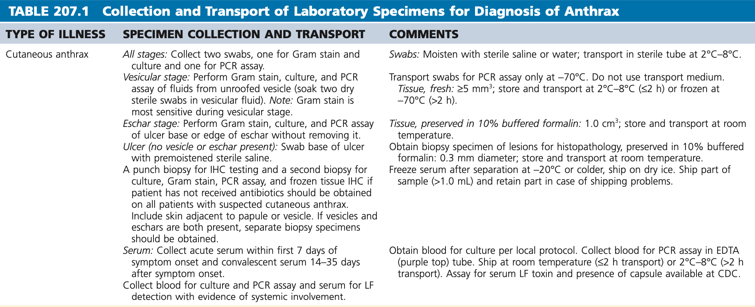
Cutaneous Anthrax
Notes:
Here is a table depicting the summary of the specimens used and how to properly transport them

Slide 15
Injectional Anthrax
Rare
Described in patients who use injection drugs or contaminated heroin
Advanced localized soft tissue infections such as necrotizing fasciitis
Some patients had no localized infection related but with features of systemic disease and deteriorate rapidly
Treatment – surgical debridement, antibiotics, IV anthrax immunoglobulin
Notes:
Injectional anthrax is rare and is usually seen in patients who use IV drugs or contaminated heroin. It manifests as a localized soft tissue infection such as necrotizing fasciitis. Occasionally, patients do not have a localized infection but have systemic disease and deteriorates rapidly. Treatment consists of prompt surgical debridement, antibiotics and IV immunoglobulin.

Slide 16
Inhalational or Pulmonary Anthrax
Woolsorter’s disease
All cases should raise possibility of deliberate spread of spores because naturally occurring inhalational disease is extremely rare
3-level modified staging system by Lucey (2005)
  Early prodromal stage
  Immediate progressive stage
  Late fulminant
Notes:
Inhalational or pulmonary anthrax is also known as woolsorter’s disease. Presence of a case should raise the possibility of a deliberate spread of spores because naturally occurring inhalational disease is extremely rare. The 3 stages of inhalational anthrax are: early prodromal stage, immediate progressive stage, and late fulminant stage

Slide 17
Inhalational or Pulmonary Anthrax
Early prodromal stage
  Inhaled spores <5 µm reach terminal bronchioles and alveoli ➔ phagocytized by alveolar cells ➔ transported to lymph nodes
  Incubation period 1 to 6 days
  Initial influenza-like symptoms – low-grade fever, malaise, fatigue, myalgia, headache, blurred vision, photophobia
Intermediate progressive stage
  High-grade fever, respiratory distress, diaphoresis, pleuritic chest pain, confusion
  Positive blood cultures
  Widened mediastinum and pleural effusions on chest x-ray
Late fulminant phase
  Respiratory failure requiring intubation, sepsis, meningitis, multiorgan failure with overwhelming bacteremia and toxemia
  Death within 24 hours
  Aggressive antibiotics and ICU management, antitoxin
Notes:
Early prodromal stage begins upon inhalation of spores and phagocytosis by alveolar cells and then transported to the lymph nodes. Incubation period is said to last from 1-6 days. Patients usually develop flu like symptoms such as low grade fever, malaise, fatigue, headache, blurred vision, and photophobia. The progressive stage is characterized by high grade fevers, respiratory distress, pleuritic chest pain, and sensorial changes. Blood CS will also be positive and abnormalities in the CXR can be seen such as a widened mediastinum and pleural effusion. In the late fulminant phase, respiratory failure might ensue with sepsis, meningitis, organ failure and overwhelming bacteremia and toxemia. Death happens within 24 hours and management for the fulminant phase involves aggressive antibiotics, antitoxins, and ICU admission.

Slide 18
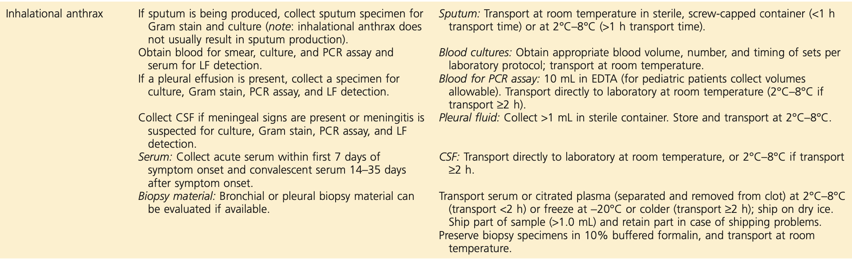
Inhalational or Pulmonary Anthrax
Radiology
  Chest x-ray – widened mediastinum, bilateral pleural effusions (serosanguinous or hemorrhagic)
  Consolidation and infiltrates are not prominent as anthrax is not a parenchymal lung disease
Notes:
Laboratory diagnosis for inhalational anthrax will show a widened mediastinum and bilateral effusion in the xrays. The table above shows the summary of the specimens that can be used for cultures in inhalational anthrax.

Slide 19
Gastrointestinal Anthrax
Oropharyngeal or intestinal
Common in grazing herbivores (usual host for anthrax)
More likely to be associated with bacteremia, sepsis, seeding of other sites
Mortality rate 40% without treatment
Most human cases are associated with ingestion of undercooked meat from infected animal
Notes:
Gastrointestinal anthrax can be divided into oropharyngeal or intestinal. This is common in those grazing herbivores which are the usual host for anthrax. GI anthrax is associated with bacteremia, sepsis, and seeding to other sites. Mortality rate is high at 40% without treatment. Most cases are due to ingestion of undercooked meat from an infected animal.

Slide 20
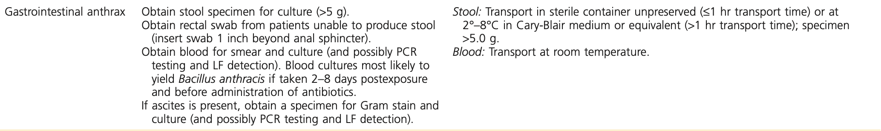
Gastrointestinal Anthrax
Incubation period 1 to 5 days
Oropharynx
  Pharyngitis, dysphagia, odynophagia, fever, respiratory distress due to edema and lymphadenitis
  Pseudomembranes appear over ulcer after 1st week
Intestinal disease
  Nausea, vomiting, fever, severe abdominal pain, hematemesis, ascites, bloody diarrhea
  Blood, stool, ascitic fluid may be tested for culture and PCR
Notes:
Incubation period for GI anthrax is 1-5 days. Oropharynx anthrax causes pharyngitis, dysphagia, odynophagia, fever, and respiratory distress. Pseudomembranes appear after the 1st week. Intestinal anthrax causes nausea, vomiting, fever, abdominal pain, hematemesis, ascities, and bloody diarrhea. Specimens that can be used for culture and PCR are blood, stool, and ascitic fluid.

Slide 21
Anthrax Meningitis
Uncommon sequelae of cutaneous anthrax but frequent complication of bacteremia in inhalational or GI disease
Severe headache, altered mental status, meningeal signs
Spread to the CNS may be due to hemorrhagic necrosis that permits the bacilli to pass the meninges
Hallmark: hemorrhagic component associated with large gram-positive bacilli
Cerebral edema may also be prominent
Death may occur within 24 hours
Early initiation of 3 or more antibiotics is associated with greater potential for survival
Notes:
Anthrax meningitis is a rare sequalae of cutaneous anthrax and more common in inhalational or GI disease. Symptoms include severe headache, altered mental status and meningeal signs. The spread to the CNS is due to the hemorrhagic necrosis that permits the bacilli to pass the meninges. Hallmark lesion is a hemorrhagic component associated with large gram positive bacilli on gram stain. Death may occur within 24 hours and early initiation of 3 or more antibiotics is associated with greater potential for survival.

Slide 22
Bacillus anthracis: Treatment
Rapid initiation of antibiotic therapy especially in the severe non-cutaneous cases
Drug of choice – penicillin
Other drugs with known sensitivity to B. anthracis – tetracyclines, macrolides, aminoglycosides, fluoroquinolones, carbapenems, linezolid, clindamycin, rifampin, quinupristin-dalfopristin, cephalosporins, chloramphenicol
Resistant to 3rd generation cephalosporins, aztreonam, cotrimoxazole
Most strains have a chromosomally mediated weak inducible β-lactamase and cephalosporinase
For bioterrorism-associated anthrax – fluoroquinolones, carbapenem, doxycycline pending resistance testing
  It is recommended to use 3 antibiotics – 2 bactericidal and 3rd protein synthesis inhibitor
Duration – at least 2 weeks or until patient becomes stable
Notes:
Treatment includes rapid initiation of antibiotics especially in severe non-cutaneous cases. Drug of choice is penicillin. Other drugs with known sensitivity are tetracyclines, macrolides, aminoglycosides, fluoroquinolones, carbapenems, linezolid, clindamycin, rifampicin, cephalosporins, and chloramphenicol. Bacillus anthracis are known to be resistant to 3rd gen cephalosporins, aztreonam and cotrimoxazole. Most strains have inducible Beta lactamase and cephalosporinases.
For bioterrorism associated anthrax, fluoroquinolones, carbapenem, and doxycyclines can be given pending resistance testing. 3 antibiotics are recommended, 2 bactericidal and a protein synthesis inhibitor. Antibiotics should be given for at least 2 weeks or until patient becomes stable.

Slide 23
Bacillus anthracis: Agent of Bioterrorism
2001 – anthrax-spore laden letters were sent using US postal service to recipients in New York and Washington
  22 people developed anthrax – 11 inhalational and 11 cutaneous
  5 people died among inhalational cases
Dissemination of anthrax as a bioterrorist agent
  Spores can be dispersed or sprayed as a powder or liquid
  Animals can be infected and released with intent to spread among others
Lethal dose (LD₅₀) for humans range from 4,000 to 55,000 spores
Outbreak characteristics after use of anthrax as bioterrorist agent
Notes:
As an agent of bioterrorism, antrax spores have been placed in letters sent using US postal service to recipients in new York and Washington in 2001 where 22 people developed anthrax, mostly inhalational and 5 died. Anthrax spores can be dispersed or sprayed as a powder or liquid and animals can be infected and released to infect others; hence, it is often used as a bioterrorist agent.

Slide 24
Other Bacillus spp.
B. cereus
B. circulans
B. licheniformis
B. megaterium
B. pumilus
B. subtilis
Brevibacillus brevis
Brevibacillus laterosporus
Paenibacillus alvei
Notes:
Other than Bacillus anthracis, the following are the other medically important bacillus species.

Slide 25
Microbiology and Pathogenesis
Aerobic or facultatively anaerobic
Gram variable spore-forming bacilli
  Gram positive in early growth
  Gram variable or even gram negative in old cultures
As compared to B. anthracis, other species of Bacillus are motile and β-hemolytic
Notes:
Bacillus is a gram positive spore-forming bacilli particularly endospores. It is an aerobic or facultatively anaerobic bacterium. It also exhibits Gram variability in which it is Gram positive on an early growth and variable or negative in old cultures.
As compared to B. anthacis, other species of Bacillus are motile and beta hemolytic in BAP

Slide 26
Microbiology and Pathogenesis
Commonly found in soil and water
Normal flora in children and adults
Can survive in high concentration of ethyl alcohol up to 95%
Tolerate extremes of temperature and moisture
  B. stearothermophilus – used to determine the efficacy of heat sterilization
  B. subtilis – used to determine efficacy of fumigation procedure
Notes:
It is ubiquitously found in soil and water.
Bacillus sp can survive in high concentration of ethyl alcohol up to 95%, the failure of alcohol to kill bacillus sp can lead to a serious problem.
These bacteria are able to tolerate extremes of temperature and moisture hence their hardiness under condition of dessication and heat has been used
Determine the efficacy of heat sterilization using Bacillus stearothermophilus.
Determine the efficacy of Fumigation procedures using bacillus subtilis.

Slide 27
Microbiology and Pathogenesis
Bacillus spp. able to adhere to plastic intravascular catheters
B. cereus spores
  Sticky and have tendrils that stick out from dense spore to provide a mode of attachment to various surfaces
B. licheniformis
  Often mucoid which may account in part for its ability to cause an indolent but difficult-to-treat infections in patients with long term indwelling vascular catheters
Notes:
Bacillus spp are able to adhere to plastic intravascular catheter which may help account for the frequency with which bacillus spp infection presents as bacteremia.
The spores of B. cereus are also sticky and have tendrils that stick out from the dense spore and provide a mode of attachment to various surfaces.
B. licheniformis is often mucoid in colonial morphology, which may account in part for its ability to cause somewhat indolent but difficult-to-treat infections in patients with long-term indwelling vascular catheters.

Slide 28
B. cereus
Found within the soil and widely distributed in nature
Opportunistic pathogens and often associated with food-borne illness
Emetic toxins
  Cereulide: heat stable, proteolysis and acid-resistant toxins
Diarrheal toxins
  Hemolysin BL (HBL)
  Non-hemolytic enterotoxin (Nhe)
    Responsible for the major symptoms in diarrheal presentation of infection
  Cytotoxin K (CytK)
Notes:
B. Cereus is commonly found within the soil and widely distributed in nature and often associated with food-borne illness.
There are 2 Toxins related to B. cereus
Emetic Toxin is a small peptide that is a heat stable and is associated with starchy foods such as rice.
Diarrheal toxins which are: Hemolysin BL, Nonhemolytic Enterotoxin and Cytotoxin K. Among the 3, Nonhemolytic Enterotoxin is responsible for the major symptoms in diarrheal presentation of infection.

Slide 29
Laboratory Diagnosis
Specimen for isolation of Bacillus spp. other than B. anthracis and B. cereus may be handled safely under normal standard laboratory practices
Pretreatment with heat or alcohol shock removes contaminating organisms and only spore-forming bacteria survive
Notes:
Specimen for isolation of bacillus spp other than B. anthracis and B. cereus may be handled safely under normal standard laboratory practices.
Pretreatment with heat or alcohol shock removes contaminating organisms and only spore-forming bacteria survive.

Slide 30
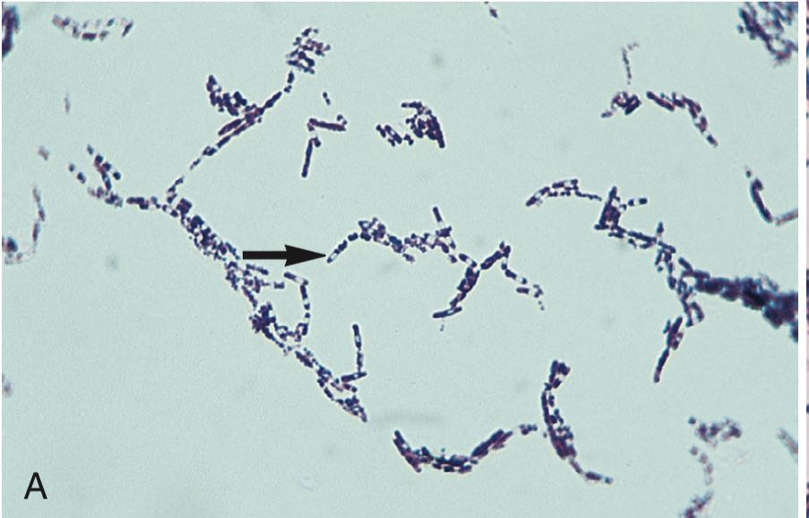
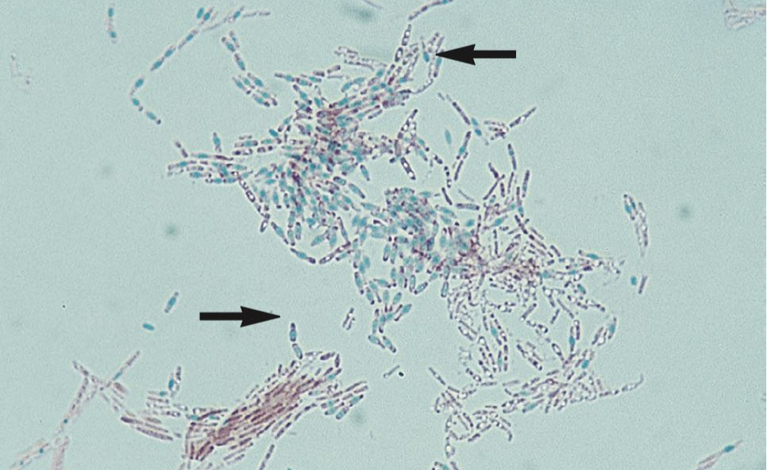
Laboratory Diagnosis
Direct Detection Method
  Gram Stain: large, gram positive bacilli in singles, pairs or serpentine chains
  Special Stain for Endospores: endospores stain green from malachite green and the vegetative cells will appear pink from safranin
Notes:
Gram Staining morphology of Bacillus spp are large gram positive rods that can be arranged in singles, pairs or serpentine chains.
Special stain for endospores stains green from malachite green and the vegetative cells will appear pink from safranin .

Slide 31
Laboratory Diagnosis
Media of Choice: Blood Agar, Chocolate Agar, Columbia Nalidixic Acid Agar, Phenylethyl Alcohol Blood Agar
  Selective Medium: Mannitol Egg Yolk Polymixin Agar, Biosynth Chromogenic Agar
    Contains phospholipase C-positive reaction on egg yolk agar
    Lack of production of acid from mannitol
    Selective agent: pyruvate or polymyxin
Serodiagnosis: available for detection of B. cereus toxin in food and feces
Molecular Method: MALDI-TOF
Notes:
Different medium can be used in isolating Bacillus spp.
But Selective medium is also available like MEYP ( Mannitol, egg yolk and Polymyxin B agar) or BCM: B cereus medium. It contains Pyruvate or polymyxin as selective agent.
For Serodiagnosis, B. cereus toxin in food and feces is also available.

Slide 32
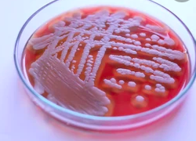
Colonial Appearance and Other Characteristics
Organism
B. cereus and B. thuringiensis | Large, feathery, spreading; β-hemolytic
B. mycoides | Rhizoid colony that resembles a fungus, weakly β-hemolytic
B. megaterium | Large, convex, entire, moist, non-hemolytic
B. licheniformis | Large blister colony; becomes opaque with dull to rough surface with age; β-hemolytic
B. pumilus | Large, moist, blister colony, may be β-hemolytic
B. subtilis | Large, flat, dull with ground-glass appearance; may be pigmented (pink, yellow, orange or brown); may be β-hemolytic
B. cereus
Notes:
This table shows the colonial appearance of different bacillus.

Slide 33
Colonial Appearance and Other Characteristics
Organism
B. circulans | Large, entire, convex, butyrous; smooth, translucent surface, may be β-hemolytic
B. coagulans | Medium-large, entire raised, butyrous, cream-buff, may be β-hemolytic
B. sphaericus | Large, convex, sloth opaque, butyrous, non-hemolytic
Brevibacillus brevis | Medium-large, convex, circular, granular may be β-hemolytic
Paenibacillus macerans | Large, convex, fine granular surface, non-hemolytic
Paenibacillus alvei | Swarms over agar surface; discrete colonies are large, circular convex, sloth glistening, translucent or opaque; may be β-hemolytic
Paenibacillus polymyxa | Large, moist blister colony with amoeboid spreading in young cultures; older colonies wrinkled, non-hemolytic

Slide 34
Clinical Manifestation
Species | Clinical Syndrome
B. cereus | Bacteremia, osteomyelitis, endocarditis, soft tissue infections, nosocomial infections, meningoencephalitis, fulminant hepatitis, Pneumonia – caused by capsule, plasmid carriage of B. cereus strain Eye infection – keratitis from contact lens wear and rapidly destructive endophthalmitis from ocular trauma, therapeutic injection, surgery or hematogenous dissemination Food Poisoning – occurs within 24 hours of eating, often within a few hours of the offending meal Diarrheal Form – profuse diarrhea and cramping but rarely vomiting or fever Onset: 8 to 16 hours (median duration, 24 hours) Toxin: heat labile, it disrupts cell membranes and may have sphingomyelinase activity Associated with meat, vegetables, sauces
Notes:
Aside from B. anthracis, B. cereus can cause several clinical diseases such as bacteremia, osteomyelitis, endocarditis etc. Pneumonia can be caused by capsule, plasmid carriage of B. cereus strain.
Eye infection caused by bacillus cereus is usually associated with contact lens wears .
Most prominently B. cereus is known for causing food poisoning which can occur within 24 hours of eating, often within a few hours of the offending meal.
Diarrheal syndrome caused by B. cereus is usually profuse and associated with crampy abdominal pain and rarely vomiting or fever.
-> Diarrheal form occurs within 8-16 hrs with median duration of 24 hrs

Slide 35
Clinical Manifestation
Species | Clinical Syndrome
B. cereus | Emetic Form Onset: 1-5 hours, resolves within 24 hours Nausea, vomiting, cramps Diarrhea in 1/3 of cases Emetic Toxin: heat stable Associated with starchy foods, such as rice
B. pumilus | Meningitis, bacteremia, soft tissue infection
B. sphaericus | Peritonitis, pleuritis, pericarditis, pseudotumor of the lung, meningitis, bacteremia
B. circulans | Meningitis, cerebrospinal fluid shunt infection, endocarditis, wound infection, endophthalmitis
B. licheniformis | Bacteremia, catheter-related sepsis, food poisoning, central nervous system infections after surgery or trauma
B. megaterium | Meningitis, bacteremia
Notes:
Emetic form of B. cereus infection occurs within 1-5 hrs and resolves within 24 hrs. It presents with nausea, vomiting, cramps and associated with heating or reheating of starchy foods which may eliminate viable bacillus and diarrheal toxin but not the heat stable EMETIC TOXIN.
The following in the table are the other Bacillus spp with their associated clinical syndrome.

Slide 36
Clinical Manifestation
Species | Clinical Syndrome
B. subtilis | Meningitis after lumbar puncture or head trauma, otitis, mastoiditis, wound infection, bacteremia, pneumonia, endocarditis, shunt infection, emetic food poisoning B. subtilis food poisoning: Short incubation period (median 2.5 hours) Symptoms: vomiting, diarrhea, flushing, sweating, headaches Large amounts of B. subtilis are required
Brevibacillus brevis | Keratitis, food poisoning
Brevibacillus laterosporus | Bacteremia
Paenibacillus alvei | Sepsis, meningitis, prosthetic joint infection, wound infection
Notes:
Bacillus subtilis can cause meningitis after Lumbar puncture or head trauma. It is usually with short incubation period, a median of 2.5 hours.

Slide 37
Treatment
Supportive measures
Deep tissue infection: removal of prosthetic material
Most Bacillus spp. are susceptible to vancomycin, clindamycin, fluoroquinolones, aminoglycosides, carbapenems
B. cereus is often resistant to β-lactam and uniformly susceptible to vancomycin, ciprofloxacin, levofloxacin, linezolid and gentamycin
Notes:
Bacillus infection is usually treated with supportive therapy except for deep tissue infection wherein debridement is needed or removal of prosthetic material if present is warranted.
But it must be noted that most bacillus spp are susceptible to vancomycin, clindamycin, fluoroquinolones, aminoglycosides, carbapenems and MOST B. cereus is resistant to Beta lactam and uniformly susceptible to vancomycin, Ciprofloxacin, levofloxacin, Linezolid and Gentamycin

Slide 38
CLOSTRIDIUM
Notes:
Let us now proceed to Clostridium Species

Slide 39
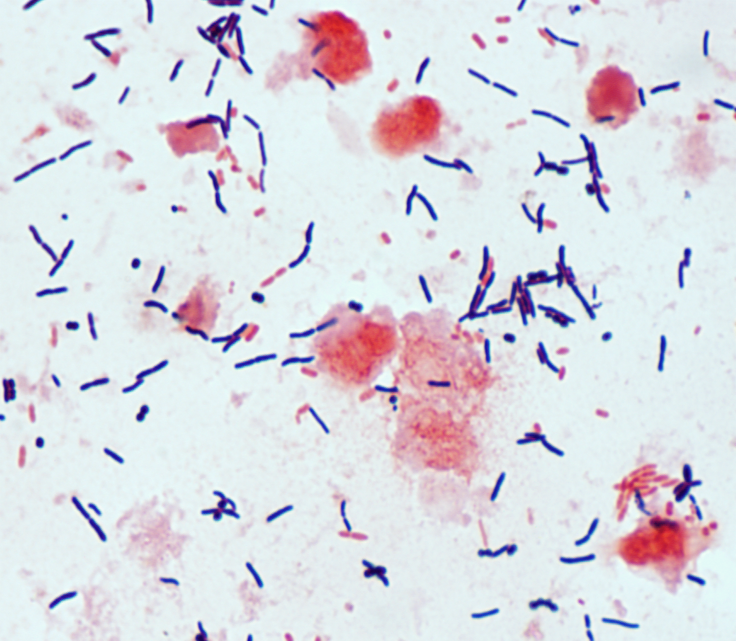
Clostridium difficile: Microbiology
Gram positive bacilli
Obligate anaerobic
Survive in environments under aerobic conditions by forming spores
Majority of strains produce two toxins, A and B – responsible for many of the disease characteristics
Some strains of C. difficile lack the genes for toxin production and are non-toxigenic, and are not thought to cause infection
Notes:
First in our Clostridium species is C. difficile. These are are obligate gram-positive anaerobic bacteria that can survive in environments under aerobic conditions by forming spores. The majority of strains produce two toxins, A and B, that are thought to be responsible for many of the disease characteristics. A third toxin, binary toxin, is produced by recent epidemic strains that have caused outbreaks with increased severity and mortality.
Some strains of C. difficile lack the genes for toxin production and are nontoxigenic, and are not thought to cause CDI.

Slide 40
Clostridium difficile: Microbiology
Other virulence factors
  C. difficile binary toxin (CDT)
  Surface layer proteins
  Surface polysaccharides
  Flagella
  Various adhesins
Notes:
The third toxin called binary toxin is a two-part toxin that is an ADP-ribosyltransferase specific for actin monomers, thus disrupting the actin cytoskeleton. CDT is produced by only a small fraction of C. difficile strains, and thus its role in pathogenesis is unclear.
In addition to the three toxins, multiple other potential virulence factors for C. difficile have been studied, including surface layer proteins, surface polysaccharides, flagella, and various adhesins

Slide 41
C. difficile Infection (CDI)
Clostridium difficile: Pathogenesis
Diagnosis is based on:
  Presence of clinical symptoms (usually defined as ≥ 3 watery, loose, or unformed stools within a period of 24 hours or less)
  Presence of either the C. difficile organism or its toxin genes from the stool sample, or detection of C. difficile toxin using an enzyme immunoassay or cell cytotoxin assay
  Presence of pseudomembranes in the colon visualized by endoscopy
Notes:
The major disease entity caused by Clostrodium or Clostridum difficile infection is diagnosed based on the following:
presence of clinical symptoms (usually defined as ≥3 watery, loose, or unformed stools within a period of 24 hours or less) coupled with a
diagnostic test (usually of a stool specimen) that detects the presence of either the C. difficile organism or its toxin genes, or detection of C. difficile toxin using an enzyme immunoassay or cell cytotoxin assay
Lastly, diagnosis can also be made in patients with diarrheal symptoms by the use of lower gastrointestinal endoscopy to visualize pseudomembranes in the colon (but this method is used sparingly and is far more costly and less sensitive than a variety of stool diagnostics)
The presence of appropriate symptoms prior to stool testing is critical because C. difficile can be carried asymptomatically, especially by hospitalized patients. Since the pathogen and its toxins can be readily detected with most of the available tests, detection of C. difficile in the absence of symptoms does not meet the criteria for a CDI diagnosis.

Slide 42
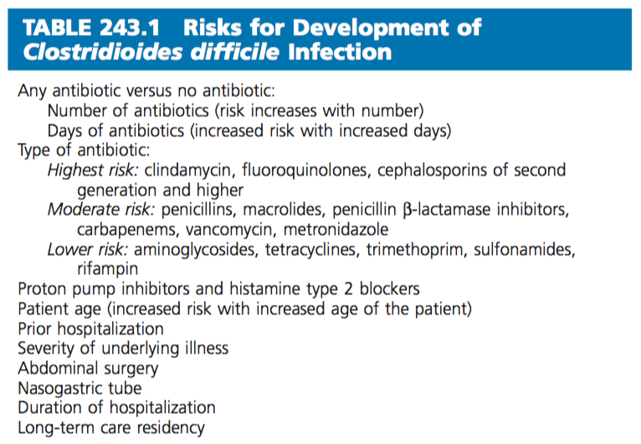
Risk Factors: C. difficile Infection (CDI)
Notes:
This table shows the risk factors associated with CDI.
The overall risk for developing CDI is dominated by antimicrobial exposure, including duration, number, and class of antimicrobials (with clindamycin, fluoroqinolone, cephalosporin of second generation higher conferring the highest risk). Risk is also highest during therapy and in the first month after cessation of antimicrobial therapy and decreases between 1 and 3 months posttherapy. In addition, stomach acid–inhibiting agents such as PPIs and histamine type 2 antagonists have also been associated with increased risk for CDI, although some studies fail to make this association. It is likely that the combination of an antimicrobial and a PPI increases the risk for CDI. Patient factors are also important CDI risks, with advanced age, immunosuppression, prior hospitalization, and severity of underlying illness contributing to increased risk.

Slide 43
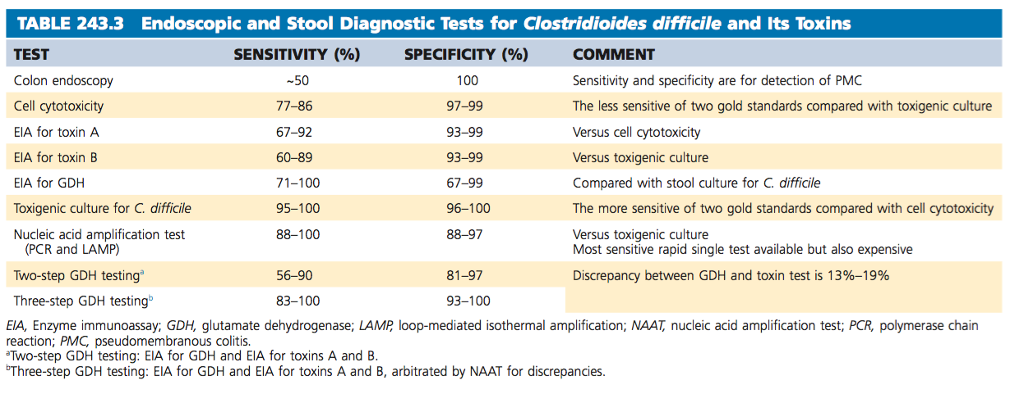
Diagnostic Modalities: C. difficile Infection (CDI)
Notes:
This table shows the different diagnostic modalities to test for Clostriodioides difficile and its toxins.
The two gold standards are cell cytotoxicity assay and stool culture for toxigenic C. difficile, the latter being more sensitive than the former.
Enzyme linked Immunosorbent Assay (EIA) for toxin A/B may not nearly be as sensitive as the two gold standards, but it is less labor intensive and provided more rapid turn around of test results.
The use of glutamate dehydrogenase (GDH), which is not specific to C. difficile and is present in both toxigenic and non toxigenic C. difficle isolates, as part of a two-step or three-step test algorithm has become one of the choices to replace toxin EIA alone with more sensitive tests. Utilizing the high negative predictive value of the GDH EIA test and the level of test positivity in the laboratory, 80% to 95% of specimens can be reported as C. difficile negative with rapid turnaround of results in the laboratory. However, confirmation that a positive GDH specimen is due to a toxigenic strain requires doing a cell cytotoxin assay of the stool to confirm presence of C. difficile toxin, and this adds 2 to 3 days to the test reporting.
When results of GDH and toxin A/B EIA are discrepant (13%–19% of tests), the difference can be resolved by NAAT, which results in rapid turnaround of results (the so-called three-step algorithm) and is less expensive than testing all specimens with NAAT. NAAT targets to amplify conserved regions of either toxin A or toxin B genes using either PCR or loop-mediated isothermal amplification technology. It detects the presence of a toxin gene in stool and thus is a test for detection of the presence of toxigenic C. difficile, similar to doing a toxigenic culture, but is not a test for toxin in the stool.

Slide 44
C. difficile:
Clinical and Pathologic Manifestations
Can be asymptomatic
For those with symptomatic disease, symptoms can occur concurrently with the initiation of antibiotics or even several weeks after the discontinuation
Diarrhea can be minimal, self-limited to profuse, with 20 or more episodes a day
Other signs: fever, abdominal pain, tenesmus
Notes:
Infection with a toxin-producing strain of C. difficile can be asymptomatic, especially in certain populations, including infants and patients in hospitals and chronic care facilities. In patients who develop symptomatic disease during a course of therapeutic antibiotics, symptoms can occur concurrently with the initiation of antibiotics or even several weeks after the discontinuation of therapy.
Diarrhea due to CDI can range in severity from minimal, self-limited disease to profuse, with 20 or more episodes a day. About 20% to 25% of patients can be expected to resolve symptoms by stopping the offending antibiotics without using specific CDI treatment. Associated signs and symptoms can include fever, abdominal pain, and tenesmus.

Slide 45
C. difficile:
Clinical and Pathologic Manifestations
Markers of severe disease:
  Significant WBC count elevation
  Hypoalbuminemia
  Elevated creatinine
Complications:
  Hypotension/shock
  Development of toxic megacolon
  Intestinal perforation
  Acute peritonitis
Notes:
Significant WBC count elevation can serve as a marker of severe disease, along with hypoalbuminemia and elevation of baseline serum creatinine levels.179 Complications of the most severe forms of CDI include hypotension or shock, the development of toxic megacolon (suggested by radiographic evidence of acute dilatation of the colon to >6 cm), intestinal perforation, and acute peritonitis. Extraintestinal manifestations of CDI are surprisingly rare, including very infrequent evidence of bacteremia or peritonitis in the absence of perforation.

Slide 46
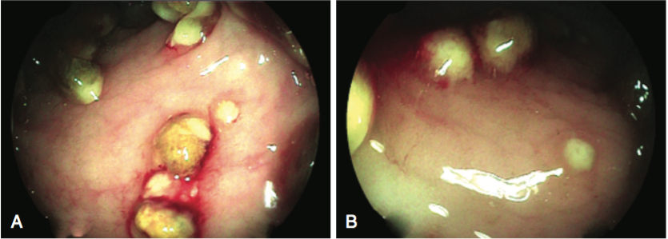
C. difficile:
Clinical and Pathologic Manifestations
Endoscopic Examination:
  Initial lesions appear 1 to 2 mm whitish-yellowish plaques that appear on a background of normal appearing mucosa
  As the disease progresses, plaques coalesce and, as they become confluent, form the typical pseudomembrane covering the entire colon wall
Notes:
By endoscopic examination, the initial lesions of PMC initially appear as 1- to 2-mm whitish-yellow plaques that appear on a background of normal-appearing mucosa. As the disease progresses, these plaques coalesce and, as they become confluent, form the typical pseudomembrane covering the entire colon wall. Generally the entire colon is involved, but 10% of patients have rectal sparing. Although endoscopy is not part of the typical diagnostic strategy for diagnosis of CDI, it can be useful when there is an acute abdomen or coexisting conditions such as inflammatory bowel disease.

Slide 47
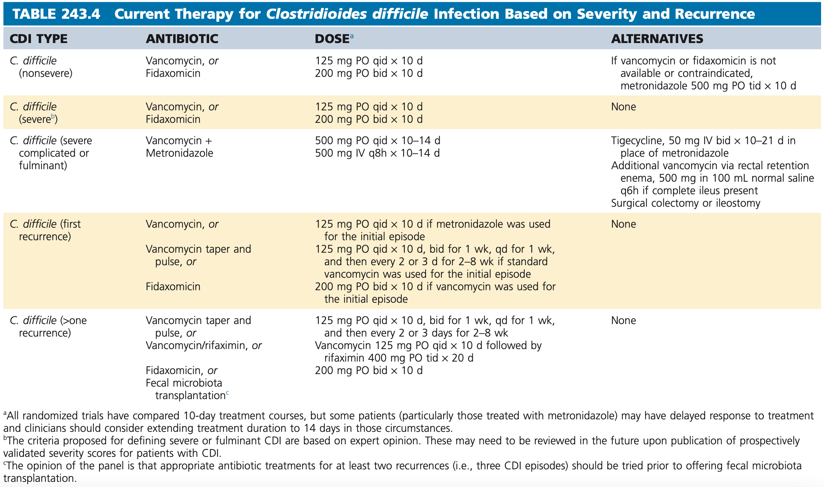
Treatment: C. difficile Infection (CDI)
Notes:
Treatment recommendations for CDI have been developed for mild, moderate, severe, and severe complicated (also called fulminant) CDI, and for first and multiple recurrences of CDI. Recommendations adapted from the IDSA/SHEA Guidelines are shown on this table, together with alternative treatments that may also be effective.
For all ther treatments, the primary goal of successful treatment is the elimination of symptoms, and the secondary goal is prevention of recurrent CDI. Microbiologic persistence of C. difficile in stool occurs in the majority of patients following successful treatment, peaking at about 2 weeks posttreatment and persisting in about 5% for 6 months. Repeat stool testing following treatment as a “test of cure” should not be done because it is not a predictor of either treatment success or failure, and will lead to unnecessary treatments, testing, and likely morbidity.

Slide 48
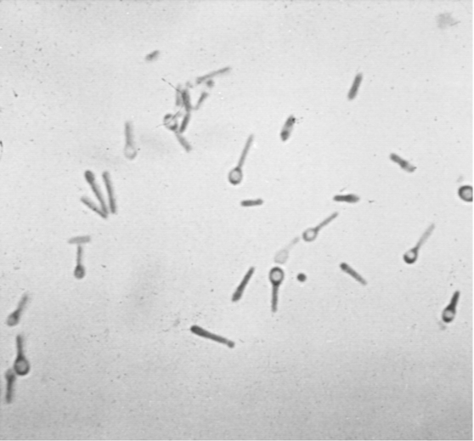
Clostridium tetani: Microbiology
Obligately anaerobic bacilli that is gram positive in fresh cultures but may have variable staining in older cultures or tissue samples
Present in soil, especially heavily manured soil, and in the intestinal tract and feces of various animals
2 toxins:
1) Tetanospasmin – called tetanus toxin
2) Tetanolysin
Notes:
Let us now proceed to our 2nd microorganism under Clostridium species, which is, Clostridium tetani.
Clostridium tetani is an obligately anaerobic bacillus that is gram positive in fresh cultures but may have variable staining in older cultures or tissue samples. It is present in soil, especially heavily manured soil, and in the intestinal tract and feces of various animals. It is believed to be transiently present in the human gastrointestinal tract, perhaps dependent on recent ingestion.
Two toxins, tetanospasmin (commonly called tetanus toxin) and tetanolysin, are produced during the growth phase. Tetanospasmin is encoded on a plasmid that is present in all toxigenic starins, Tetanolysin is of uncertain importance in the pathogenesis of tetanus.

Slide 49
Clostridium tetani: Microbiology
Mature organisms lose their flagella, develop a terminal spore and begin to resemble a squash racquet
Spores are extremely stable in the environment
  Withstand exposure to ethanol, phenol, or formalin but can be rendered non-infectious by iodine, glutaraldehyde, hydrogen peroxide, or autoclaving at 121ºC and 103 kilopascals (15 psi) for 15 minutes
Growth in culture is optimal at 37ºC under strictly anaerobic conditions
Notes:
During growth, the bacilli possess abdundant flagella and are sluggishly motile. Later on, mature organisms lose their flagella, develop a terminal spore and begin to resemble a squash racquet. Spores are extremely stable in the environment, retaining the ability to germinate and cause disease indefinitely.
They withstand exposure to ethanol, phenol, or fomralin but can be rendered non infectious by iodine, glutaraldehyde, hydrogen peroxide, or autoclaving at 121ºC and 103 kilopascals (15 psi) for 15 minutes.
Growth in culture is optimal at 37ºC under strictly anaerobic conditions, but culture results are of no diagnostic value.

Slide 50
Tetanus
Clostridium tetani: Pathogenesis
A disease of the nervous system characterized by persistent tonic spasm, with violent brief exacerbations
Commences in the muscles of the neck and jaw, causing closure of the jaw (trismus, lockjaw)
Involves muscles of the trunk more than the limbs
Always acute in onset
Incubation period: 3 to 21 days
Notes:
Tetanus is a disease of the nervous system characterized by persistent tonic spasm, with violent brief exacerbations. The spasm almost always commences in the muscles of the neck and jaw, causing closure of the jaws (trismus, lockjaw), and involves the muscles of the trunk more than those of the limbs. It is always acute in onset, and a very large proportion of those affected die. The incubation period ranges 3 to 21 days.

Slide 51
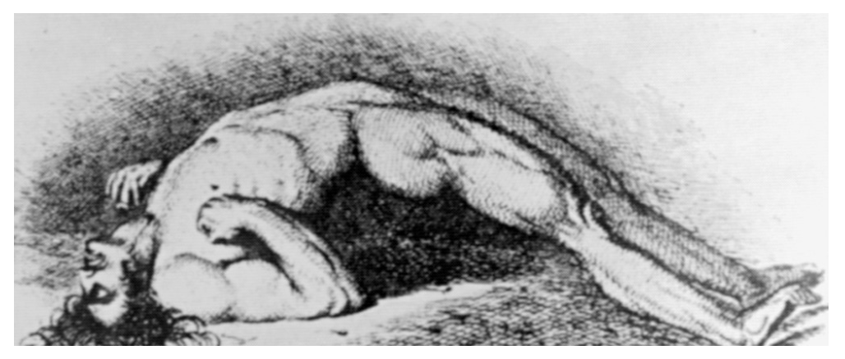
Tetanus
4 Clinical Types
  Generalized
    Often begins with risus sardonicus (increased tone in the orbicularis oris) and trismus (lockjaw, or masseter rigidity)
    Resembles decorticate posturing and consists of opisthotonic posturing with flexion of the arms and extension of the legs
    Spasms triggered by sensory stimuli
Notes:
Tetanus is classically divided in to four clinical types: generalized, localized, cephalic, and neonatal:
GENERALIZED tetanus is the most commonly recognized form and often begins with risus sardonicus (increased tone in the orbicularis oris) and trismus (lockjaw). The generalized spasm resembles decorticate posturing and consists of opisthotonic posturing with flexion of the arms and extension of the legs. The patient does not lose consciousness and experiences severe pain during each spasm. The spams are often triggered by sensory stimuli.

Slide 52
Tetanus
4 Clinical Types
  Localized
    Involves rigidity of the muscles associated with the site of spore inoculation
  Cephalic
    Special form of localized disease affecting the cranial nerve musculature
  Neonatal
    Follows infection of the umbilical stump, most commonly caused by a failure of aseptic technique if mothers are inadequately immunized
Notes:
2) LOCALIZED tetanus involves rigidity of the muscles associated with the site of spore inoculation. This may be mild and persistent and often resolves spontaneously. Lower motor neuron dysfunction is often present in the most involved muscle. This is more commonly a prodrome of generalized tetanus, how=ever, which occurs when enough toxin gains access to the CNS.
3) CEPHALIC tetanus is a special form of localized disease affecting the cranial nerve musculature, almost always after an apparent head wound. A lower motor neuron lesion, frequently producing facial nerve weakness, is often apparent. Extraocular muscle involvement is occasionally noted.
4) NEONATAL tetanus follows infection of the umbilical stump, most commonly caused by a failure of aseptic technique if mothers are inadequately immunized

Slide 53
Tetanus
Diagnosis
  Diagnosed by clinical observation
  Culture C. tetani wounds are not useful in diagnosis:
    Even carefully performed anaerobic cultures are frequently negative
    A positive culture does not indicate whether the organism contains the toxin-producing plasmid
    A positive culture may be present without disease in patients with adequate immunity
Notes:
Tetanus is diagnosed by clinical observation and has a limited differential diagnosis. Laboratory testing cannot confirm or exclude the condition and is primarily useful for excluding intoxications that may mimic tetanus.
Attempts to culture C. tetani from wounds are not useful in diagnosis because (1) even carefully performed anaerobic cultures are frequently negative; (2) a positive culture does not indicate whether the organism contains the toxin-producing plasmid; and (3) a positive culture may be present without disease in patients with adequate immunity

Slide 54
Tetanus
Treatment
  Stabilization
    Early tracheostomy is usually beneficial
  Management of muscle spasms
    Benzodiazepines as mainstay as symptomatic therapy
  Wound management
  Passive immunization
    Human tetanus immune globulin (HTIG) shortens the course of tetanus and may lessen its severity
    A dose of 500 units appears as effective as larger doses
Notes:
Treatment includes:
STABILIZATION of airway: tetanic spams demand that airway be secured before other lines of therapy are possible. Because the endotracheal tube may stimulate spasms, an early tracheostomy is usually beneficial.
MANAGEMENT OF MUSCLE SPASMS: Benzodiazepines have emerged as the mainstay of symptomatic therapy for tetanus. These drugs are GABA-A agonists and thereby indirectly antagonize the effect of the toxin. They do not restore glycinergic inhibition.
WOUND MANAGEMENT: Most tetanus patients still have the portal of entry apparent when they present. If the wound requires surgical attention, this may be performed after spasms are controlled. However, the course of tetanus is not affected by wound débridement.
PASSIVE IMMUNIZATION: Passive immunization with human tetanus immune globulin (HTIG) shortens the course of tetanus and may lessen its severity. A dose of 500 units appears as effective as larger doses

Slide 55
Tetanus
Treatment
  Antimicrobial Therapy
    In vitro susceptibility of C. tetani to metronidazole, penicillins, cephalosporins, imipinem, macrolides and tetracycline
    Oral metronidazole showed better survival, shorter hospitalization, and less progression of disease than intramuscular penicillin
    Penicillin may have a negative effect as it is a potent GABA_{A} antagonist
Notes:
ANTIMICROBIAL THERAPY: The in vitro susceptibilities of C. tetani include metronidazole, penicillins, cephalosporins, imipenem, macrolides, and tetracycline. A study comparing oral metronidazole to intramuscular penicillin showed better survival, shorter hospitalization, and less progression of disease in the metronidazole group. This may reflect a true advantage of metronidazole over penicillin, but it more likely corresponds to a negative effect of penicillin, a potent GABAA antagonist.

Slide 56
Tetanus
Treatment
  Management of Autonomic Dysfunction
    Autonomic dysfunction generally reflects excessive catecholamine release and may respond to combined aα-adrenergic and β-adrenergic blockade with IV labetalol
  Nutritional support
    Should be started as soon as the patient is stable
Notes:
MANAGEMENT OF AUTONOMIC DYSFUNCTION:
Autonomic dysfunction generally reflects excessive catecholamine release and may respond to combined α-adrenergic and β-adrenergic blockade with IV labetalol.73 β-Blockade alone is rarely used because the resulting unopposed α effect may produce severe hypertension. If β-blockade is chosen, the short-acting agent esmolol should be used
NUTRITIONAL SUPPORT:
Nutritional support should be started as soon as the patient is stable. The volume of enteral feeding needed to meet the exceptionally high caloric and protein requirements of these patients may exceed the capacity of the GI system.

Slide 57
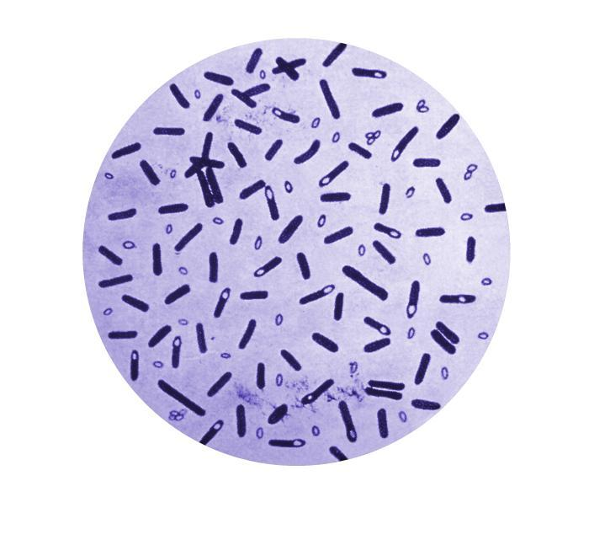
Clostridium botulinum: Microbiology
Large, gram positive, strictly anaerobic bacilli
Subterminal spore
  Able to tolerate 100ºC at 1 atm for several hours
Notes:
Clostridium botulinum is a large, gram-positive, strictly anaerobic bacillus that forms a subterminal spore. Its spores are found throughout the world in soil samples and marine sediments and are able to tolerate 100°C at 1 atm for several hours.

Slide 58
Clostridium botulinum: Microbiology
Group | Toxin Type
I | Type A, B, F | 30 to 37ºC
II | Type B, E. F | 25 to 30ºC
III | Type C, D | 30 to 37ºC
IV | Type G (Plasmid-encoded) | 30 to 37ºC
Notes:
The species is divided into four physiologic groups. Group I organisms are proteolytic in culture and can produce toxin types A, B, and F. Group II organisms are nonproteolytic and can produce toxin types B, E, and F. Group III organisms produce toxin types C and D, and group IV produces type G. A single strain almost always produces only one toxin type. Group II organisms grow optimally between 25°C and 30°C, and the other groups grow best between 30°C and 37°C. Although each strain of the organism typically contains several plasmids, only type G toxin is encoded on a plasmid.

Slide 59
Clostridium botulinum: Pathogenesis
Infant botulism—ingestion of spores → germination in the intestinal microbiota
Adult botulism—achlorhydia and antibiotic use → colonization of C. botulinum
Wound botulism—spores introduced to the wound → germination and toxin production
Inhalational botulism—toxin → pulmonary alveolar epithelium → bloodstream
Notes:
In foodborne botulism, toxin is ingested with the food in which it was produced. It is absorbed primarily in the duodenum and jejunum and passes into the bloodstream, by which it reaches peripheral cholinergic
synapses (including the neuromuscular junction).
Infant botulism and adult botulism of unknown etiology have a somewhat different pathogenesis in that they are acquired through the ingestion of spores rather than preformed toxin.
The infant’s intestinal microbiota is thought to be particularly permissive for the germination of spores, which leads to the production of toxin. The spores are acquired from environmental sources contaminated with soil in which botulinum spore counts are high. In adults, achlorhydria and antibiotic use may predispose to gastrointestinal colonization with C. botulinum. In cases of wound botulism, spores are introduced into a wound, where they germinate and produce toxin. Lastly, in inhalational botulism, the toxin crosses through the pulmonary alveolar epithelium to gain access to the bloodstream.

Slide 60
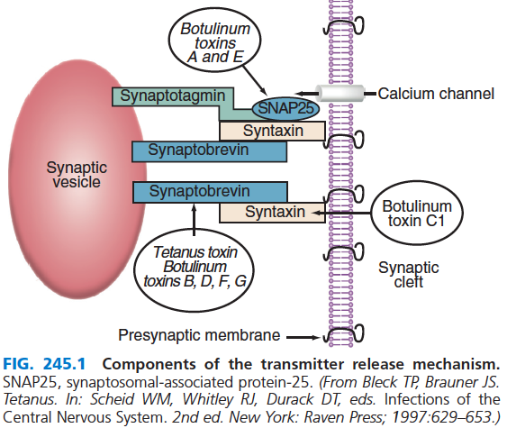
Clostridium botulinum: Pathogenesis
Botulinum Toxin
  Single polypeptide, low potency
  MW 150 to 165 kDa
  Zn-dependent metalloproteinases
  Bacterial protease – nicked to produce 2 chains
Notes:
Each toxin has a specific locus of activity. Tetanospasmin, along with botulinum neurotoxins B, D, F, and G, cleaves synaptobrevin.
Tetanospasmin and botulinum neurotoxin B appear to share the same cleavage site on synaptobrevin. In contrast, botulinum toxins A69 and E act on the 25-kDa synaptosomal-associated protein 25 (SNAP25), and botulinum toxin C1 affects syntaxin. The toxins affect only the free proteins; once they have complexed to cause transmitter release, they are not subject to attack. The result is that stimulation of the presynaptic cell (e.g., the alpha motor neuron) fails to produce transmitter release, thus producing paralysis in the motor system or autonomic dysfunction

Slide 61
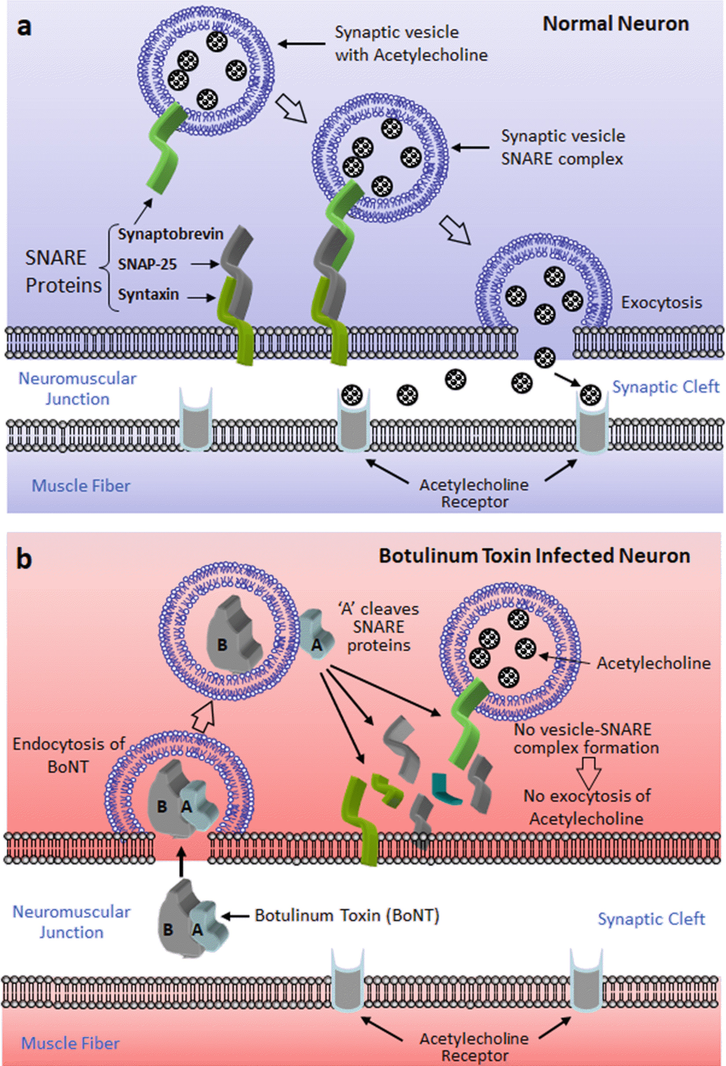
Clostridium botulinum: Pathogenesis
Notes:
Once present at the synapse, the toxins prevent the release of acetylcholine (ACh). This appears to result from a three-stage process as follows:
The heavy chain of the toxin mediates binding to presynaptic receptors. The nature of these receptors is uncertain; different toxin types bind to different receptors, with type B receptors outnumbering type A receptors by a factor of four.
The toxin enters the cell by receptor-mediated endocytosis. Once inside the neuron, the toxin types differ in the mechanisms by which they inhibit ACh release.
The release of synaptic vesicles by an action potential is initiated by an abrupt rise in the intracellular free Ca2+ concentration, mediated by voltage-dependent calcium channels.
This increase in free calcium triggers an interaction between synaptotagmin (in the vesicle membrane) and syntaxin (on the presynaptic cell membrane), clamping the vesicle to the presynaptic membrane.
Synaptobrevin (also referred to as vesicle-associated membrane protein) also binds to syntaxin and appears to dock the vesicle to the membrane at the proper location for fusion.

Slide 62
Clostridium botulinum:
Clinical Manifestations
Acute, bilateral cranial neuropathies
  Starts with the eyes—blurring of vision
Symmetrical descending weakness
  Cranial neuropathy→upper extremities→trunk→lower extremities
Fever is absent
Neurological manifestations are symmetrical
Remains responsive
Heart rate is normal or slow, without hypotension
Sensory deficits do not occur
Notes:
The classic presentation of botulism is that of a patient who develops acute, bilateral cranial neuropathies associated with symmetrical descending weakness.
The CDC suggests attention to these cardinal features: (1) fever is absent (unless a complicating infection occurs), (2) the neurologic manifestations are symmetrical, (3) the patient remains responsive, (4) the heart rate is normal or slow in the absence of hypotension, and (5) sensory deficits do not occur (except for blurred vision).

Slide 63
Clostridium botulinum:
Clinical Manifestations
Recovery may not begin for up to 100 days
Type A toxin
  Dysarthria, blurred vision, dyspnea, diarrhea, sore throat, dizziness, ptosis, ophthalmoplegia, facial paresis, and upper extremity weakness
Types E and B – autonomic dysfunction
Notes:
Recovery may not begin for up to 100 days. Type A is significantly more commonly associated with dysarthria, blurred vision, dyspnea, diarrhea, sore throat, dizziness, ptosis, ophthalmoplegia, facial paresis, and upper extremity weakness. Types B and E appear to produce more autonomic dysfunction. None of these differences is diagnostic of the toxin type, however, it is important to note that the pupils are either dilated or unreactive in less than 50% of patients; although these are useful signs when present, their absence in no way diminishes the likelihood of botulism.

Slide 64
Clostridium botulinum:
Clinical Manifestations
Infant botulism
  Constipation → feeding difficulties, hypotonia, increased drooling, weak cry → upper airway obstruction
  1 to 2 weeks: progression → 2 to 3 weeks: stabilization → recovery
Wound botulism
  No prodromal GI symptoms
  Incubation: 4 to 14 days
Inhalational botulism
  Latency: 12hrs to 3 days
Notes:
Infants with botulism present with constipation, which may be followed by feeding difficulties, hypotonia, increased drooling, and a weak cry. Upper airway obstruction may be the initial sign and is the major
indication for intubation. The condition progresses for 1 to 2 weeks and then stabilizes for another 2 to 3 weeks before recovery starts.
Wound botulism lacks the prodromal gastrointestinal disorder of the foodborne form but is otherwise similar in presentation. The reported incubation period varies from 4 to 14 days.
The signs and symptoms exhibited by victims of inhalational botulism are the same as those seen with ingestion. The latency between exposure and clinical disease after inhalation appears to be between 12 hours and 3 days, with maximal disease by about 5 days.

Slide 65
Clostridium botulinum: Diagnosis
History
  Afebrile status
  At least 1 of the following symptoms:
    Blurred vision, double vision, difficulty speaking, change in sound of voice, dysphagia, thick tongue
  At least 1 of the following signs:
    Ptosis, extraocular palsy, facial paralysis, fixed pupils, descending paralysis
  Biologic weapon: acute flaccid paralysis and prominent bulbar palsies + common geographic location→confirmed rapidly with electromyography
Conventional diagnosis – Biosafety level 2 containment
  Toxin in serum, gastric secretions, stool or food samples
  Mouse bioassay
  Mass spectroscopy
Notes:
A screening tool has been suggested to help facilitate timely diagnosis of botulism, which is intended to aid physicians in identifying patients who may have botulism, although it is not intended for diagnosis. This tool uses three criteria: (1) afebrile status; (2) at least one of the following symptoms: blurred vision, double vision, difficulty speaking, change in sound of voice, dysphagia, or thick tongue; and (3) at least one of the following signs>> Ptosis, extraocular palsy, facial paralysis, fixed pupils, descending paralysis
If botulinum toxin is used as a biologic weapon, the diagnosis would
depend on the route of exposure. Contaminated food or beverages
would result in an epidemic resembling that of a natural foodborne
outbreak. A deliberate release of botulinum toxin should be suspected
if patients with acute flaccid paralysis and prominent bulbar palsies
present in large numbers. An unusual toxin type (such as C, D, F, G, or
F/A Hybrid) or symptoms among patients with a common geographic
location may suggest an act of bioterrorism
Conventional diagnosis of botulism relies on the demonstration of toxin in serum, gastric secretions, stool, or food samples. A Biosafety Level 2 containment facility is a minimum requirement for C. botulinum detection and evaluation, given its potency. Testing should be performed under the direction of
local state or health departments.
The most sensitive means of botulism toxin detection has traditionally been the mouse bioassay. Toxin type may be determined by injecting infected mice with type-specific botulism antitoxin. Botulism symptoms are absent from infected mice that receive the appropriate antitoxin. Confirmation and toxin typing are obtained in almost 75% of cases. However, the mouse bioassay is labor and resource intensive, and therefore the testing is performed in a limited number of public health laboratories.
A novel assay based on mass spectroscopy has been reported to have greater sensitivity than the mouse bioassay and detected botulinum toxin in an infant in whom polymerase chain reaction, bacterial cultures, and mouse bioassay were negative. This assay can be performed in 7 to 8 hours.

Slide 66
Clostridium botulinum: Diagnosis
Anaerobic cultures
  Toxin excretion my continue up to 1 month after the onset of illness
ELISA
Electrophysiologic studies
Notes:
Anaerobic cultures of serum, stool, and the implicated food, if available, may assist in making the diagnosis. However, samples rarely yield C. botulinum because strict anaerobic conditions are required for growth, and competing fecal microbiota or nontoxigenic C. botulinum strains can make isolation difficult. Toxin excretion may continue up to 1 month after the onset of illness, and stool cultures may remain positive for a similar period.
Enzyme-linked immunosorbent assay has been used to detect botulinum toxin in clinical specimens and in contaminated food samples, such as fish fillets, canned salmon and corned beef, pasta products, and
canned vegetables.
EPS is very uncomfortable and should not be requested unless botulism or LEMS (Lambert Eaton Mysathenic Syndrome) is a serious consideration.

Slide 67
Clostridium botulinum: Diagnosis
Differential diagnosis
  Myasthenia gravis
  Lambert-Eaton myasthenic syndrome: rarely fulminant
  Tick paralysis
  Guillain-Barré syndrome: sensory complaints →areflexia
    Miller-Fischer variant: oculomotor dysfunction but with prominent ataxia
  Poliomyelitis
    Febrile on presentation
    Asymmetrical weakness
Notes:
Myasthenia gravis and Lambert-Eaton myasthenic syndrome (LEMS) each share some of the
characteristics of botulism, but are rarely fulminant, and myasthenia lacks autonomic features. An edrophonium test may be considered, but an improvement in strength is not pathognomonic of myasthenia gravis and has been reported in botulism; however, edrophoniumis currently out of production.
Tick paralysis is excluded by a careful physical examination because the Dermacentor tick will still be attached.
Classic acute inflammatory demyelinating polyneuropathy (Guillain-Barré
syndrome) frequently begins with sensory complaints, rapidly produces
areflexia, rarely begins with cranial nerve dysfunction, and does not
alter pupillary reactivity. Patients with botulism do not become areflexic
until the affected muscle group is completely paralyzed. The Miller
Fisher variant of Guillain-Barré syndrome presents with oculomotor
dysfunction and may produce other cranial neuropathies but includes
a prominent ataxia that is lacking in botulism. Patients with polio are
febrile on presentation and have asymmetrical weakness

Slide 68
Clostridium botulinum: Treatment
Supportive care
  Decision to intubate
    Bedside assessment of upper airway competency
    Changes in vital capacity
Heptavalent botulinum antitoxin (HBAT) – A to G botulinum toxin types equine-derived antibody
  For non-infant botulism
  Administered within 2 days of symptom onset
  Current recommended dose is 50 mg/kg as an IV infusion
Antibacterial therapy – untested
  Penicillin G (10 to 20 million units daily) is frequently recommended
  Alternative: metronidazole
Recovery – greatest improvement in muscle strength: 1st 3 months up to 1 year
Notes:
The importance of supportive therapy for botulism is underlined by
the progressive improvement in mortality rates with advances in critical
care, especially ventilatory support. The decision to intubate should be
based on (1) bedside assessment of upper airway competency and (2)
changes in vital capacity.
In March 2010, the CDC announced the availability of a new,
heptavalent botulinum antitoxin (HBAT). HBAT contains equine-derived
antibody to the seven known botulinum toxin types (A through G). It was FDA
approved in 2013 and is the only antitoxin available for noninfant botulism
in the United States and has been found to be relatively safe and effective
in adults, particularly when administered within 2 days of symptom onset. Because of the risk of serious adverse reactions and the potential for lifelong sensitization to equine proteins, HBAT is not approved for
administration in infants younger than 1 year. The current recommended dose is 50 mg/kg
as an intravenous infusion.
The role of antibiotic treatment is untested, but
penicillin G (10–20 million units daily) is frequently recommended.
Metronidazole may be an effective alternative. Aminoglycosides and
tetracyclines, which can impair neuron calcium entry, worsen infant
botulism.
Although the greatest improvement in muscle strength occurs in
the first 3 months of recovery from botulism, patients still show improvements
in strength and endurance for up to 1 year after disease onset.

Slide 69
Clostridium perfringens and
Clostridial Myonecrosis (Gas gangrene)
Traumatic injury + clostridial spores
C. perfringens Type A: most common in human stool
Other species that can cause myonecrosis: C. septicum, C. sordellii, C. novyi, C. bifermentans, C. histolyticum
Production of exotoxin: lecithinase
Notes:
Clostridial myonecrosis, or gas gangrene, is most often caused by a
traumatic injury that becomes contaminated with clostridial spores
from species that cause myonecrosis, most commonly those of
C. perfringens. Although other clostridial species can
and do cause gas gangrene, the prevalence of C. perfringens in such
infections marks it as one of the major clostridial pathogens. Clostridium
perfringens can be isolated from soil and sediment samples from any
geographic region. It is also one of the most common clostridial species
isolated from the intestinal tract of humans and other animals.
Epidemiologically, C. perfringens type A is most common in human stool, with other
types more commonly associated with food poisoning and other
enterotoxigenic disease.
Other species that can also cause myonecrosis are as follows>>
C. septicum, C. sordellii, C. novyi, C. bifermentans, C. histolyticum
The common denominator for these species is the
production of exotoxins, most often lecithinase, that devitalize tissue
and promote invasive disease and myonecrosis.

Slide 70
Clostridium perfringens: Pathogenesis
Contaminated wound
Invasion of clostridial spores
Myonecrosis
Alpha toxin (Lecithinase), hemolysins, proteases, collagenase, hyaluronidase, DNase, neuraminidase
Contaminated wounds
  Automobile accidents, post-operative GI/BT surgery, septic abortions
  Lesions of vascular insufficiency, burns, malignancy
Lecithinase – alpha toxin→rapid hemolytic anemia
Notes:
Gas gangrene is most common following traumatic injuries that result in lowered tissue oxygen tension which are often described as contaminated wounds.
All strains of C. perfringens produce α-toxin, a lecithinase that causes damage to cell membranes. During severe sepsis with C. perfringens, rapid hemolytic anemia may occur due to hemolysis caused
by the α-toxin. The α-toxin is considered the major lethal toxin produced by C. perfringens during gas gangrene. In addition to the α-toxin, most strains produce additional hemolysins, proteases, collagenase, hyaluronidase, DNase, and neuraminidase.

Slide 71
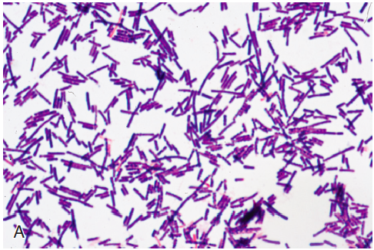
Clostridium perfringens: Diagnosis
Incubation period: 24 to 72 hours
Clinical presentation: severe pain in the absence of obvious physical findings
  Redness at the site of the wound→rapidly spreading brown to purple discoloration of the skin→hemorrhagic bullae, serosanguinous discharge with mousy odor
Diagnosis: Gram stain of discharge – gram positive boxcar-shaped bacilli, few PMNs (earliest laboratory finding)
Notes:
Clinically, clostridial myonecrosis generally begins within 24 to 72 hours
after traumatic injury or surgery. Initial symptoms may include severe
pain in the absence of obvious physical findings, suggesting a deep
tissue infection. When traumatic injuries penetrate the skin, redness
at the site of the wound, followed by a rapidly spreading brown to
purple discoloration of the skin, is often seen. Hemorrhagic bullae
may occur, along with a serosanguineous discharge and characteristic
odor often described as “mousy.” The odor is distinct from the putrid
odor, due to the production of volatile amines, associated with gram negative
anaerobic infections.
Gram staining of the discharge often reveals the typical gram-positive boxcar-shaped rods characteristic of C. perfringens as seen in the picture. Neutrophils are often not seen on Gram
stain due to the lethal nature of α-toxin for these polymorphonuclear cells. This is the earliest laboratory finding in clostridial myonecrosis.

Slide 72
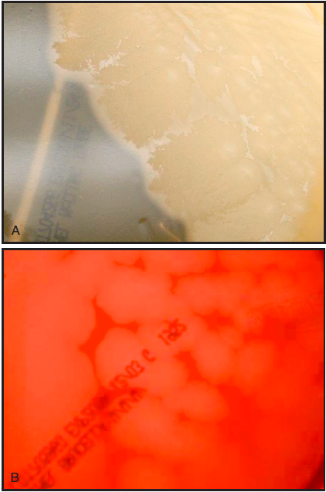
Clostridium perfringens: Diagnosis
Profound ischemia
  No bleeding from wound due to proischemic exotoxins – perfringolysin O + alpha toxin
Minimal or no fever
Culture: Blood agar plate
  Yellowish to gray and opaque colonies, 4 to 8 mm with irregular borders
  Double zone hemolysis: inner zone β-hemolysis, outer zone α-hemolysis
Notes:
Gas gangrene leads to profound ischemia resulting from obstructed
microvascular circulation caused by platelet aggregation within vessels
and fibrin deposition. Unlike most soft tissue infections, in which the
inflammatory process increases blood flow, lesions resulting from
clostridial myonecrosis do not bleed readily. The other toxin of C. perfringens,
perfringolysin O, may also act synergistically with α-toxin to decrease
microvascular perfusion.
Fever is often minimal during the early stages of disease; however,
progression to full-blown sepsis with its classic hypotension, renal failure,
and metabolic acidosis may set in rapidly.
Growth of C. perfringens
on blood agar plates is rapid, with colonies often detected within 12 to
16 hours of inoculation. Colonies are yellowish to gray and opaque,
and 4 to 8 mm in diameter with irregular borders, and exhibit a
characteristic double zone of hemolysis with an inner zone of β-hemolysis
surrounded by an outer zone of partial hemolysis

Slide 73
Clostridium perfringens: Diagnosis
Lecithinase production by C. perfringens on egg yolk agar (opaque zone surrounding the colony) – white precipitation surrounding colonies
  Presumptive evidence: neutralization by specific antisera – Nagler reaction
Molecular
  Rapid PCR
  MALDI-TOF mass spectrometry
Notes:
The lecithinase or α-toxin can be detected by growth on egg yolk agar
medium, which is rich in triglycerides. An obvious white precipitation surrounding colonies is evidence of lecithinase production. Neutralization of this reaction by specific antisera (the
Nagler reaction) is presumptive evidence for the identification of C. perfringens.
Although not widely used at present by clinical microbiology laboratories, rapid PCR
methods for identification of C. perfringens are available. Methods
such as MALDI-TOF mass spectrometry may be used for rapid identification
of organisms, including Clostridium spp

Slide 74
Clostridium perfringens: Treatment
Urgent surgical debridement of infected tissues
  Abdominal wall: debridement + generous resection margin – prevention of recurrence or progression of infection
  PLUS
Antimicrobial therapy
  Early antibiotic intervention is essential
  Penicillin
  Alternative agents: metronidazole, clindamycin, carbapenems
Notes:
The most important part of therapy for clostridial myonecrosis is emergent surgical débridement of infected tissues with generous resection margins of apparently healthy tissue is important to prevent
recurrence or progression of infection. In addition to that, early antibiotic intervention is essential
for survival, and penicillin remains the most commonly employed antibiotic. Although there is some concern regarding the continued susceptibility of C. perfringens to penicillin, most strains tested are
susceptible to easily achieved levels.

Slide 75
References
Mandell, Douglas, and Bennett’s principles and Practice of Infectious Disease, 9th edition
Bailey & Scott's Diagnostic Microbiology 14th Edition
Koneman's Color Atlas & Textbook of Diagnostic Microbiology 7th Edition

