Slide 1

PARASITOLOGY MODULE
Intestinal and Luminal Flagellates
Coccidia
Parasitic Trypanosomes

Slide 2
INTESTINAL AND LUMINAL FLAGELLATES
Giardia lamblia
Trichomonas vaginalis

Slide 3
Giardia lamblia

Slide 4
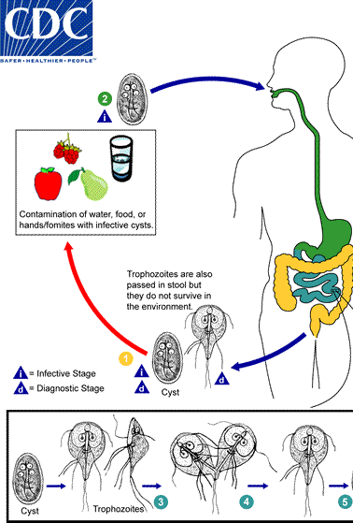
DESCRIPTION OF PATHOGEN
First described in 1600s
Giardia lamblia, Giardia intestinalis, Giardia duodenalis
Life cycle stages:
  Cyst – infective stage
  Trophozoite – diagnostic stage
Notes:
Giardia lamblia was 1st discovered as early as 1600s but was named in 1900s when the parasite received the genus Giardia. Giardia lamblia is the species infecting humans. It is also called Giardia intestinalis and Giardia duodenalis. The life cycle of Giardia has 2 stages as shown in the figure in the right. The cyst is environmentally resistant and is the infective stage while the trophozoites are motile and present in the intestines of the host.

Slide 5
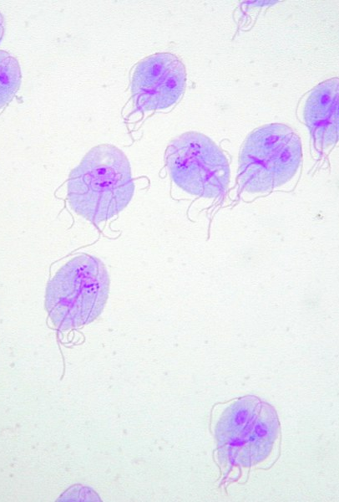
TROPHOZOITE
    Motile, dividing
    Convex dorsal, flat ventral surface
    With 2 anteriorly placed diploid nuclei - create a characteristic face-like image in stained preparations
    Median bodies are used to identify morphologically distinct types of Gardia
Notes:
The trophozoite is the motile and dividing stage. It has convex dorsal and flat ventral surface which contains proteins used for attachment of the parasite to the host. It has 2 anteriorly placed nuclei with a central prominent karyosome. The nuclei create the characteristic face-like image in stained preparation. The median bodies which are collections of microtubules are used to identify the distinct types of Giardia.

Slide 6
ENCYSTATION
A complex process wherein trophozoites form cysts
Early phase:
  Formation of highly characteristic encystment vesicles where cyst wall proteins are produced
  Late phase:
    Transport of the vesicles to the cell surface, assembly into cyst wall, nuclear division, and DNA replication without cell division
Notes:
The trophozoites develop into cyst in a complex process called encystation. The early phase consist of formation of vesicles where cyst wall proteins are produced while in the late phase encystation, these vesicles are being transported into the cell surface and assembly into the cyst wall. Nuclear division and dna replication is also a feature of late phase encystation.

Slide 7
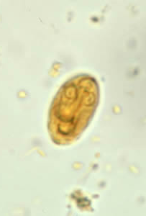
CYST
    Infectious stage
    Environmentally resistant
    Thin-walled, 8-12 um long, 7-10 um wide
Notes:
After encystation, the infective stage if produced. The cyst is considered environmentally resistant although it is thin-walled.

Slide 8
EXCYSTATION
Initiated when the cysts are exposed to environmental stimuli such as gastric acid and pancreatic enzymes
An excyzoite with four nuclei is released which divides without further DNA replication resulting into 4 daughter trophozoites
Notes:
After being swallowed and exposed to environmental stimuli such as gastric acid and pancreatic enzymes, the cyst undergo excystation. The excyzoite with 4 nuclei is released and forms into trophozoites.

Slide 9
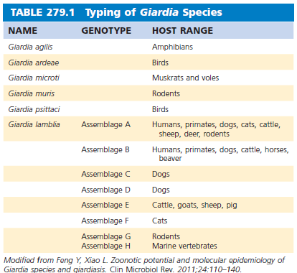
DIFFERENTIATION INTO SPECIES
Giardia lamblia – humans
  8 genotypes (A-H)
  Assemblage B -Philippines
Giardia muris – mice
Giardia agilis – amphibians
Giardia psittaci – parakeets
Giardia microti – voles, muskrats
Source: Mandell, Douglas & Bennett’s Principles and Practice of Infectious Diseases 9th Edition
Notes:
There are different Giardia species that infect humans, mice, amphibians, parakeets, ,voles, and muskrats. Only Giardia lamblia is the specie infecting humans. They are divided into 8 genotypes and majority of the species found in the Philippines belong to assemblage B.

Slide 10
EPIDEMIOLOGY
Prevalence in the Philippines is 1.6-22%
Natural acquisition occurs through feco-oral ingestion of cysts through contaminated water, food, or person-to-person transmission
Oral-anal sexual contact among men who have sex with men may increase the risk of infection
Also identified most frequently in returning travelers and immigrants diagnosed with infectious gastrointestinal disease
  Travel to Indian subcontinent was the highest-risk destination
Notes:
In the Philippines, the prevalence is approximately 1.6-22%. Risk factors for infection are poor sanitation and hygiene practices. Mode of transmission is through feco-oral route by ingestion of cysts through contaminated food and water. It may also be transmitted via person-to-person contact. Oral-anal sex among men who have sex with men is also a risk factor for disease. Giardiasis is also identified frequently among returning travelers and immigrants with GI disease. Among the countries, the highest risk destination is in the Indian subcontinent.

Slide 11
PATHOGENESIS AND IMMUNE RESPONSE
Oral ingestion of as few as 10-25 cysts
Excystation
Trophozoites adhere to brush border of epithelium and multiply in the upper small bowel.
Postulated mechanisms of trophozoite pathogenesis in S.I. – mucosal invasion, elaboration of enterotoxin, disruption of intestinal epithelial brush border and function
Notes:
As low as 10-25 cysts can cause infection when ingested. After ingestion, excystation occurs. Trophozoites produced adhere to the brush border of the intestine and multiply. It is said to cause mucosal invasion, elaborate enterotoxins, and disruption of intestinal epithelial brush border and function

Slide 12
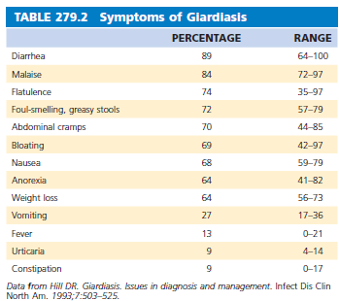
CLINICAL MANIFESTATION
Incubation period: 1-2 weeks
Symptomatic giardiasis: diarrhea, abdominal cramps, bloating, flatulence, malaise, anorexia.
  Fever and tenesmus are rare
  Stools may be profuse and watery initially then become small in volume, greasy and foul-smelling
  Gross blood, pus, mucus, and WBCs are absent
Source: Mandell, Douglas & Bennett’s Principles and Practice of Infectious Diseases 9th Edition
Notes:
Incubation period is from 1-2 weeks. Symptoms of infection include diarrhea, abdominal cramps, Bloatedness, flatulence, malaise, anorexia, and belching. Fever and tenesmus is not common. Initial stools appear profuse and watery then gradually become small in volume, greasy, foul smelling, frothy, and yellowish due to malabsorption. Blood in the stools, mucus, pus, and WBCs in the stool are usually absent

Slide 13
CLINICAL MANIFESTATION
  Important distinguishing feature: prolonged duration of diarrhea, commonly intermittent with waxing and waning symptoms over months
  Malabsorption of Vit A, B12, protein, xylose, iron
Notes:
. An important distinguishing feature of giardiasis is the prolonged duration of diarrhea which is usually intermittent with waxing and waning symptoms over months. Due to prolonged diarrhea, there is malabsorption of vitamin A, B12, protein, xylose, and iron. Other symptoms of giardiasis can be seen in the table in the right.

Slide 14
CLINICAL MANIFESTATION
Lactase is the most common disaccharidase deficiency – may persist for several weeks after treatment
Post-Giardia Irritable Bowel Syndrome – IBS-like symptoms and chronic fatigue for years after primary infection in a nonendemic population
Notes:
After the infection, lactase deficiency may persist for several weeks. Post giardia irritable bowel syndrome may occur even after years from primary infection in a non-endemic population.

Slide 15
DIAGNOSIS
Clinical: prolonged diarrhea with malabsorption or weight loss and with risk factors such as history of travel to an endemic area, ingestion or exposure to untreated water sources, with small children at home who attend daycare centers, or with sexual risk factors
Notes:
Diagnosis of giardiasis can be done through clinical and lab parameters. Clinically, patients presenting with prolonged diarrhea with malabsorption or weight loss and with risk factors such as travel to an endemic area, ingestion or exposure to untreated water sources, having small children at home who attend daycare centers, or with high risk sexual behaviors can be suspected of having giardiasis.

Slide 16
DIAGNOSIS
Diagnostic:
  Detection of cyst or trophozoites in feces – sensitivity is dependent on multiple factors
  3 stool examinations over multiple days
  Others – Giardia antigen in stools (sen 85-90%, spe 90-100%), cyst detection with immunofluorescence, PCR-based testing along with array of GI pathogens
  Detection of giardia trophozoites in small intestines thru sampling – rarely done
  Detection of anti-Giardia antibody is not useful as antibodies may persist from prior infections
Notes:
Detection of cyst or trophozoites in feces is the most common lab test used for diagnosis however the sensitivity of this test is highly dependent on the number of organisms present, skill of the microscopist ,amount of feces examined, and time taken to examine the stool. To increase its sensitivity, 3 stool examinations are recommended over multiple days. Other tests used to detect giardia are as follows: giardia antigen in stools, cyst detection using immunofluorescence, and PCR based testing along with other array of GI pathogens. The trophozoites in the small intestines can be seen thru sampling of the mucosa however this is rarely done now due to the availability of non-invasive tests. Antibodies against giardia can persist for a long time after the primary infection hence it is not recommended to detect current infection.

Slide 17
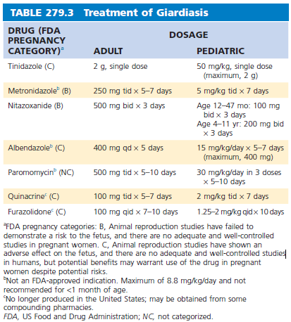
THERAPY
Drug of choice: Tinidazole
Alternatives: Metronidazole, Albendazole, Quinacrine, Furazolidone
For pregnant patients – no recommended therapy
  If therapy cannot be avoided, metronidazole, tinidazole and nitazoxanide can be used in the last 2 trimesters of pregnancy
Source: Mandell, Douglas & Bennett’s Principles and Practice of Infectious Diseases 9th Edition
Notes:
The drug of choice for patients in the US is tinidazole. Due to a long half life, it is only given once a day. Alternatives include metronidazole, albendazole, quinacrine, and furazolidone. Those who did not respond to the initial treatment can be switched to another class. If a single-drug therapy do not work, a combination treatment with quinacrine and metronidazole can be given. Pregnant patients with mild disease can be given hydration and nutrition alone. If therapy cannot be avoided, tinidazole and nitazoxanide can be used in the last 2 trimesters of pregnancy. The dose and duration of the medications can be seen in the right side of the slide.

Slide 18
PREVENTION
Proper handling and treatment of water for communities
Good personal hygiene
Chlorination, coagulation-flocculation, sedimentation, filtration of public water supplies (pore size 0.2-1.0 um)
Boil water for 1 minute, if not possible, may use chlorine-based or iodine-based preparations in tablet forms
Notes:
Prevention of giardiasis can be done through proper handling and treatment of water for communities and good personal hygiene. Chlorination, coagulation-flocculation, sedimentation, filtration of public water supplies can be done to lessen the risk of acquiring giardiasis. If boiling cannot be done, chlorine-based or iodine-based preparations can be used.

Slide 19
Trichomonas vaginalis

Slide 20
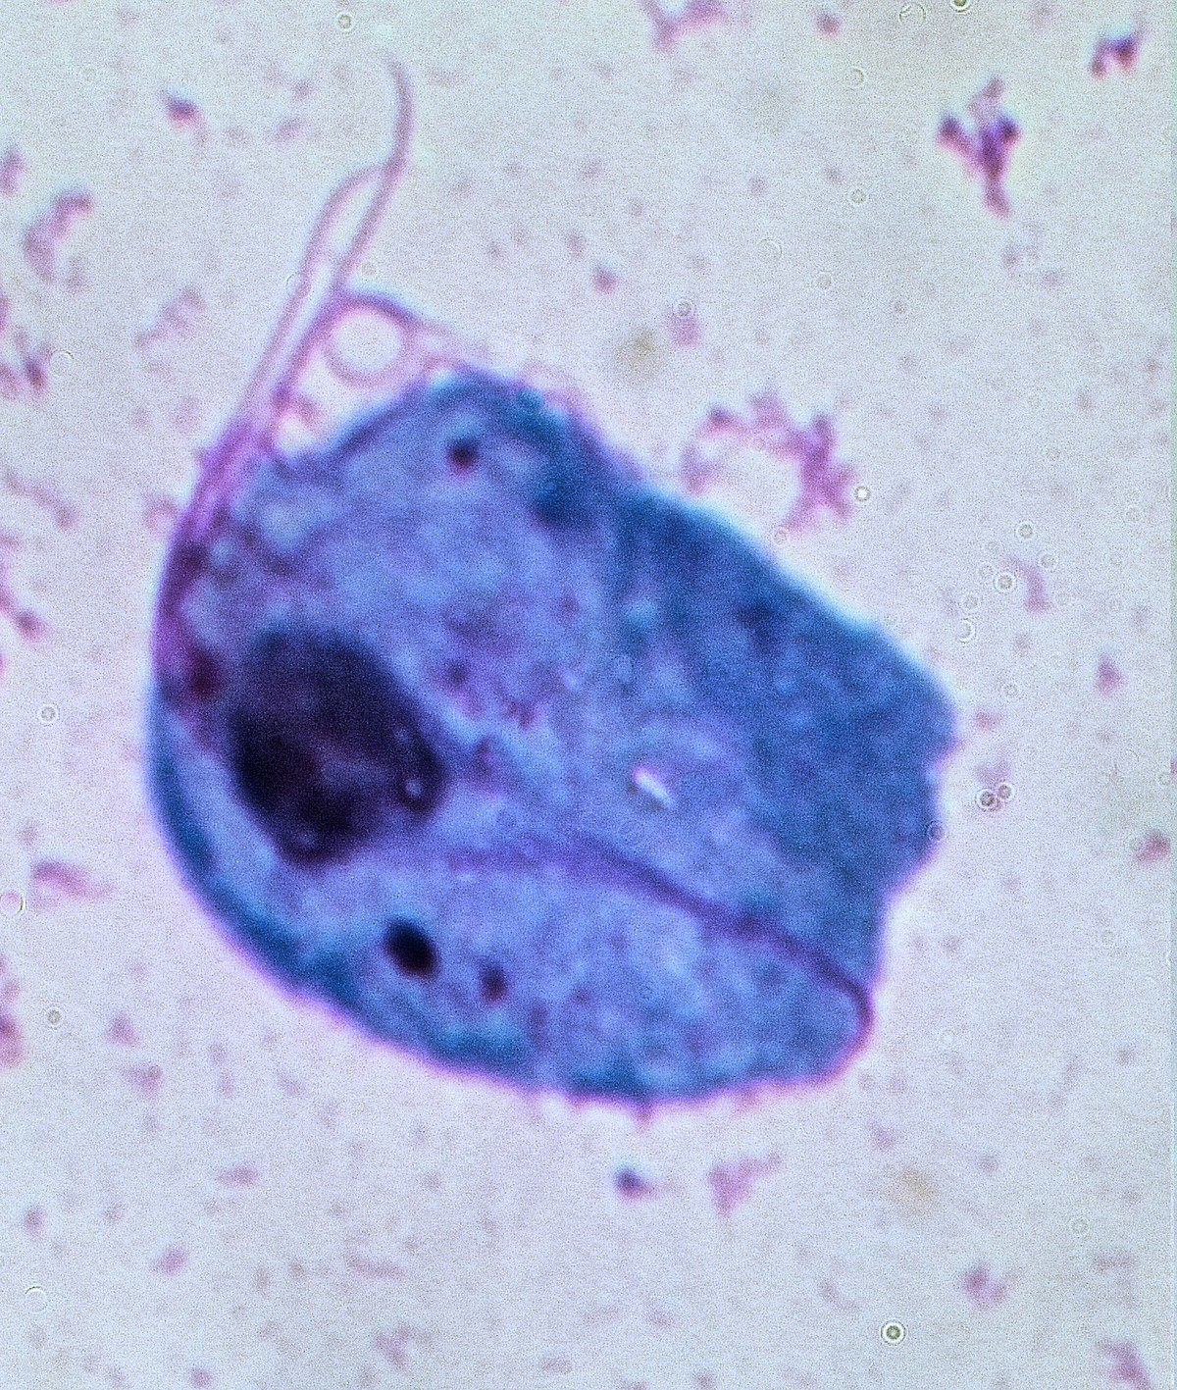
Trichomonas vaginalis (T. vaginalis)
Pear-shaped protozoa
10 x 7 um
Four free flagella and one recurrent flagellum along the margin of the undulating membrane
Costa
Axostyle
Notes:
Trichomonas vaginalis is a pear-shaped protozoan with an average size of 10 x 7 um. It has four free flagella and one recurrent flagellum along the outer margin of the undulating membrane; a costa at the base of the undulating membrane and an axostyle extending through the cell.

Slide 21
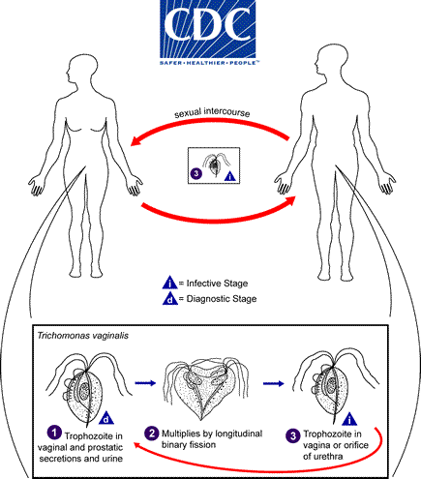
Life cycle of
T. vaginalis
Notes:
The life cycle of T vaginalis is simple in that the trophozoite is transmitted through coitus and no cyst form is known.
The trophozoite divides by binary fission and in natural infections gives rise to a population in the lumen and on the mucosal surfaces of the urogenital tracts of humans.

Slide 22
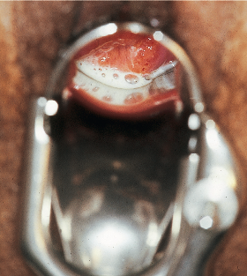
Clinical Manifestations
Almost 50% are asymptomatic
Women
  Frothy vaginal discharge, pruritus and irritation
  Colpitis macularis: Strawberry cervix
Notes:
Almost 50% of all women with T vaginalis are asymptomatic hence, if these women are not screened, the diagnosis will be missed. On the other hand, if symptomatic, it usually presents as a frothy vaginal discharge associated with pruritus and irritation and the characteristic PE finding of strawberry cervix.

Slide 23
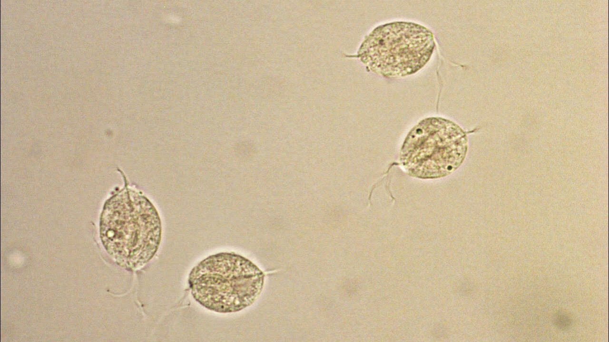
Diagnosis
Direct microscopic examination of vaginal fluid
  Presence of motile trichomonads
  Sensitivity: 40-60%
    Decreases if transport time of specimen is longer than 10 minutes
Culture and Sensitivity: Susceptibility testing
Notes:
Direct microscopic examination of vaginal fluid for the presence of motile trichomonads is the most common diagnostic method employed for the detection of trichomoniasis. The sensitivity of this test varies from 40 to 60%, and may be less in asymptomatic women. Sensitivity decreases dramatically if specimen transport time is longer than 10 minutes. Culture media are commercially available and until recently have been the gold standard for diagnosis, but the cultured specimen requires incubation for up to 7 days prior to finalization.

Slide 24
Diagnosis
Affirm VPIII: nucleic acid probe hybridization semiautomated system
OSOM Trichomonas Rapid Test: antigen detection test by immunochromatogropahy
  Sensitivity: 77% to 98%, Specificity: 99% to 100%
AmpliVue and Solana Trichomonas Assay: isothermal helicase-dependent amplification-based method
Notes:
Additional tests include the Affirm VPIII (Becton Dickenson, Franklin Lakes, NJ), a nucleic acid probe hybridization semiautomated system that also detects candidiasis and bacterial vaginosis and has results available in less than an hour. The OSOM Trichomonas Rapid Test (Sekisui, Lexington, MA), an antigen detection test using immunochromatographic capillary flow dipstick technology, is Clinical Laboratories Improvement Amendments–waived with results available in 10 minutes and sensitivity estimates from 77% to 98%, with specificities of 99% to 100%. Finally, AmpliVue Trichomonas assay and Solana Trichomonas assay (Quidel, San Diego, CA) use an isothermal helicase-dependent amplification-based method to detect trichomonas DNA, with results available within an hour and performance characteristics comparable to culture.

Slide 25
Diagnosis
NAATs: GOLD STANDARD
  Sensitivity: >90%, Specificity: 95% to 100%
  Aptima and ProbeTec Trichomonas vaginalis Assay
  Xpert TV test
Notes:
Nucleic acid amplification tests (NAATs) are now commercially available for the diagnosis of trichomoniasis and have replaced culture as the gold standard diagnostic test.
Genital (endocervical, provider and patient-collected vaginal swabs), urine, and liquid PAP-based specimens are acceptable, with some variation depending on the specific NAAT test being utilized.37 With sensitivities greater than 90% and specificities from 95% to 100%, current US Food and Drug Association (FDA)–approved NAATs includes the following--

Slide 26
Therapy
Single dose 2-g oral Metronidazole or Tinidazole
Treat sexual partners
Notes:
In most cases, the infection is easily treated with a single 2-g oral dose of metronidazole or tinidazole, and because it is an STD, sexual partners should be routinely treated. The reported cure rates are 90% to 100%.
Failure to treat the male sexual partner is likely the most common cause of recurrent disease in women and should be explored before assuming that the woman has a strain of T. vaginalis that is resistant to metronidazole.

Slide 27
References
Mandell, Douglas & Bennett’s Principles and Practice of Infectious Diseases 9th Edition
Bailey & Scott’s Diagnostic Microbiology 14th Edition
Spec, Escota, Chrisler and Davies. Comprehensive Review of Infectious Diseases.
https://www.cdc.gov/
Notes:
The following references were used in this module…
---

Slide 28

Notes:
Thank you and good luck!!! ^~^
---

