Slide 1

Laboratory Module:
BACTERIOLOGY
Mycoplasma
Philippine Society for Microbiology & Infectious Diseases
Ad Hoc Committee on Training & Curriculum Development

Slide 2
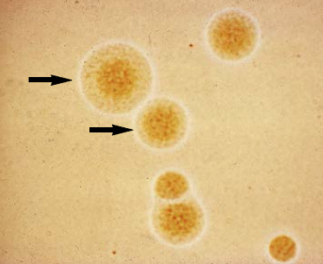
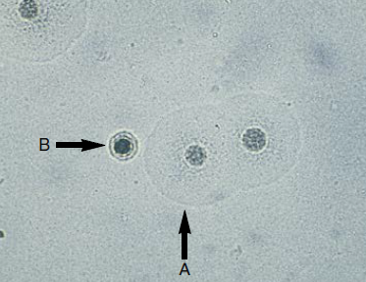
Mycoplasma
Class Mollicutes (cell wall free bacteria)
  > 200 known species
  At least 16 species thought to be of human origin, 4 of clinical importance
    M. pneumoniae
    M. hominis
    Ureaplasma urealyticum
    M. genitalium
Smallest organisms that can be free living in nature and self replicating on laboratory media

Slide 3
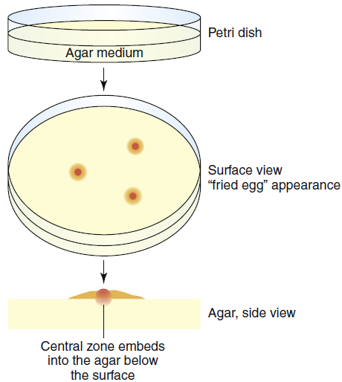
Mycoplasma
Grown in cell-free artificial media but has complex growth requirements and grows slowly
  Require nucleic acid precursor molecules, fatty acids, and sterols such as cholesterol for growth
“fried egg”-appearing colonies
Bounded by a trilaminar cell membrane that is rich in sterols
Highly fastidious and slow growing

Slide 4
Species | Common Sites of Isolation | Substrates |  |  | Clinical Presentations
Mycoplasma pneumoniae | Respiratory tract, genital tract, joint fluid aspirates | Glu | Arg | Urea | Primary atypical pneumonia, bronchitis, meningoencephalitis
 |  | + | - | -
M. hominis | Female genitourinary tract, oropharynx | - | + | - | Bacterial vaginosis, genital tract infections, neonatal infections, prosthesis-associated infections, chorioamnionitis
M. genitalium | Genitourinary tract, oropharynx | + | - | - | Urethritis, prostatitis, PID, enhanced HIV transmission
Ureaplasma urealyticum | Genitourinary tract, oropharynx, lower respiratory tract, placental tissues | - | - | + | Chorioamnionitis, preterm labor, nongonococcal urethritis

Slide 5
Name | Common Sites of Isolation | Substrates |  |  | Clinical Presentations
M. fermentans | Oropharynx, blood, genitourinary tract, respiratory tract | Glu | Arg | Urea | Lipshütz ulcer, infectious rheumatoid arthritis, opportunistic pneumonia (proposed)
 |  | + | + | -
M. salivarium | Oropharynx, nasopharynx, gingiva | - | + | - | Submasseteric abscess, gingivitis, or periodontitis in immunocompromised patients
M. orale | Oropharynx | - | + | - | Opportunistic pneumonia, infectious synovitis, osteomyelitis, abscess in immunocompromised
M. penetrans | Urine, genital tract, blood, respiratory tract |  |  |  | HIV disease progression (proposed), idiopathic nongonococcal urethritis
M. pirum | Rectum, blood, urine |  |  |  | Gastrointestinal microbiome

Slide 6
Species | Common Sites of Isolation | Clinical Presentations
M. amphoriforme | Respiratory tract | Chronic bronchopneumonia and relapsing airway infection in immunocompromised patients
M. phocicerebrale | Cutaneous lesions | “Seal finger”
M. primatum | Genital tract, oropharynx | Oral microbiome, opportunistic keratitis
M. buccale | Oropharynx | Oral microbiome
M. faucium | Oropharynx | Oral microbiome, cerebral abscess
M. lipophilum | Respiratory tract | Pneumonia
M. spermatophilum | Genital tract, semen | Impaired fertility (proposed)
U. parvum | Genitourinary tract, semen, blood | Chorioamnionitis, preterm labor, nongonococcal urethritis

Slide 7
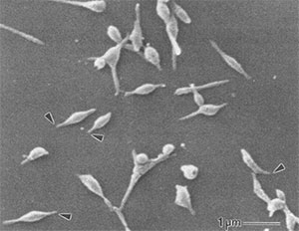
M. pneumoniae
Ferments glucose and other sugars, including xylose, mannose, maltose, dextrin, and starch
Produces a hemolysin
Adheres to respiratory epithelial cells and to red blood cells via sialic acid receptors
Elaborates a cytotoxin that has been called the community-acquired respiratory distress syndrome (CARDS) toxin

Slide 8
M. pneumoniae
Colonies visualized under 100x magnification
Media culture:
  SP-4 broth
  Hayflick’s broth/agar

Slide 9
M. pneumoniae
Colony on glucose agar to which guinea pig erythrocytes have become adsorbed
Only M. pneumoniae demonstrates this hemadsorbing property

Slide 10
M. hominis & U. urealyticum
Shepard’s A7B differential agar
Colonies have typical “fried egg” morphology
Blue color is due to the Diene’s stain
U. urealyticum colonies are smaller

Slide 11
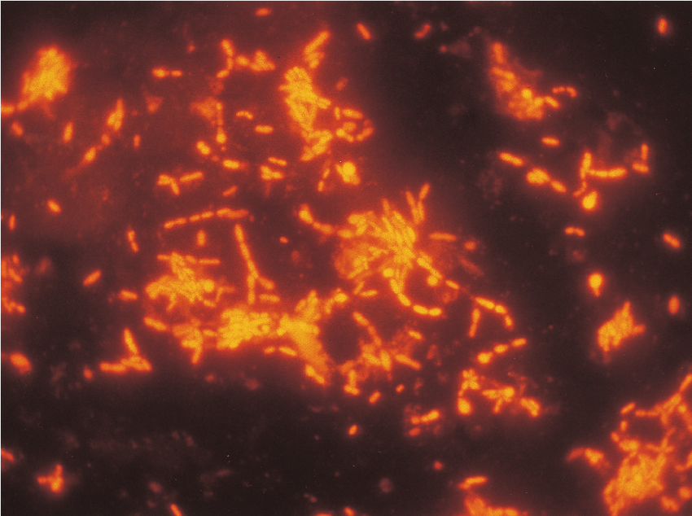
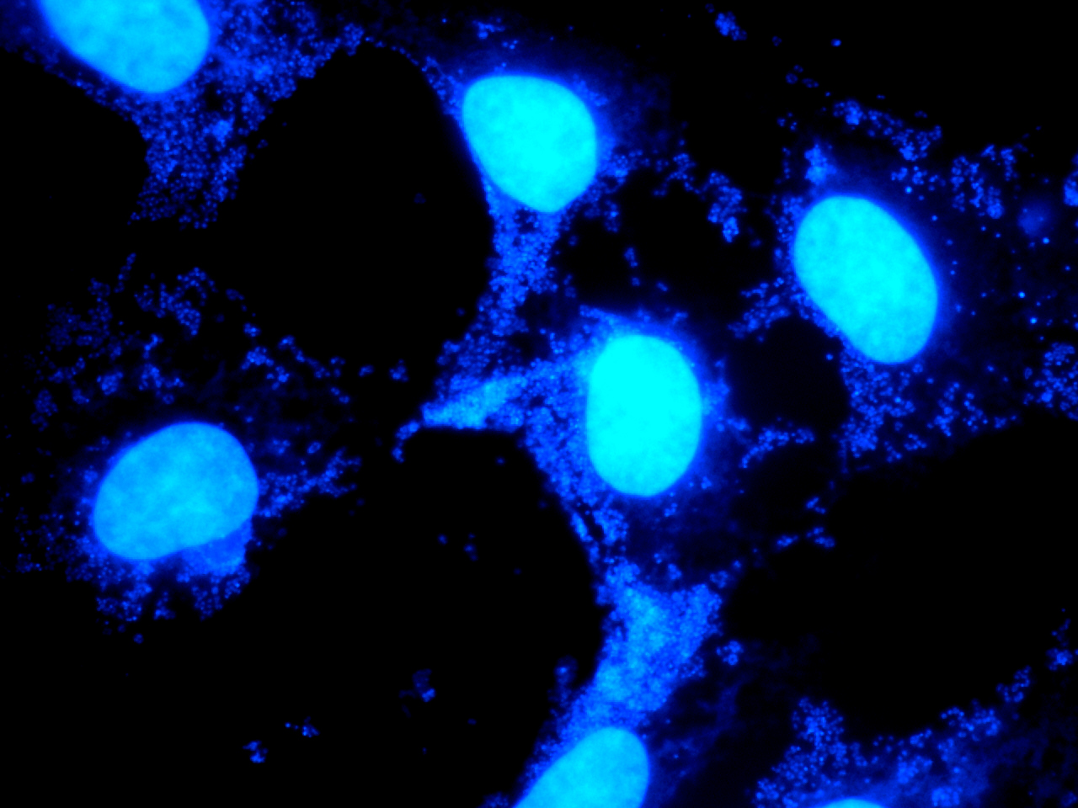
Direct Detection Methods
No direct methods for identifying Mycoplasma spp.
Gram stain will not informatively stain cell wall-deficient Mycoplasma
Acridine orange or fluorochrome stain may be useful to visualize organisms, however, nonspecific

Slide 12
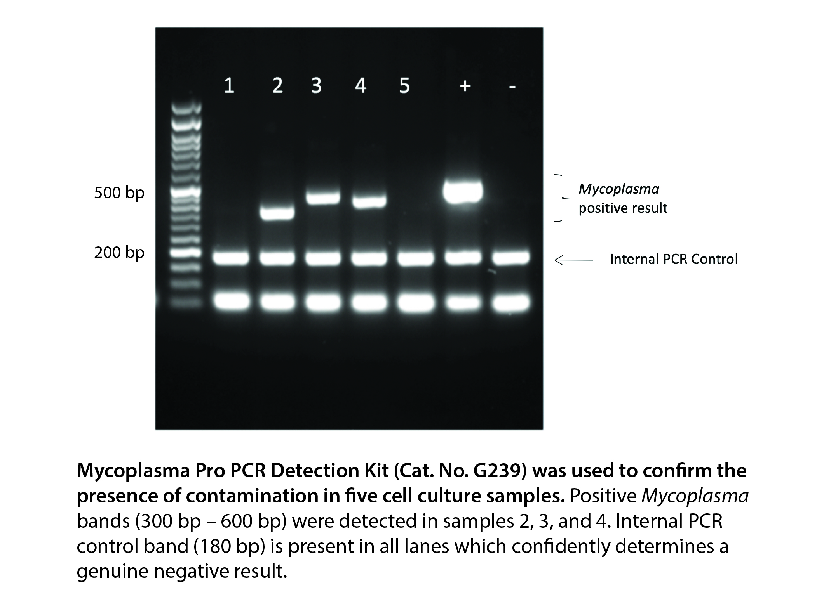
PCR
Current gold standard for identification
Patient’s signs and symptoms must be correlated with the identified agent

Slide 13
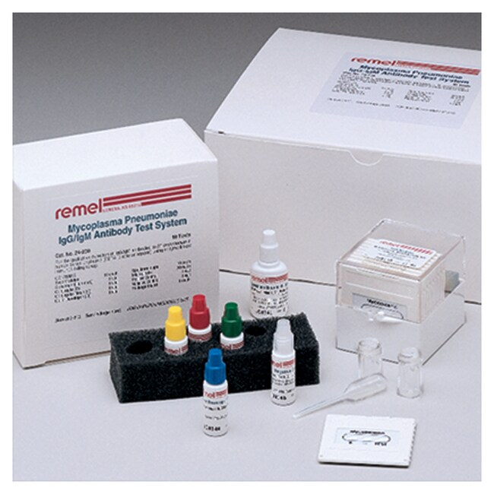
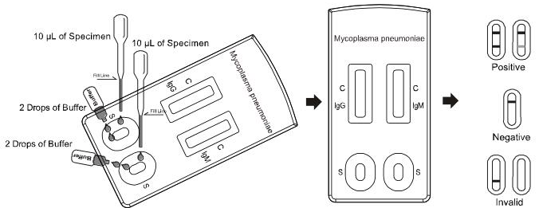
Serologic Tests (M. pneumoniae)
Indirect immunofluorescence
  M. pneumoniae Antibody Test System
Particle agglutination
  Serodyne Color Vue IgG/IgM test
  Serodia Myco II test
EIA
  ImmunoWELL M. pneumoniae
  IgM EIA
  Zeus Mycoplasma IgM EIA
  ETI-M. pneumoniae IgM/IgG
  assay

Slide 14
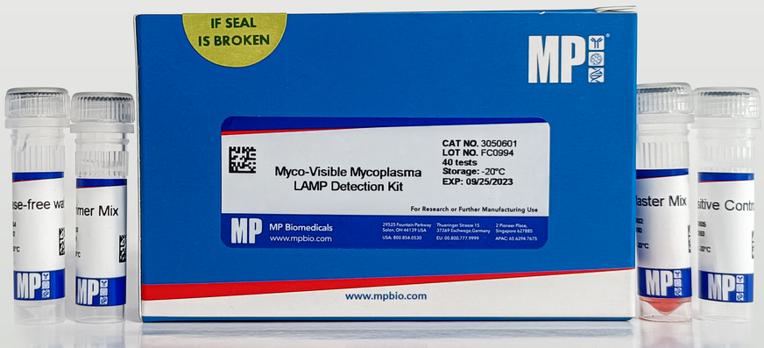
Serologic Tests (Genital Mycoplasmas)
M. hominis: lipid associated membrane proteins (LAMPs)
U. urealyticum
  EIA
  Western immunoblot

Slide 15
Mycoplasma pneumoniae
Children and adolescents | Adults
<5 years old: predominantly manifests as coryza Older children and adolescents: most common syndrome is a combination of tracheobronchitis and upper respiratory tract infection, such as coryza, pharyngitis, and otitis media | Atypical pneumonia: low-grade fever, malaise, headache, myalgia, and cough; gradual onset Natural history: extended illness, with fever and cough lasting well into the third week of illness, and then followed by gradual recovery

Slide 16
Mycoplasma pneumoniae
Transient exanthems
Stevens-Johnson syndrome
Bullous erythema multiforme
Raynaud phenomenon

Slide 17
Mycoplasma hominis
NOT a cause of NGU
Implicated in a few cases of pyelonephritis
Associated with bacterial vaginosis
Correlated strongly with shedding of HIV in the vagina
Colonizes neonates and has been isolated from the chorioamnion of premature infants
Most commonly reported to play a role in systemic infections (postoperative wound infections, septic arthritis, endocarditis, abscesses)

Slide 18
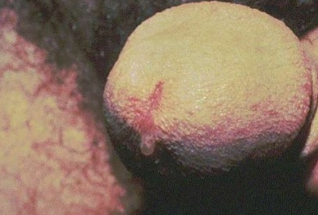
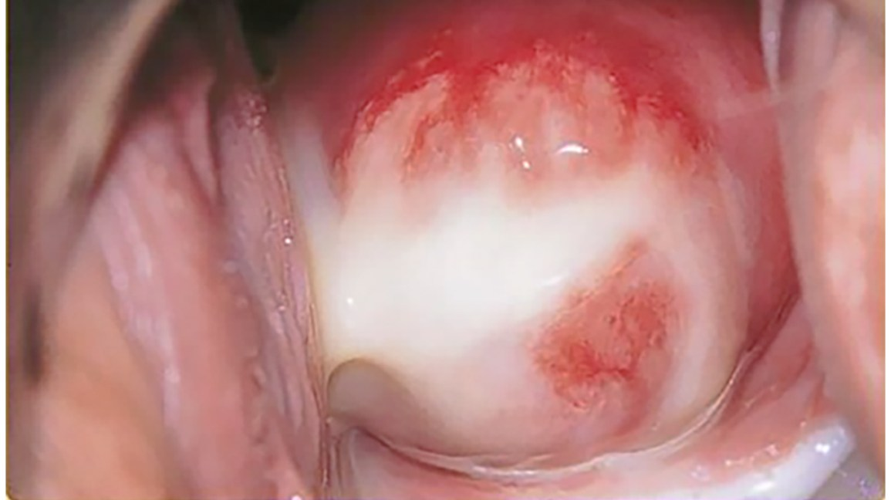
Mycoplasma genitalium
2nd most common cause of urethritis in men after C. trachomatis
Most common cause of persistent or recurrent symptomatic NGU
Associated with endocervicitis, evidenced by mucopurulent discharge, cervical friability, and erythema

Slide 19
Ureaplasma
U. urealyticum is a urethral pathogen associated with NGU
Present in the amniotic fluid of some women experiencing preterm labor and delivery and in cases of preterm premature rupture of membranes
Strongly associated with chorioamnionitis
Systemic infection in adults: postpartum fever, cystitis, urethral syndrome, pericarditis, mediastinitis
Single cases of ambulatory peritoneal dialysis–associated peritonitis, meningitis, and brain abscess

Slide 20
Infection Control
M. pneumoniae – believed to spread by droplet transmission
Recommend droplet precaution for the duration of illness
Human vaccine development has not yet yielded a vaccine suitable for general use

Slide 21
Treatment
Macrolides – favored due to its low MIC and fewer contraindications
  Azithromycin 500 mg orally on day 1 and 250 mg daily on days 2–5
Fluoroquinolones
  moxifloxacin 400 mg orally once daily for 7–14 days
Tetracyclines
  Doxycycline 100 mg orally twice daily for 7–14 days

Slide 22
References
Mandell, Douglas & Bennett’s Principles and Practice of Infectious Diseases, 9th Edition
Bailey & Scott’s Diagnostic Microbiology, 15th Edition
Koneman’s Color Atlas and Textbook of Diagnostic Microbiology, 7th Edition

