Slide 1
Laboratory Module:
BACTERIOLOGY
Neisseria
Philippine Society for Microbiology & Infectious Diseases
Standing Committee on Training & Curriculum Development
Notes:
Good day. Welcome to the laboratory module of Neisseria spp.

Slide 2
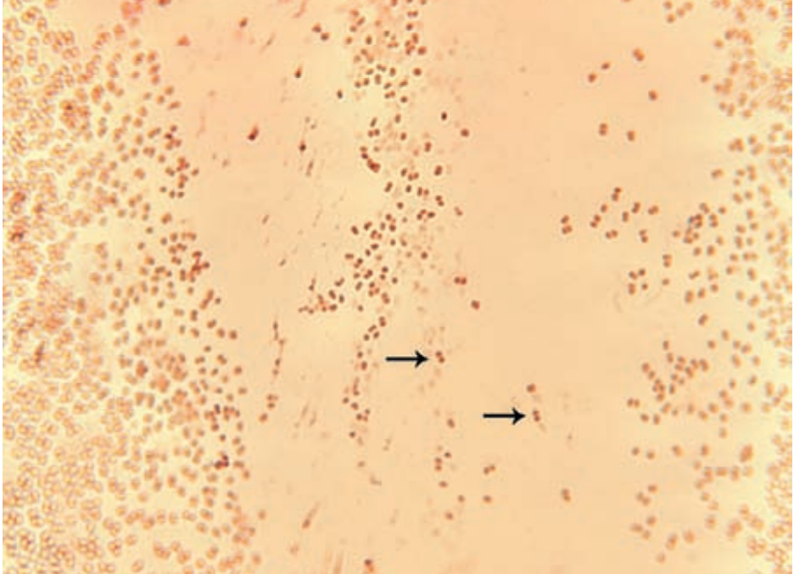
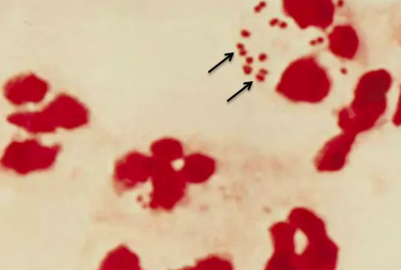

Neisseria
Gram negative
Diplococci
Oxidase positive
Gram stain of Neisseria gonorrhea showing gram negative intracellular diplococci (arrows)
Gram stain of N. meningitidis in CSF (arrows)
Notes:
Neisseriae are gram-negative cocci that usually occur in pairs (diplococci).
Neisseria gonorrhoeae (gonococci) and Neisseria meningitidis (meningococci) are pathogenic for humans and typically are found associated with or inside polymorphonuclear cells.
Gonococci and meningococci are closely related, with 70% DNA homology, and are differentiated by a few laboratory tests and specific characteristics:
Meningococci have polysaccharide capsules but gonococci do not, and meningococci rarely have plasmids but most gonococci do. Most importantly, the two species are differentiated by the usual clinical presentations of the diseases they cause: Meningococci typically are found in the upper respiratory tract and cause meningitis, but gonococci cause genital infections. The clinical spectra of the diseases caused by gonococci and meningococci overlap, however.

Slide 3
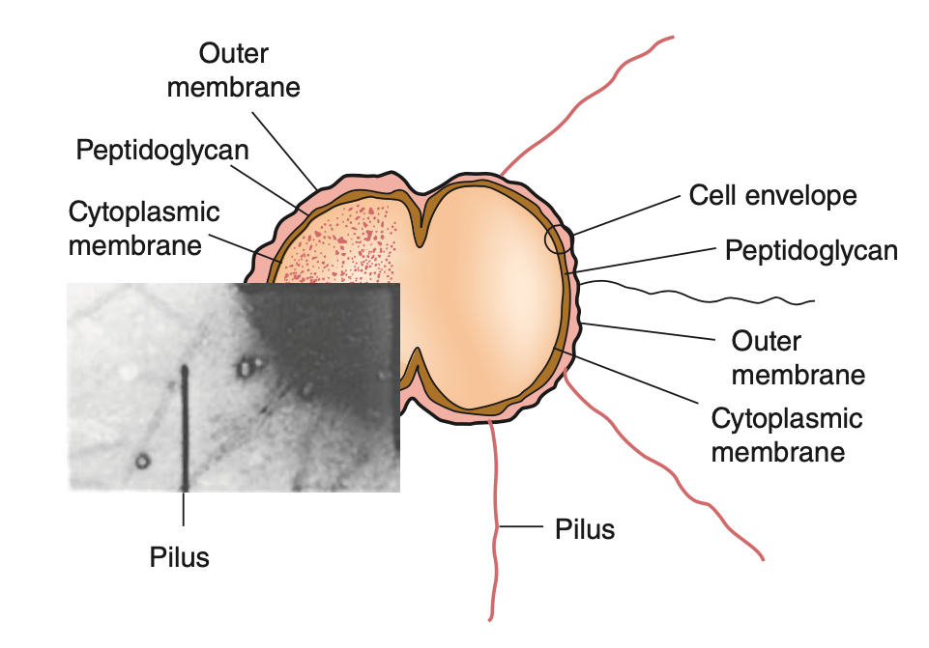
Neisseria gonorrheae
Non-spore forming, gram negative coccus
Grows in pairs with adjacent sides flattened
No flagella but can move based on extension and retraction of its type IV pilus
  - process known as “twitching”
Notes:
Neisseira gonorrheae is a non-spore-forming, gram negative coccus that characteristically grows in pairs (diplococci) with adjacent sides flattened.
It does not have flagella but can move based on extension and retraction of its type IV pilus. This process is known as “twitching” and is the basis of colony types seen in piliated and nonpiliated gonococcal strains.

Slide 4
Diagnosis – Neisseria gonorrheae
 | Sensitivity/Specificity
Culture (Modified Thayer-Martin Agar) | Urethral specimens - >95% or more sensitivity Endocervical infection – 80-90% sensitivity
Nucleid Acid Amplification Test (NAATs) | >99% sensitivity - Replaced culture in most settings
Gram-Stained Smears | Symptomatic urethritis in men – 95% sensitivity Asymptomatic urethral infection, cervical or rectal infection – 50% sensitivity
Notes:
For the diagnostics of Neisseria gonorrheae, we can use culture, nucleic acid amplification test (NAAT), gram stained smears.
Firstly, Single culture on antibiotic-containing selective medium, such as modified Thayer-Martin agar, has a sensitivity of 95% or more for urethral specimens from men with symptomatic urethritis and 80-90% for endocervical infection in women
Secondly, the nucleic acid amplification test or NAATS – have largely replaced culture in most settings in which people are screened for asymptomatic genital infection. NAATs for gonorrheae have specificities greater than 99%, offer important advantages in specimen management, and retain sensitivity when used to test voided urine or self-collected vaginal swabs
Thirdly, Gram Stained Smears – in men, with symptomatic urethritis, microscopy is at least 95% sensitive and is highly specific for diagnosis of gonorrhea, but microscopy is less useful for other anatomic sites.
The sensitivity approximates 50% for asymptomatic urethral infection in men and for cervical or rectal infection

Slide 5
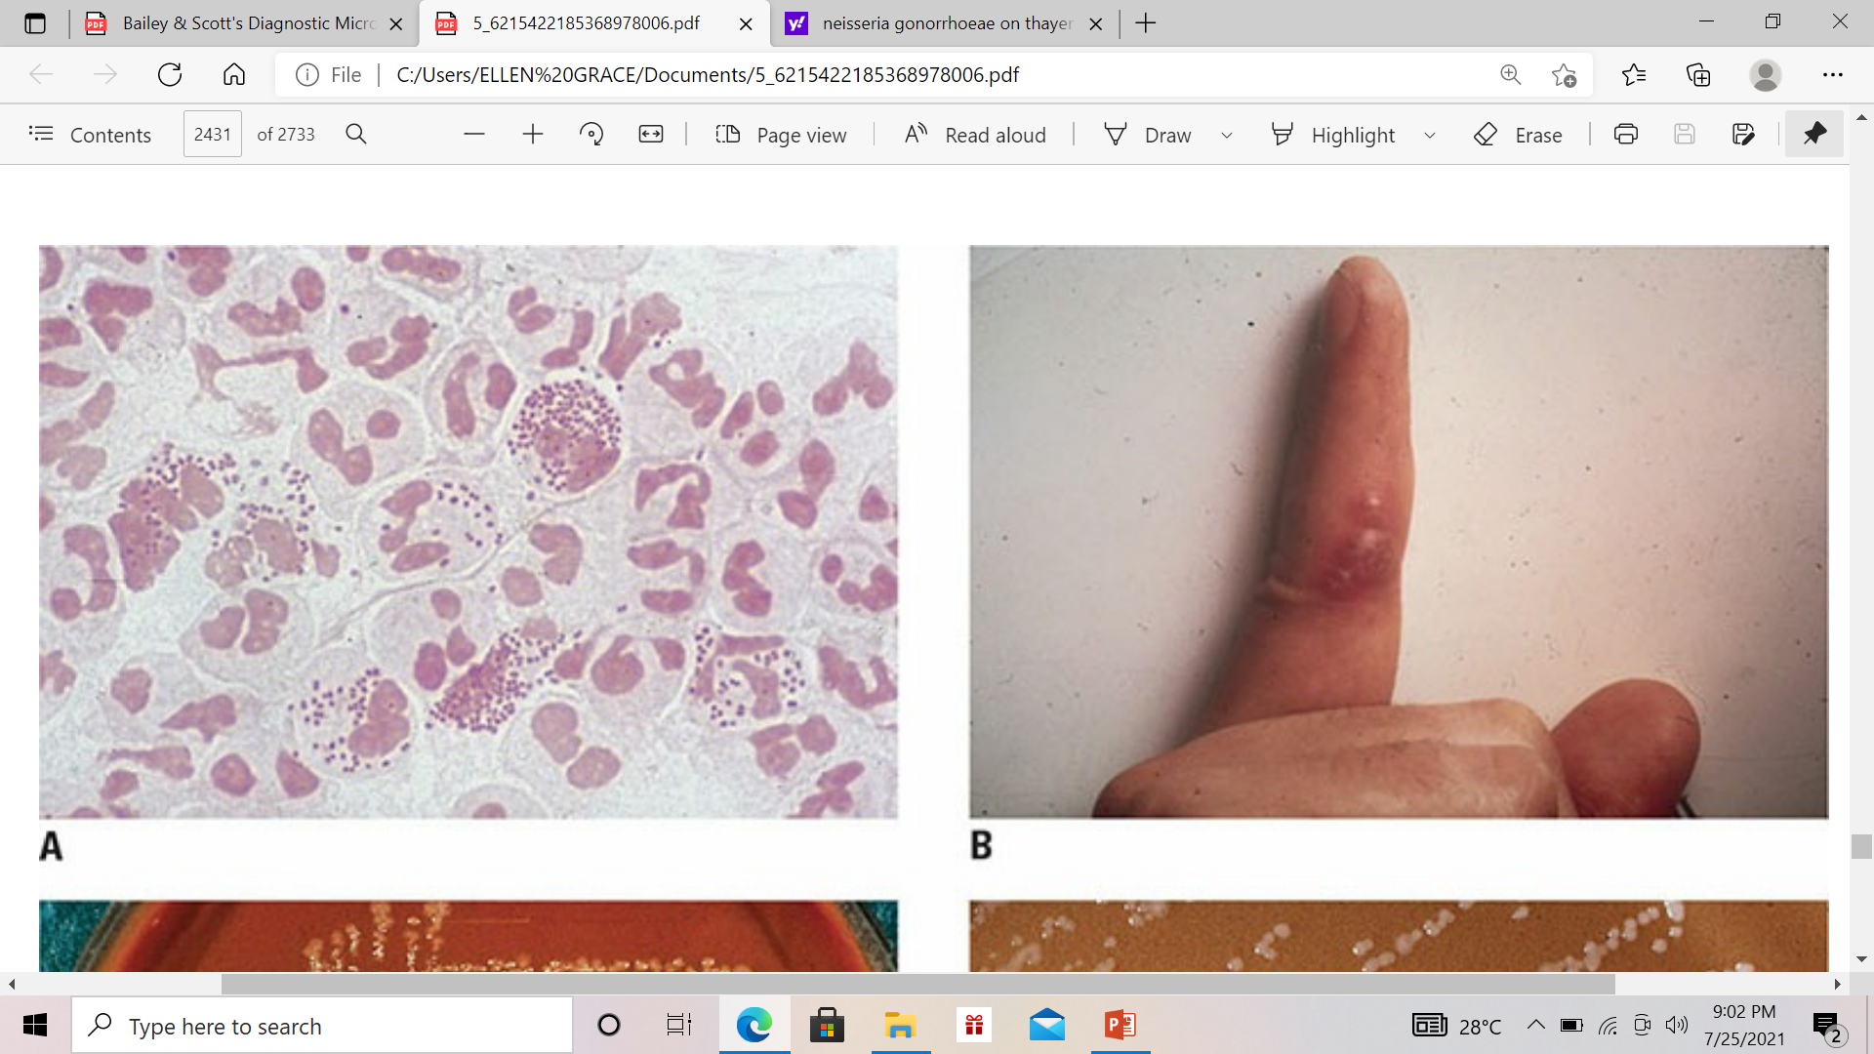
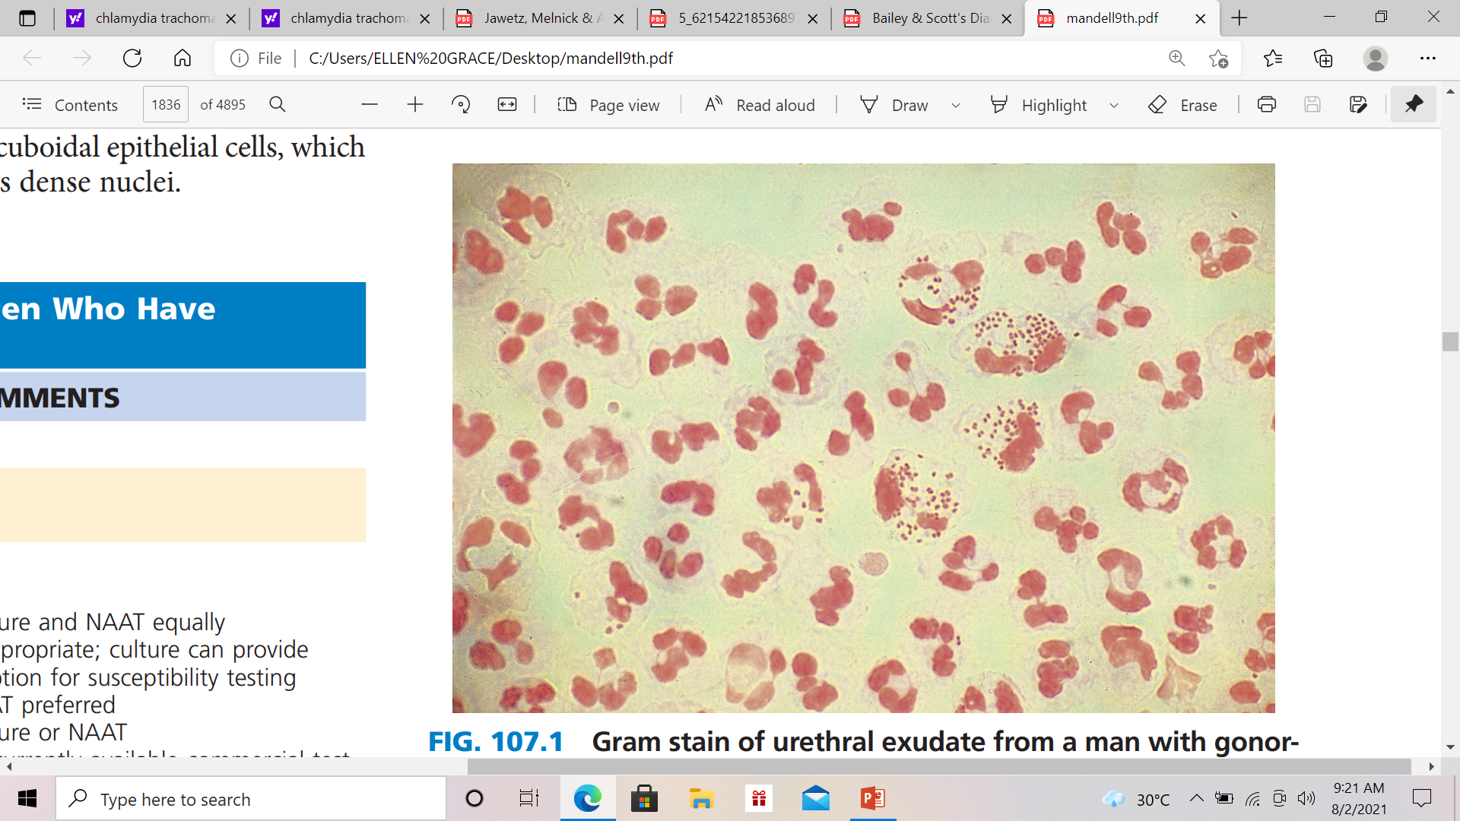
Neisseria gonorrheae
Gram stained smear of a urethral discharge from a male with gonococcal urethritis.
Note the presence of intracellular gram negative diplococci within pale-staining segmented neutrophils
Notes:
This is a picture of Gram stained smear of a urethral discharge from a male with gonococcal urethritis.
Note the presence of intracellular gram negative diplococci within pale-staining segmented neutrophils

Slide 6
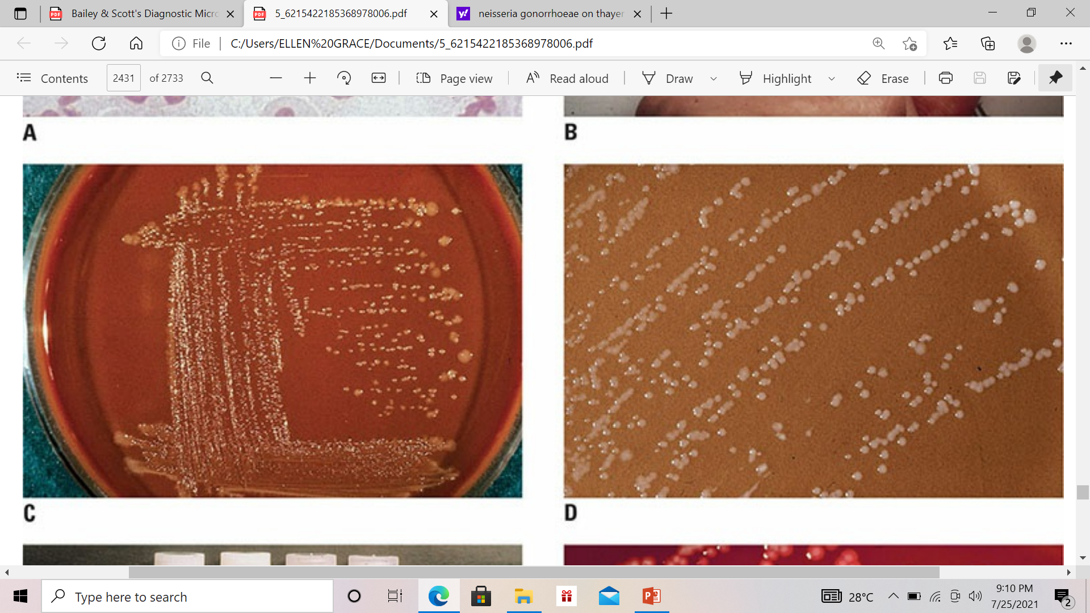
Neisseria gonorrhea
Modified Thayer-Martin Medium - typical colonies appear as small, grayish-white to colorless after 24 hours of incubation at 35°C to 37°C in 5 to 7% CO2
Notes:
This is a Modified Thayer-Martin Medium in which typical colonies appear as small, grayish-white to colorless after 24 hours of incubation at 35°C to 37°C in 5 to 7% CO2

Slide 7
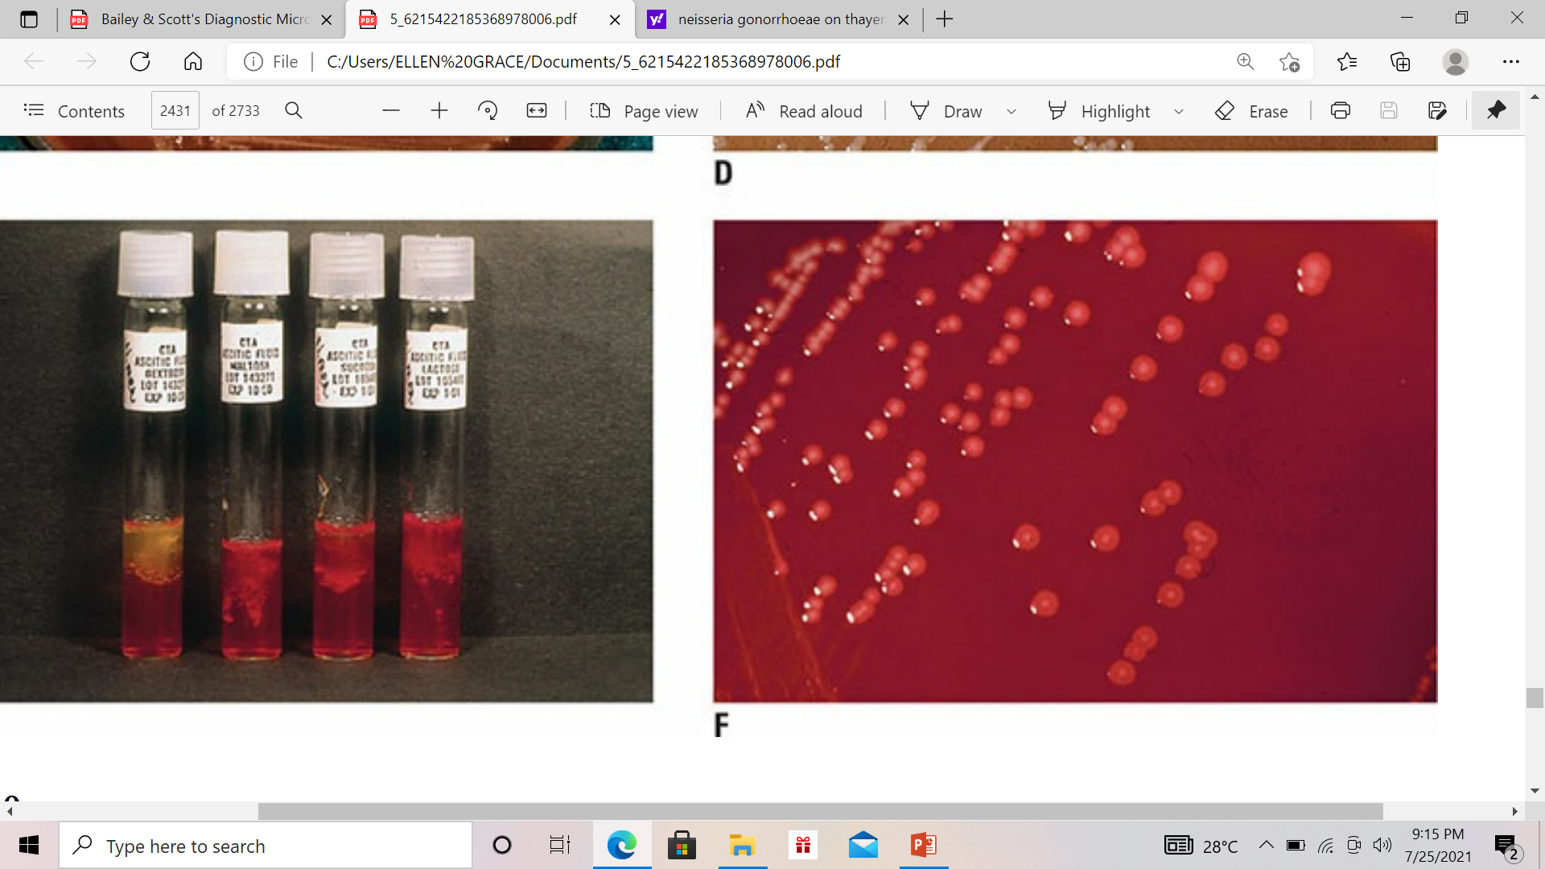
Neisseria gonorrheae
shows the conventional Cystine-Tryptic Digest Semisolid Agar (CTA) for identification of Neisseria spp
The CTA basal medium contains a phenol red indicator, and a change in the color of the medium from red to yellow indicates acid production from the respective carbohydrate
CTA-GLUCOSE
CTA-MALTOSE
CTA-SUCROSE
CTA-LACTOSE
Notes:
This photograph shows the conventional Cystine-Tryptic Digest Semisolid Agar (CTA) for identification of Neisseria spp.
The battery includes (from ;eft to right:
CTA-glucose
CTA-maltose
CTA-sucrose
CTA-lactose
The CTA basal medium contains a phenol red indicator, and a change in the color of the medium from red to yellow indicates acid production from the respective carbohydrate
In this photograph, acid has been produced from glucose only, identifying the organism as N. gonorrhea

Slide 8
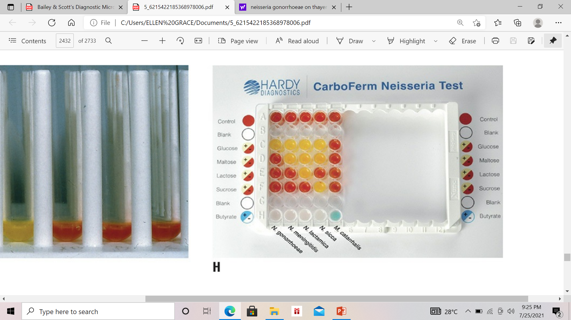
Neisseria gonorrheae
designed to identify the gram negative, oxidase positive diplococci belonging to the genus Neisseria and Moraxella catarrhalis
NEGATIVE – red or red-orange color
POSITIVE – orange, yellow orange and yellow
Notes:
This kit is designed to identify the gram negative, oxidase positive diplococci belonging to the genus Neisseria and Moraxella catarrhalis
For NEGATIVE result, we can see the red or red-orange color while for POSITIVE result, we can see orange, yellow orange and yellow.

Slide 9
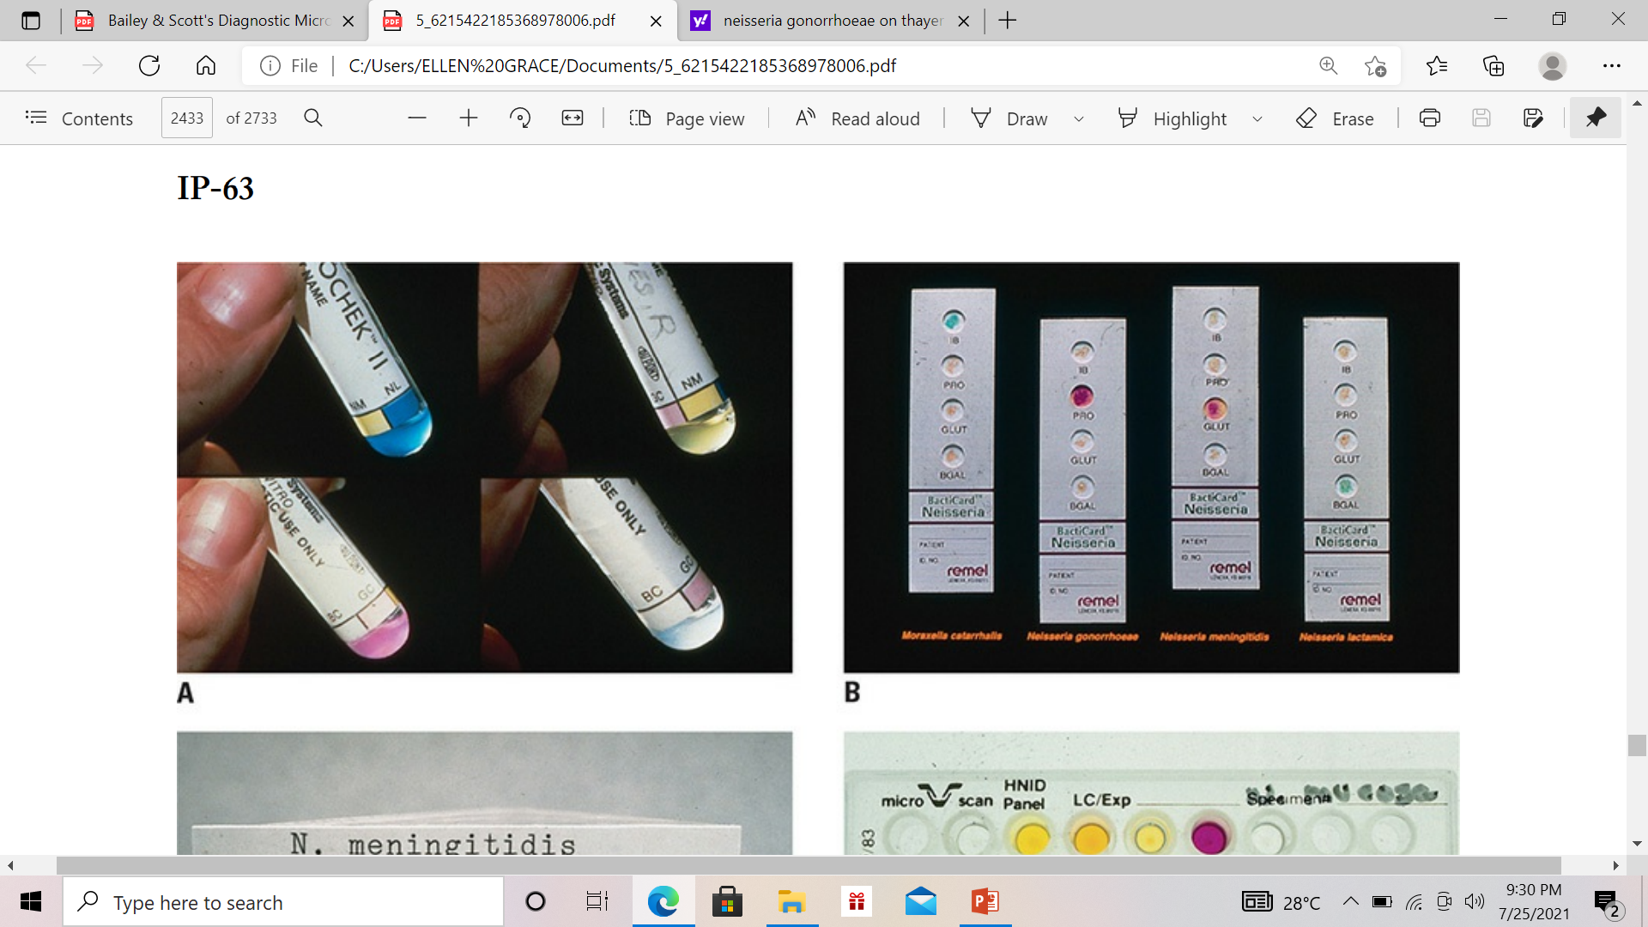
Neisseria gonorrheae
GONOCHEK II
3 chromogenic substrates are included in a single plastic tube to detect glycosidase and aminopeptidase enzymes specifically found in N. meningitidis, N. lactamica, and N. gonorrhea
Notes:
This is a GONOCHEK II - 3 chromogenic substrates are included in a single plastic tube to detect glycosidase and aminopeptidase enzymes specifically found in N. meningitidis, N. lactamica, and N. gonorrhea
- Hydrolysis of substrates in the tube results in the small inoculum volume turning various colors. Identification patterns observed are:
The Blue tube (seen at the upper left of the photo)—this identifies Neisseria lactamica (a β-galactoside hydrolysis)
The Yellow tube(seen at the upper right of the photo)—this identifies Neisseria meningitidis (γ-glutamyl- p-nitroanilide hydrolysis)
The Red tube (seen at the lower left of the photo) – identifies Neisseria gonorrheae (prolyl-naphthylamide hydrolysis)
The Lack of a color reaction (seen at the ower right of the photo) following the 30-minute incubation presumptively identifies the organism as M. catarrhalis

Slide 10
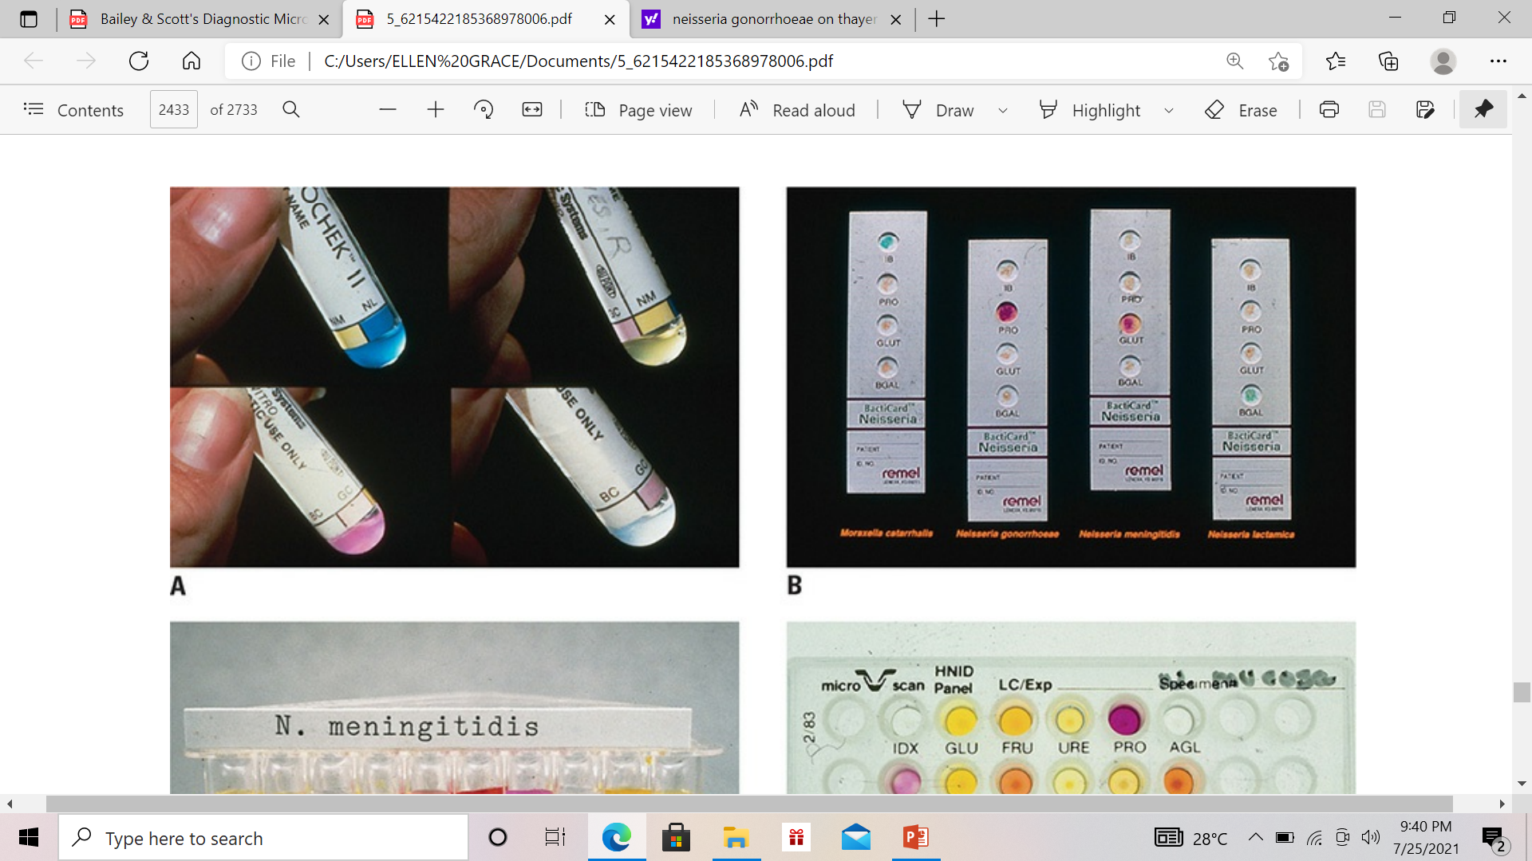
Neisseria gonorrheae
BactiCard Neisseria
Contains 4 chromogenic enzyme substrate tests for identification of the Neisseria spp. and M. catarrhalis
The appearance of a red color in the PRO (prolyl aminopeptidase) test area identifies the isolate as N. gonorrhea
Notes:
This is a BactiCard Neisseria .
This identification strip contains 4 chromogenic enzyme substrate tests for identification of the pathogenic Neisseria spp. and M. catarrhalis
The appearance of a red color in the PRO or the prolyl aminopeptidase test area identifies the isolate as N. gonorrhea, the second strip from the left

Slide 11
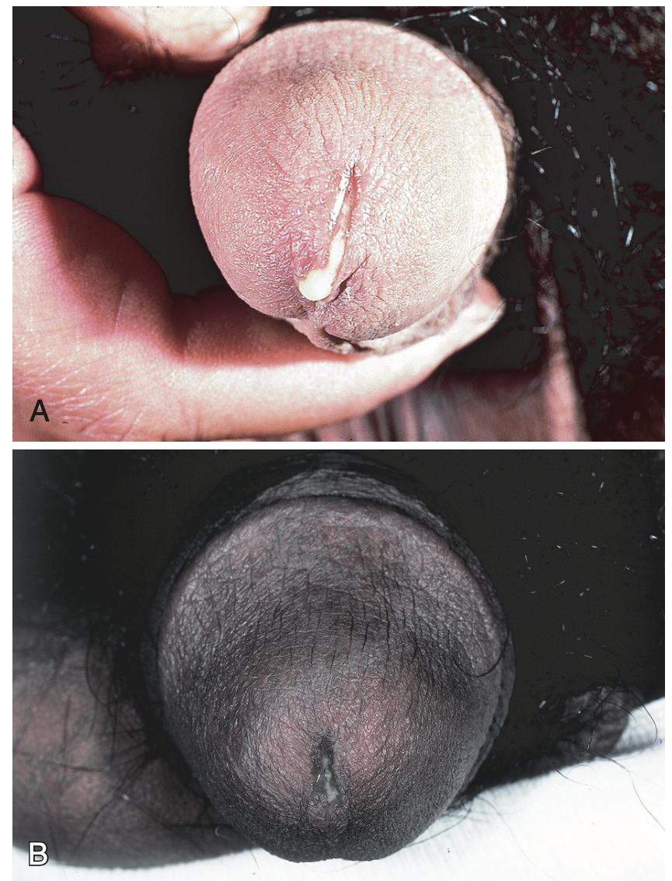
Clinical Manifestations
Gonococcal Urethritis
Incubation period: 1 to 10 days or longer Major symptoms - urethral discharge and dysuria Discharge may initially be scant and mucoid, but within 1-2 days it becomes overtly purulent
Notes:
- For the clinical manifestations of gonococcal urethritis, the incubation period is 1 to 10 days or longer.
- Urethral discharge and dysuria, usually without urinary frequency or urgency, are the major symptoms.
- The discharge may initially be scant and mucoid, but within 1 or 2 days it becomes overtly purulent

Slide 12
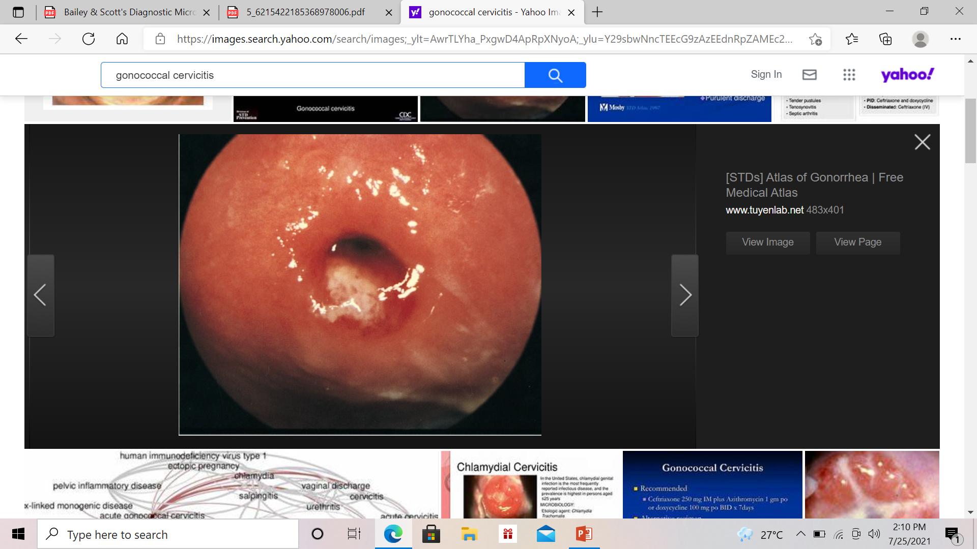
Clinical Manifestations
Endocervical Gonorrhea
Incubation period: 8 to 10 days Dominant symptoms: Increased vaginal discharge intermenstrual bleeding dysuria abdominal or pelvic pain (denotes ascending infection)
Notes:
- For the endocervical gonorrhea - Most infected women who develop symptoms do so within 10 days.
- The dominant symptoms are increased vaginal discharge, dysuria (often without urgency or frequency), and intermenstrual bleeding, sometimes triggered by coitus. Abdominal or pelvic pain usually denotes ascending infection, but some women with these symptoms lack evidence of salpingitis at laparoscopy.
- Physical examination may show purulent or mucopurulent cervical exudate and other signs of mucopurulent cervicitis, such as edema in a zone of cervical ectopy or endocervical bleeding induced by gentle swabbing

Slide 13
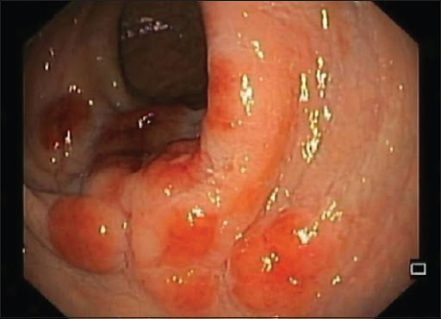
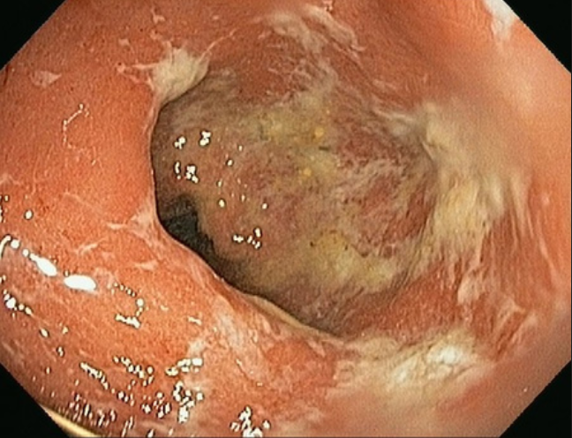
Clinical Manifestations
Rectal Gonococcal Infections
Rectal infection acquired both through receptive anal intercourse and perineal contamination with cervicovaginal secretions Symptoms include: Acute proctitis and anal pruritis Purulent discharge Rectal bleeding Tenesmus
Notes:
- Rectal infection is acquired both through receptive anal intercourse, which accounts for virtually all cases in men, and perineal contamination with cervicovaginal secretions, which is believed to be responsible for some infections in women.
Rectal gonococcal infection is usually asymptomatic, but some patients have acute proctitis manifesting with anal pruritus, tenesmus, purulent discharge, or rectal bleeding.
The apparently higher rate of clinically apparent proctitis in men than in women suggests that inoculum size or trauma during anal intercourse may influence the development of symptoms
- Anoscopy sometimes reveals mucopurulent exudate and inflammatory changes in the rectal mucosa, but infection with C. trachomatis, herpes simplex virus, or other sexually transmitted pathogens can produce the same findings.

Slide 14
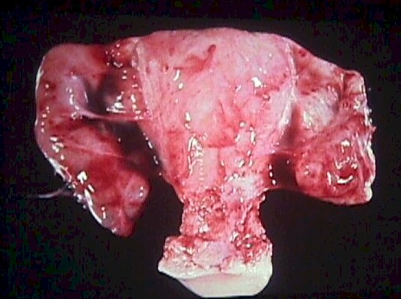
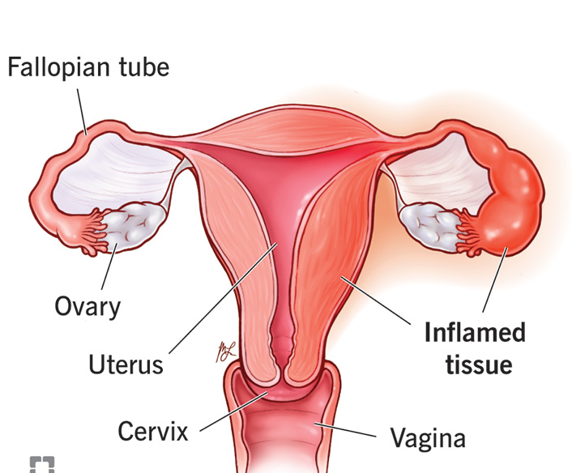
Clinical Manifestations
Pelvic Inflammatory Disease (PID)
spectrum of upper genital tract infections Salpingitis Endometritis Tubo-ovarian abscess Pelvic peritonitis perihepatitis Most consistent symptom: low abdominal pain Primary finding at physical examination: pelvic adnexal tenderness, usually bilateral
Notes:
- PID refers to a spectrum of upper genital tract infections and may occur with or without overt symptoms. When symptomatic, PID manifests with various combinations of endometritis, salpingitis, tubo-ovarian abscess, pelvic peritonitis, and perihepatitis
- PID is estimated to occur in 10% to 20% of women with gonorrhea detected at the cervix
The most consistent symptom of PID is low abdominal pain, and most women also have symptoms of lower genital tract infection.
Gonococcal PID often follows the onset of menses by a few days. Fever, chills, nausea, and vomiting may occur, but most patients lack these manifestations.
The primary finding at physical examination is pelvic adnexal tenderness, usually bilateral.

Slide 15
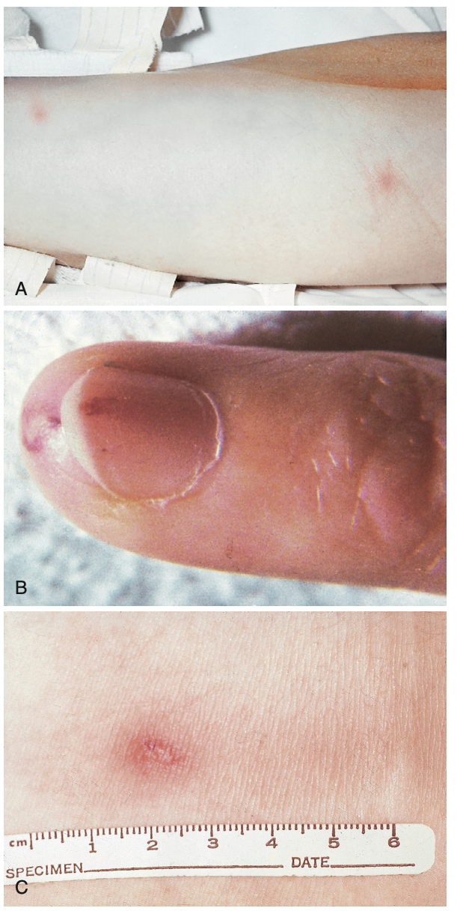
Clinical Manifestations
Disseminated Gonococcal Infection (DGI)
Results from bacteremic dissemination of N. gonorrheae Estimated to occur in 0.5% to 3% of infected patients This infection is characterized by: Hemorrhagic skin lesions Tenosynovitis Migratory polyarthralgias Septic arthritis Most common presentation: arthritis-dermatitis syndrome
Notes:
- DGI results from bacteremic dissemination of Neisseria gonorrhoeae, although immune complexes or other indirect immunologic mechanisms may contribute to pathogenesis and symptoms in some cases. - - Although once estimated to occur in 0.5% to 3% of infected patients, the rate undoubtedly is lower at present because of declining prevalences of gonococcal strains prone to disseminate.
During the first few days, most patients experience polyarthralgias that primarily involve the knees, elbows, and more distal joints; the axial skeleton is usually not involved.
Physical examination usually shows objective signs of arthritis or tenosynovitis in at least two joints. Asymmetrical involvement of only a few joints helps distinguish DGI from polyarthritis caused by most immune complex–mediated disorders, which typically manifest with symmetrical involvement of many joints.
A characteristic dermatitis is present in approximately 75% of patients and consists of discrete papules and pustules, often with a hemorrhagic component. Hemorrhagic bullae or overtly necrotic lesions that mimic ecthyma gangrenosum are sometimes seen.
The lesions usually number 5 to 40 and occur predominantly on the extremities.
Fever, systemic toxicity, and polymorphonuclear leukocytosis are common, but they are usually mild and are often absent.
- The most common presentation of DGI is the arthritis-dermatitis syndrome.

Slide 16
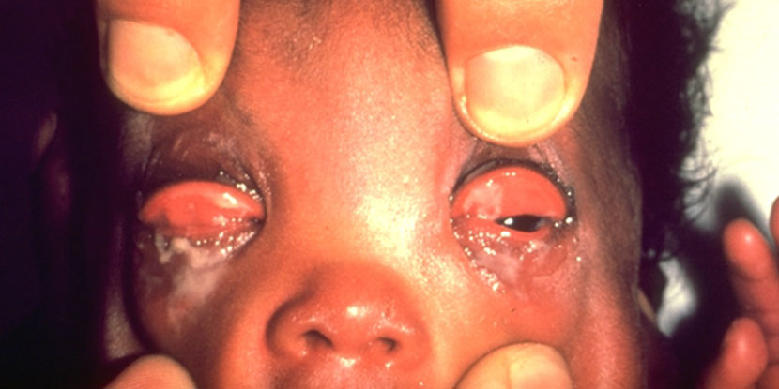
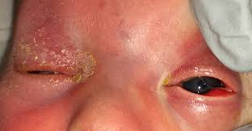
Clinical Manifestations
Gonococcal Conjunctivitis of the Newborn (Ophthalmia Neonatorum)
Most common clinically recognized manifestation of neonatal infection Most important preventive measure: routine screening and treatment of pregnant women for gonorrhea Diagnosis: suspected clinically when acute conjunctivitis develops within a few days of delivery and confirmed by identification of gonococci in conjunctival secretions
Notes:
- Gonococcal conjunctivitis of the newborn (ophthalmia neonatorum) is the most common clinically recognized manifestation of neonatal infection
The most important preventive measure is routine screening and treatment of pregnant women for gonorrhea before term.
The diagnosis of gonococcal ophthalmia should be suspected clinically when acute conjunctivitis develops within a few days of delivery and is confirmed by identification of gonococci in conjunctival secretions.

Slide 17
Treatment
Disease | Treatment
Uncomplicated Infection of the Cervix, Urethra, Rectum | Ceftriaxone 250mg IM single dose and Azithromycin 1 gm single dose
Infection of the Pharynx
Disseminated Gonococcal Infection | Ceftriaxone, 1 g IM or IV every 24 hours for 24–48 hours after improvement, with switch to oral therapy such as Cefixime 400 mg PO twice daily for completion of 1 week total antibiotic therapy.
Notes:
For the treatment of Neisseria gonorrheae,
For both uncomplicated infection of the cervix, urethra, rectum, and infection of the pharynx, we can give ceftriaxone 250mg IM single dose and azithromycin 1gm single dose. Patients should abstain from sex for 1 week after single-dose treatment. Test of cure for pharyngeal infection is recommended at 14 days if the ceftriaxone regimen is not used.
For disseminated gonococcal infection, we can give ceftriaxone 1gm IM or IV every 24hours for 24-48hrs after improvement, with switch to oral therapy for completion of 1 week total antibiotic therapy, including cefixime 500mg per orem twice daily. Ceftriaxone administered IM may be reconstituted in 1% lidocaine solution to minimize injection pain. Alternative parenteral regimens include cefotaxime, ceftizoxime, and spectinomycin

Slide 18
Treatment
Disease | Treatment
Meningitis | Ceftriaxone, 1–2 g IV every 12 hours for 10–14 days
Endocarditis | Ceftriaxone, 1–2 g IV every 12 hours for ≥4 weeks
Ophthalmia Neonatorum | Ceftriaxone, 25–50 mg/kg IV or IM in a single dose, not to exceed 125 mg
Conjunctivitis (not Ophthalmia Neonatorum) | Ceftriaxone 1gm IM single dose
Notes:
- For the treatment of meningitis/endocarditis, ceftriaxone 1-2gm IV every 12hours for 10-14 days for meningitis or 4weeks or more for endocarditis
- For the ophthalmia neonatorum, Ceftriaxone, 25–50 mg/kg IV or IM in a single dose, not to exceed 125 mg. Topical antibiotic therapy alone is inadequate for treatment of ophthalmia neonatorum.
- for conjunctivitis not ophthalmia neonatorum, we can give ceftriaxone 1gm IM single dose.

Slide 19
Treatment
Disease | Recommended treatment for Acute PID
Hospitalized | Cefotetan, 2 g IV q12h, or cefoxitin, 2 g IV q6h plus Doxycycline, 100 mg IV or PO q12h
-Regimen A
- Regimen B | Clindamycin, 900 mg IV q8h plus Gentamicin, 2 mg/kg IV once, followed by 1.5 mg/kg q8h
Notes:
- For the treatment of acute PID, treatment is categorized into hospitalized with 2 regimen options and outpatient.
- For the Regimen A of hospitalized patients, we can give Cefotetan, 2 g IV every 12 hours, or cefoxitin, 2 g IV every 6 hours plus
Doxycycline, 100 mg IV or per orem every 12 hours
Continue both drugs IV for 24 hours after the patient substantially improves,
then continue doxycycline, 100 mg per orem bid, to complete 14 days total therapy. Either clindamycin or metronidazole may be added to the oral regimen if tubo-ovarian abscess is suspected.
- For the Regimen B, Clindamycin, 900 mg IV every 8 hours plus Gentamicin, 2 mg/kg IV once, followed by 1.5 mg/kg every 8hours.
Continue both drugs IV for 24 hours after the patient substantially improves, then continue doxycycline, 100 mg per orem twice daily, or clindamycin, 450 mg per orem four times daily, to complete 14 days total therapy. Clindamycin may be preferable when tubo-ovarian abscess is suspected.

Slide 20
Treatment
Disease | Recommended treatment for Acute PID
Outpatient | Single-dose Cefoxitin, 2 g IM, plus probenecid, 1 g PO; or Ceftriaxone, 250 mg IM; or other parenteral third-generation cephalosporin (e.g., ceftizoxime or cefotaxime) plus Doxycycline, 100 mg PO bid for 14 days with or without Metronidazole, 500 mg PO bid for 14 days
Notes:
For the recommended treatment for acute PID as outpatient, single-dose cefoxitin, 2 g IM, plus probenecid, 1 g per orem; or ceftriaxone, 250 mg IM; or other parenteral third-generation cephalosporin such as ceftizoxime or cefotaxime plus Doxycycline, 100 mg per orem bid for 14 days with or without Metronidazole, 500 mg PO bid for 14 days

Slide 21
Neisseria meningitidis
Gram negative, diplococci both inside and outside of PMNs
Adjacent sides of the diplococcus are flattened to produce the typical kidney or coffee bean shape
Oxidase positive
Gram stain of CSF specimen (arrows)

Slide 22
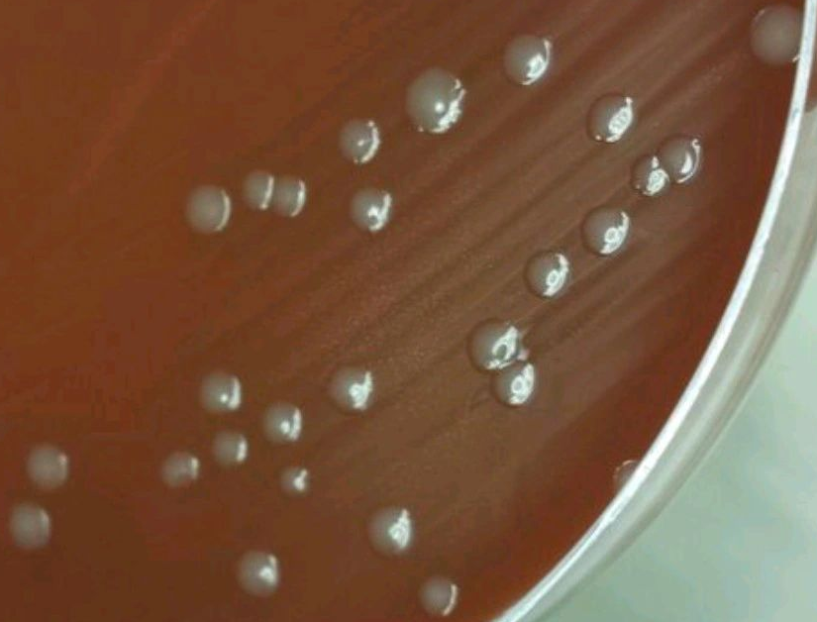
Neisseria meningitidis
Grows well on trypticase soy agar with 5% sheep blood and enriched media (chocolate agar)
Incubated at 35°C-37°C for 72 hours in a CO2-enriched (3% to 7%), humid atmosphere.
Colonies appear medium, smooth, round, moist, gray to white; encapsulated strains are mucoid; may be greenish cast in agar underneath colonies

Slide 23
Neisseria meningitidis
Biochemical and Physiologic Characteristics
Growth on:
Modified Thayer Martin | Nutrient Agar at 35C | Blood or Chocolate Agar
+ | - | +
Rapid Fermentation of Sugars
Glucose | Maltose | Lactose | Sucrose | Fructose | Nitrate reduction
+ | + | - | - | - | -

Slide 24
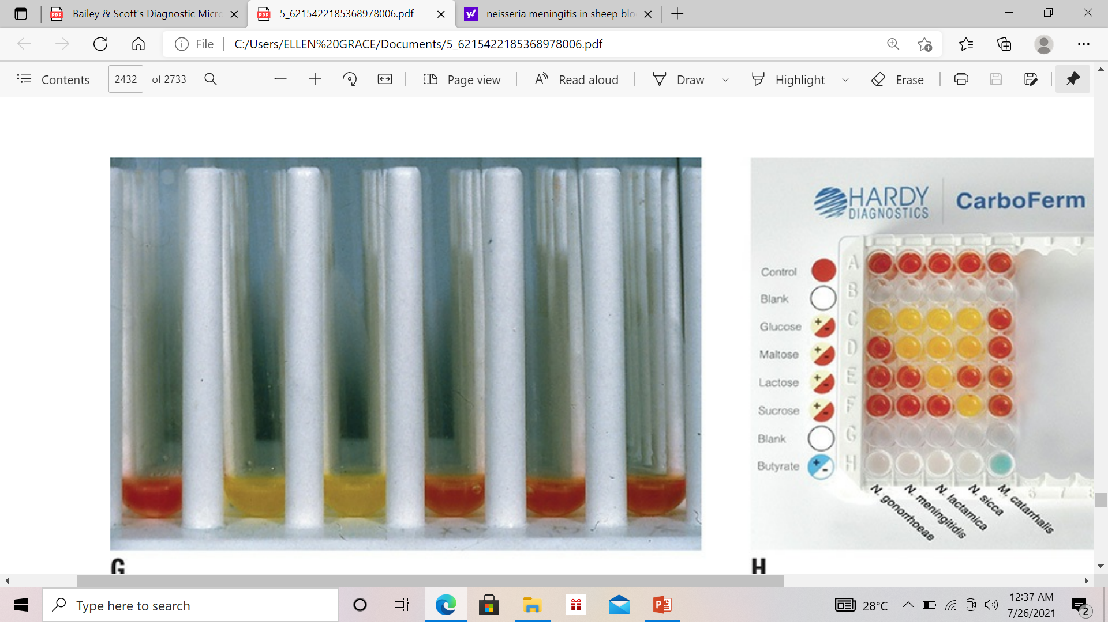
Neisseria meningitidis
Gluc
Mal
Rapid carbohydrate utilization test
A set of carbohydrates (left to right):
  BSS only (organism suspension)
  BSS-glucose
  BSS-maltose
  BSS-fructose
  BSS-sucrose
  BSS-lactose
Acid is produced in the glucose and maltose tubes (color change from red to yellow), the organism is identified as N. meningitidis

Slide 25
Neisseria meningitidis
BactiCard Neisseria (Remel Laboratories, Lenexa KS): contains 4 chromogenic enzyme substrate tests for identification of Neisseria spp. and M. catarrhalis
The development of a red color in the GLUT (γ-glutamyl aminopeptidase) test area identifies the isolate as N. meningitidis (third strip from the left)

Slide 26
Neisseria meningitidis
Nasopharynx is the portal of entry
Organisms attach to epithelial cells with the aid of pili
13 meningococcal capsular polysaccharide serogroups (A, B, C, D, H, I, K, L, X, Y, Z, W135, and 29E) have been described, but most infections are caused by organisms belonging to serogroups A, B, C, X, Y, and W135

Slide 27
Neisseria meningitidis
Virulence factors:
  Surface structures, pili, facilitate attachment to mucosal epithelial cells and invasion to the submucosa
  In the blood, survival is mediated by polysaccharide capsule
  Endotoxin release mediates many of the systemic manifestations of infection, such as shock
  Produce cellular porin proteins (PorA and PorB)
  IgA protease degrades membrane-associated IgA

Slide 28
Neisseria meningitidis
Common presentations of invasive meningococcal disease are meningococcemia and acute meningitis
Meningococcemia:
  Septicemia with shock is the dominant clinical picture
  Acute, with sudden-onset fever, generalized malaise, weakness, cold extremities and skin pallor, leukocytosis or leukopenia, petechial or purpuric rash, headache and/or drowsiness, hypotension
  Clinical signs of meningeal irritation are usually absent

Slide 29
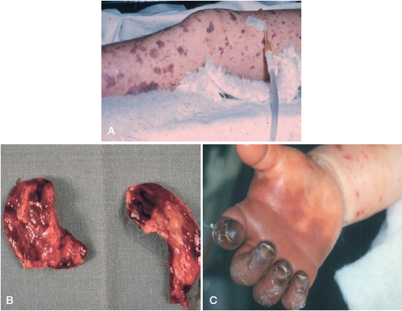
Neisseria meningitidis
Fulminant meningococcal septicemia. (A) Ecchymoses. (B) Hemorrhagic adrenals. (C) Thrombosis and gangrene of the fingers

Slide 30
Neisseria meningitidis
Meningitis:
  most common presentation of invasive meningococcal disease
  sudden-onset headache, fever, vomiting, myalgias, photophobia, irritability, agitation, drowsiness, and meningeal signs, cloudy CSF, with or without a rash
  rash may be present and is commonly petechial but may have fewer lesions than seen in meningococcal septicemia

Slide 31
Neisseria meningitidis
Rash of Meningococcal disease:
  Discrete lesions 1 to 2 mm in diameter, most frequently on the trunk and lower extremities but also on mucosal membranes and sclera
  Seen in clusters in areas where pressure may be applied
  Petechiae can coalesce and form larger lesions that appear ecchymotic
  Ecchymosis are secondary to subcutaneous hemorrhage

Slide 32
Neisseria meningitidis
Subcutaneous ecchymoses on a sole
(B) Subcutaneous ecchymoses on the back

Slide 33
Neisseria meningitidis
Other clinical manifestations:
  Primary (Purulent) Pericarditis- pericardial effusion and tamponade
  Septic Arthritis- often monoarticular affecting the knee and ankle
  Meningococcal pneumonia
  Meningococcal conjunctivitis- unilateral hyperacute purulent exudate with hyperemia and edema
  Meningococcal Urethritis and Proctitis

Slide 34
Neisseria meningitidis
Treatment:
  Ceftriaxone, 2 g IV every 12 hours OR
  Cefotaxime, 2 g IV every 4–6 hours OR
  Meropenem, 2 g IV every 8 hours
  Severe allergy to β-lactams (e.g., anaphylaxis), Moxifloxacin 400 mg IV once daily OR
  Chloramphenicol 25 mg/kg IV up to 1 g every 6 hours

Slide 35
References
Mandell, Douglas & Bennett’s Principles and Practice of Infectious Diseases, 9th Edition
Bailey & Scott’s Diagnostic Microbiology, 15th Edition
Koneman’s Color Atlas and Textbook of Diagnostic Microbiology, 7th Edition

