Slide 1
Philippine Society for Microbiology & Infectious Diseases
Standing Committee on Training & Curriculum Development
Laboratory Module:
BACTERIOLOGY
ENTERIC GRAM-NEGATIVE RODS

Slide 2

Pseudomonas

Slide 3
Pseudomonas spp.
Gram-negative bacteria that inhabit diverse environments, including soil, water, plants, insects, and animals.
P. aeruginosa is the most important
  often causing serious infections associated with substantial morbidity and mortality.
  not a common bacterium that inhabits the human microbiota among healthy hosts

Slide 4
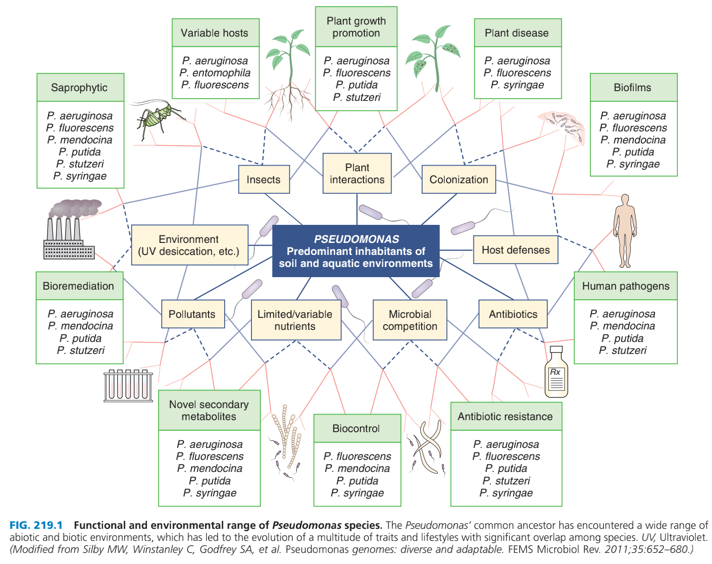
Other Pseudomonas species, including P. fluorescens, P. luteola, P. putida, and P. stutzeri
  less virulent but are still implicated in a wide variety of infections, primarily occurring among immunocompromised patients.

Slide 5
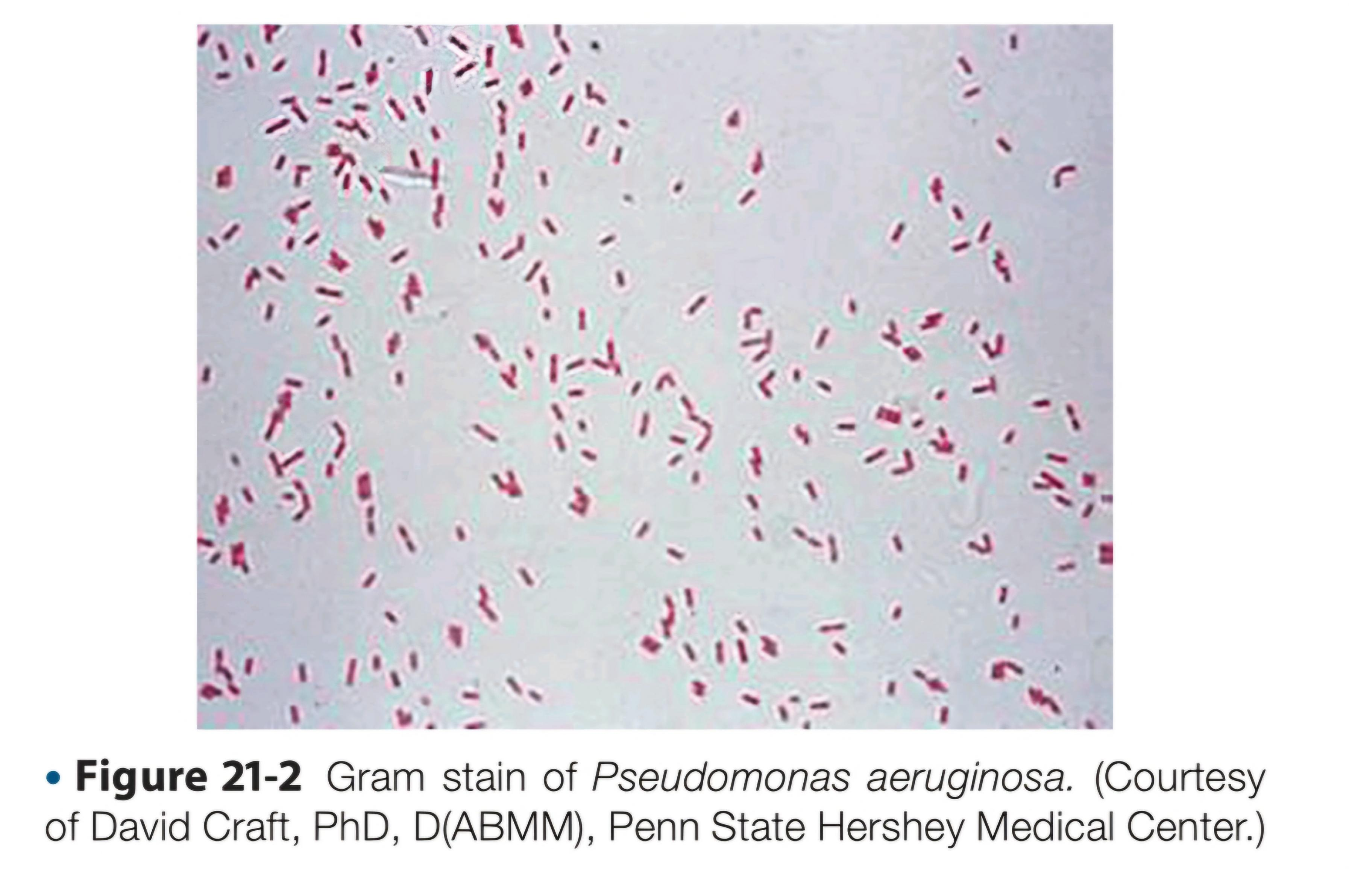
Diagnosis
an aerobic gram-negative, rod-shaped bacteria
with12 clinically relevant species
motile (1 to several flagella)
catalase (+)
generally oxidase (+) except for P. luteola & P. oryzihabitans

Slide 6
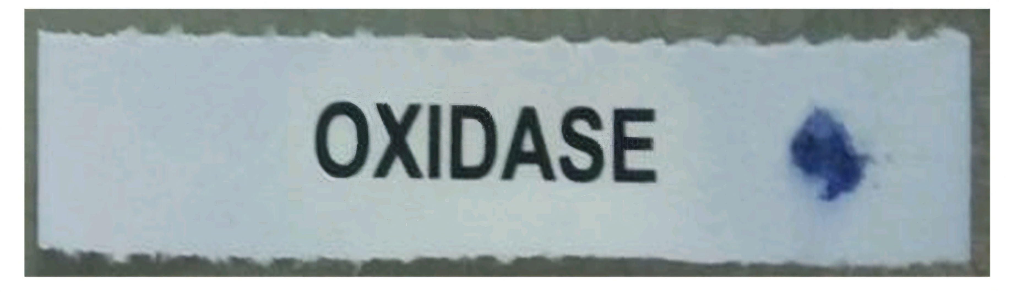
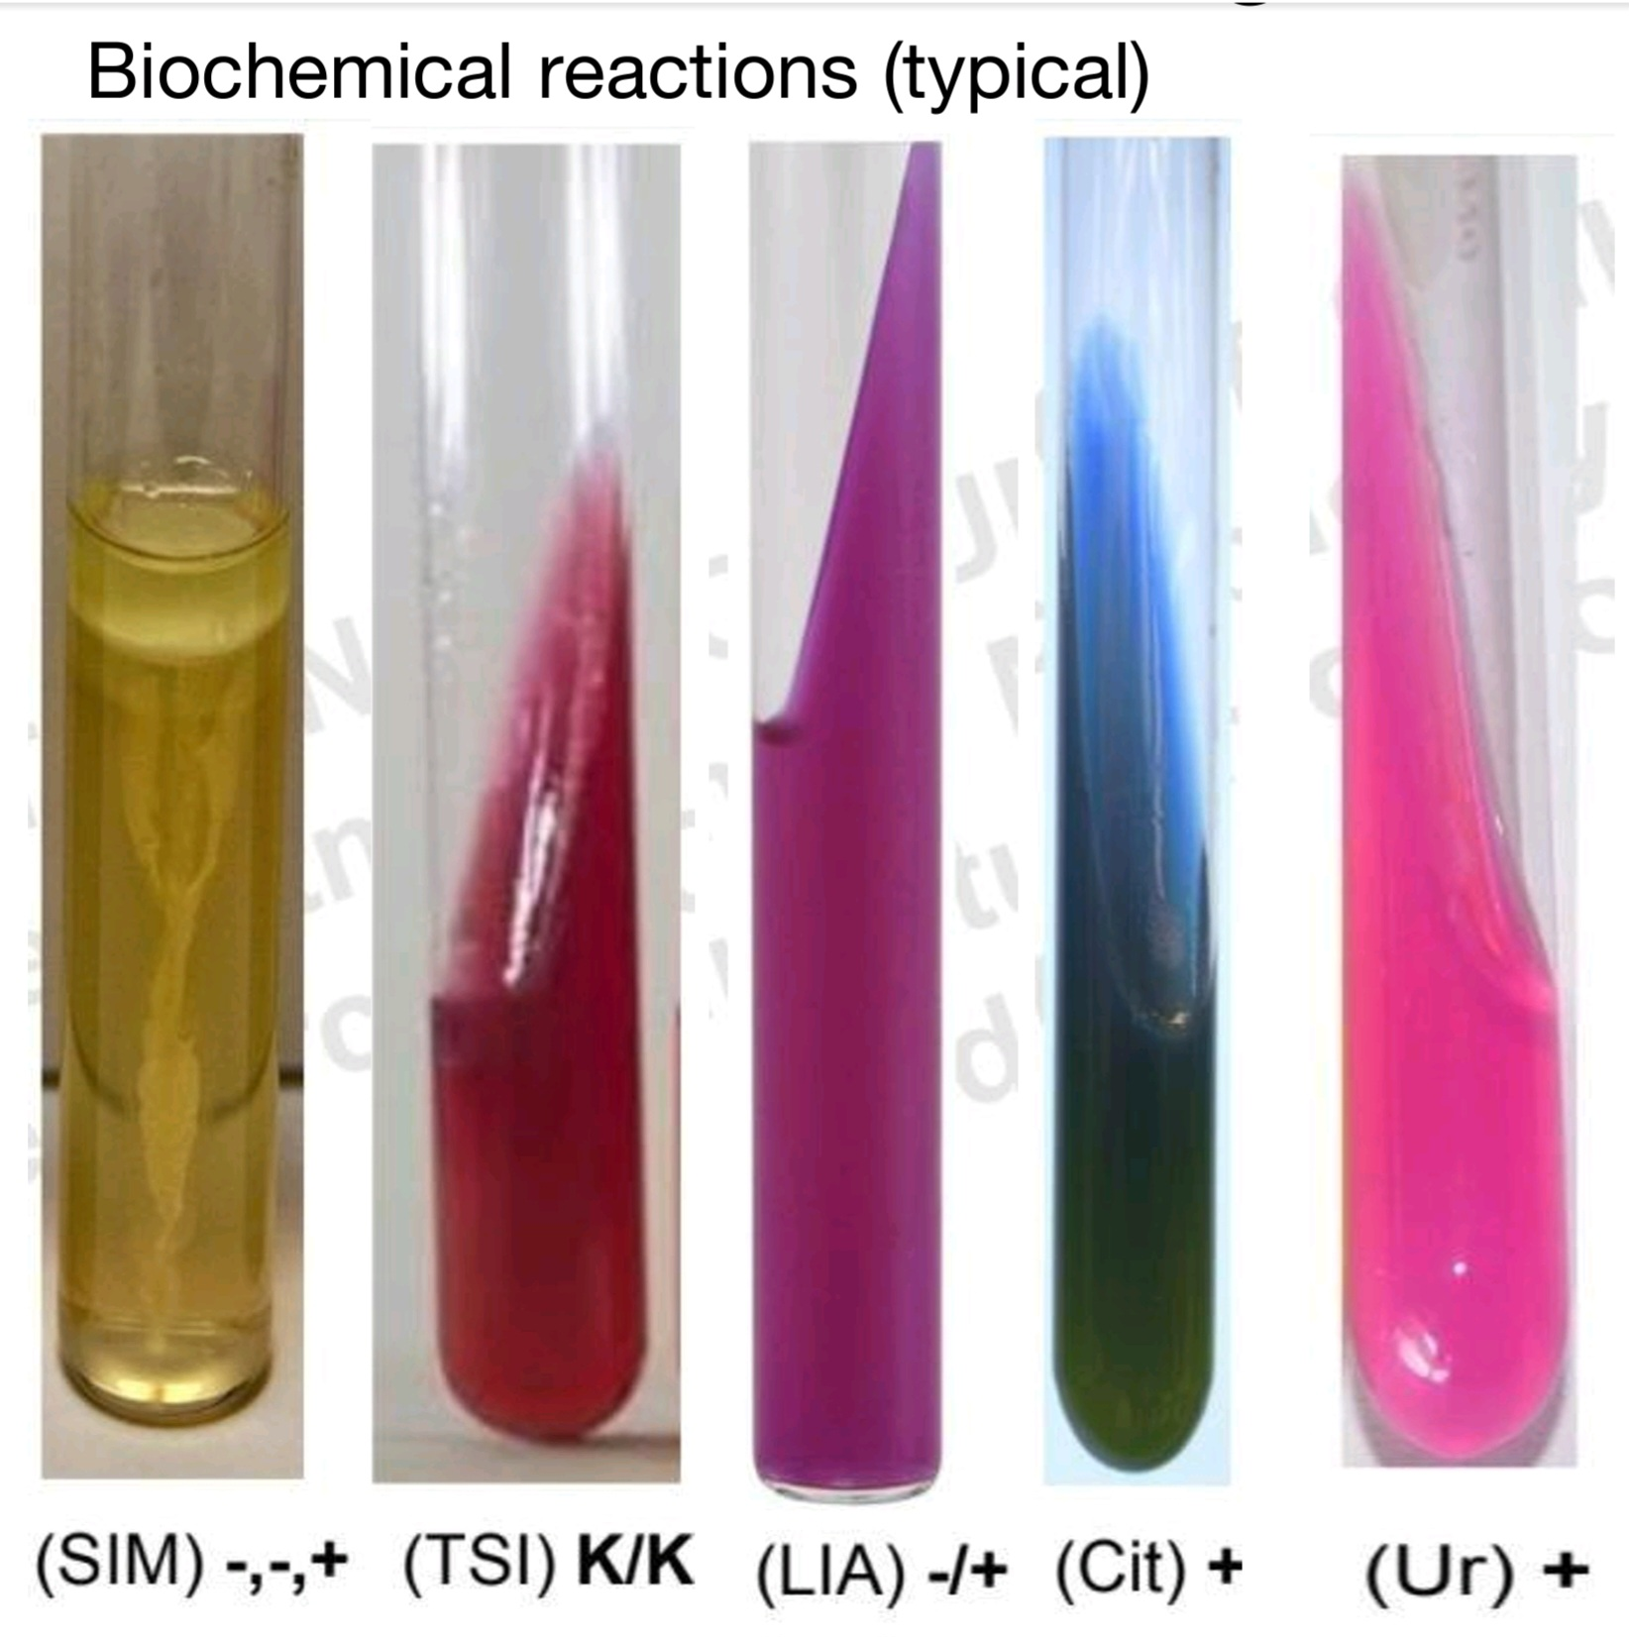
Pseudomonas aeruginosa
A convenient and reliable identification scheme for P. aeruginosa involves the following conventional tests and characteristics:
Oxidase-positive
Triple sugar iron slant with an alkaline/no change (K/NC) reaction

Slide 7
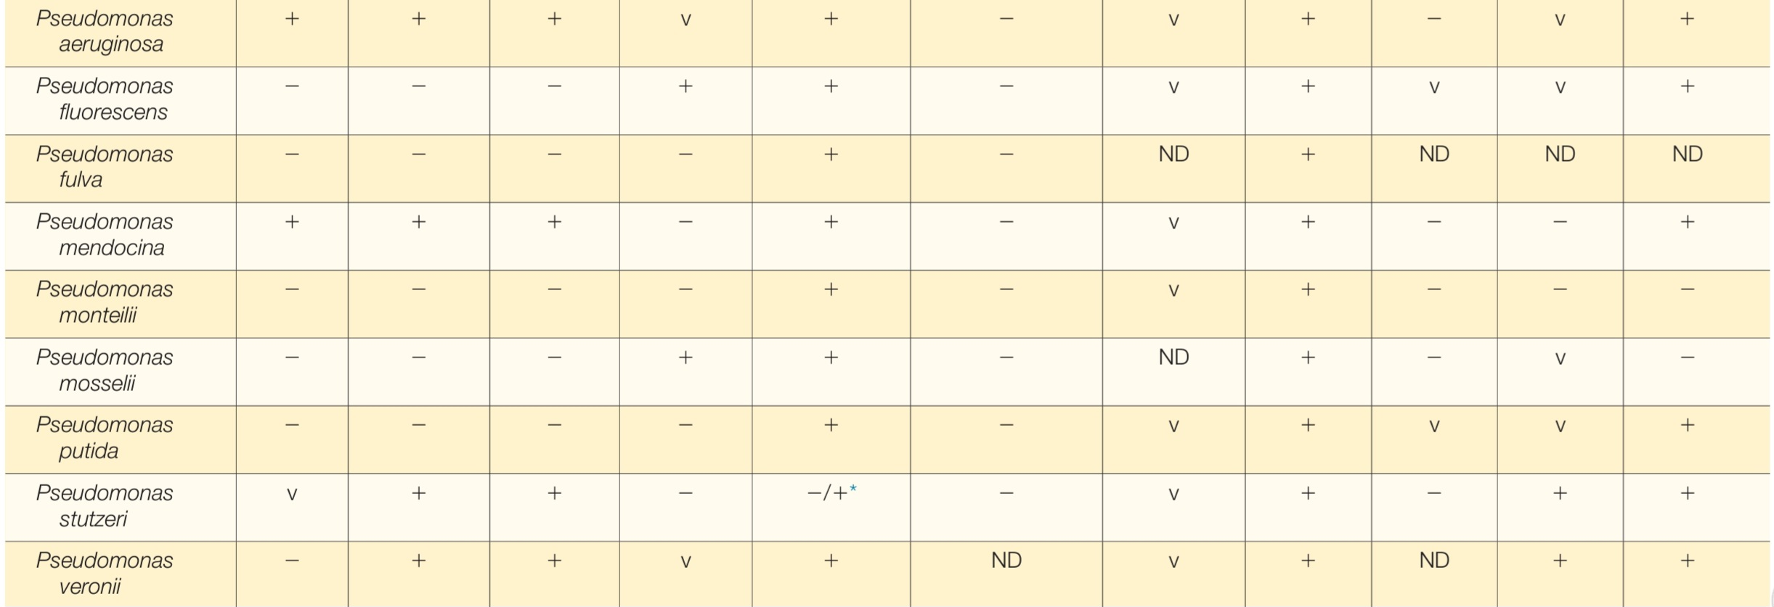

Slide 8
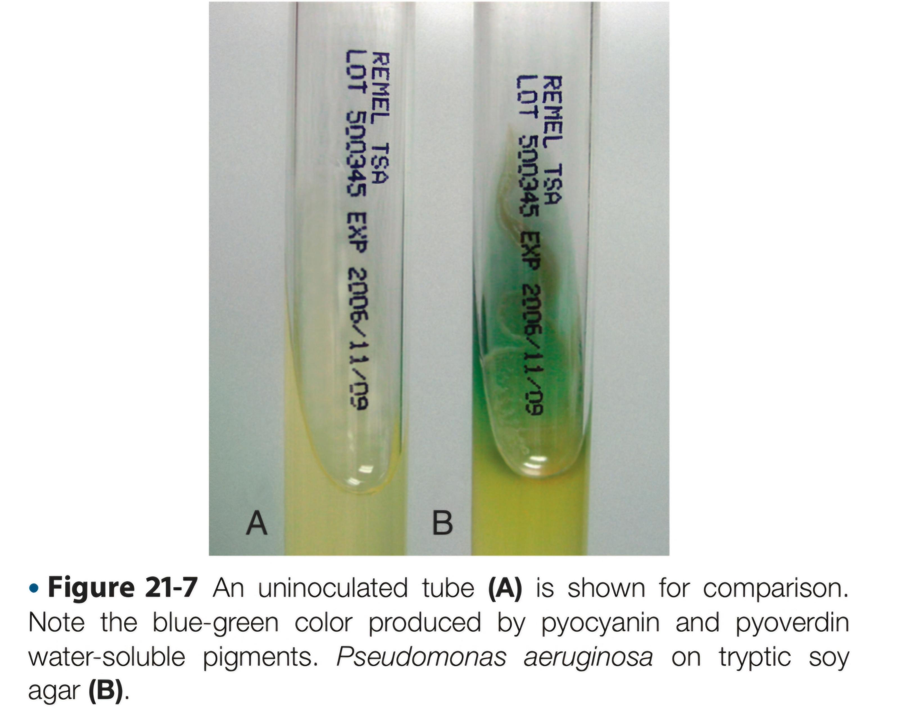
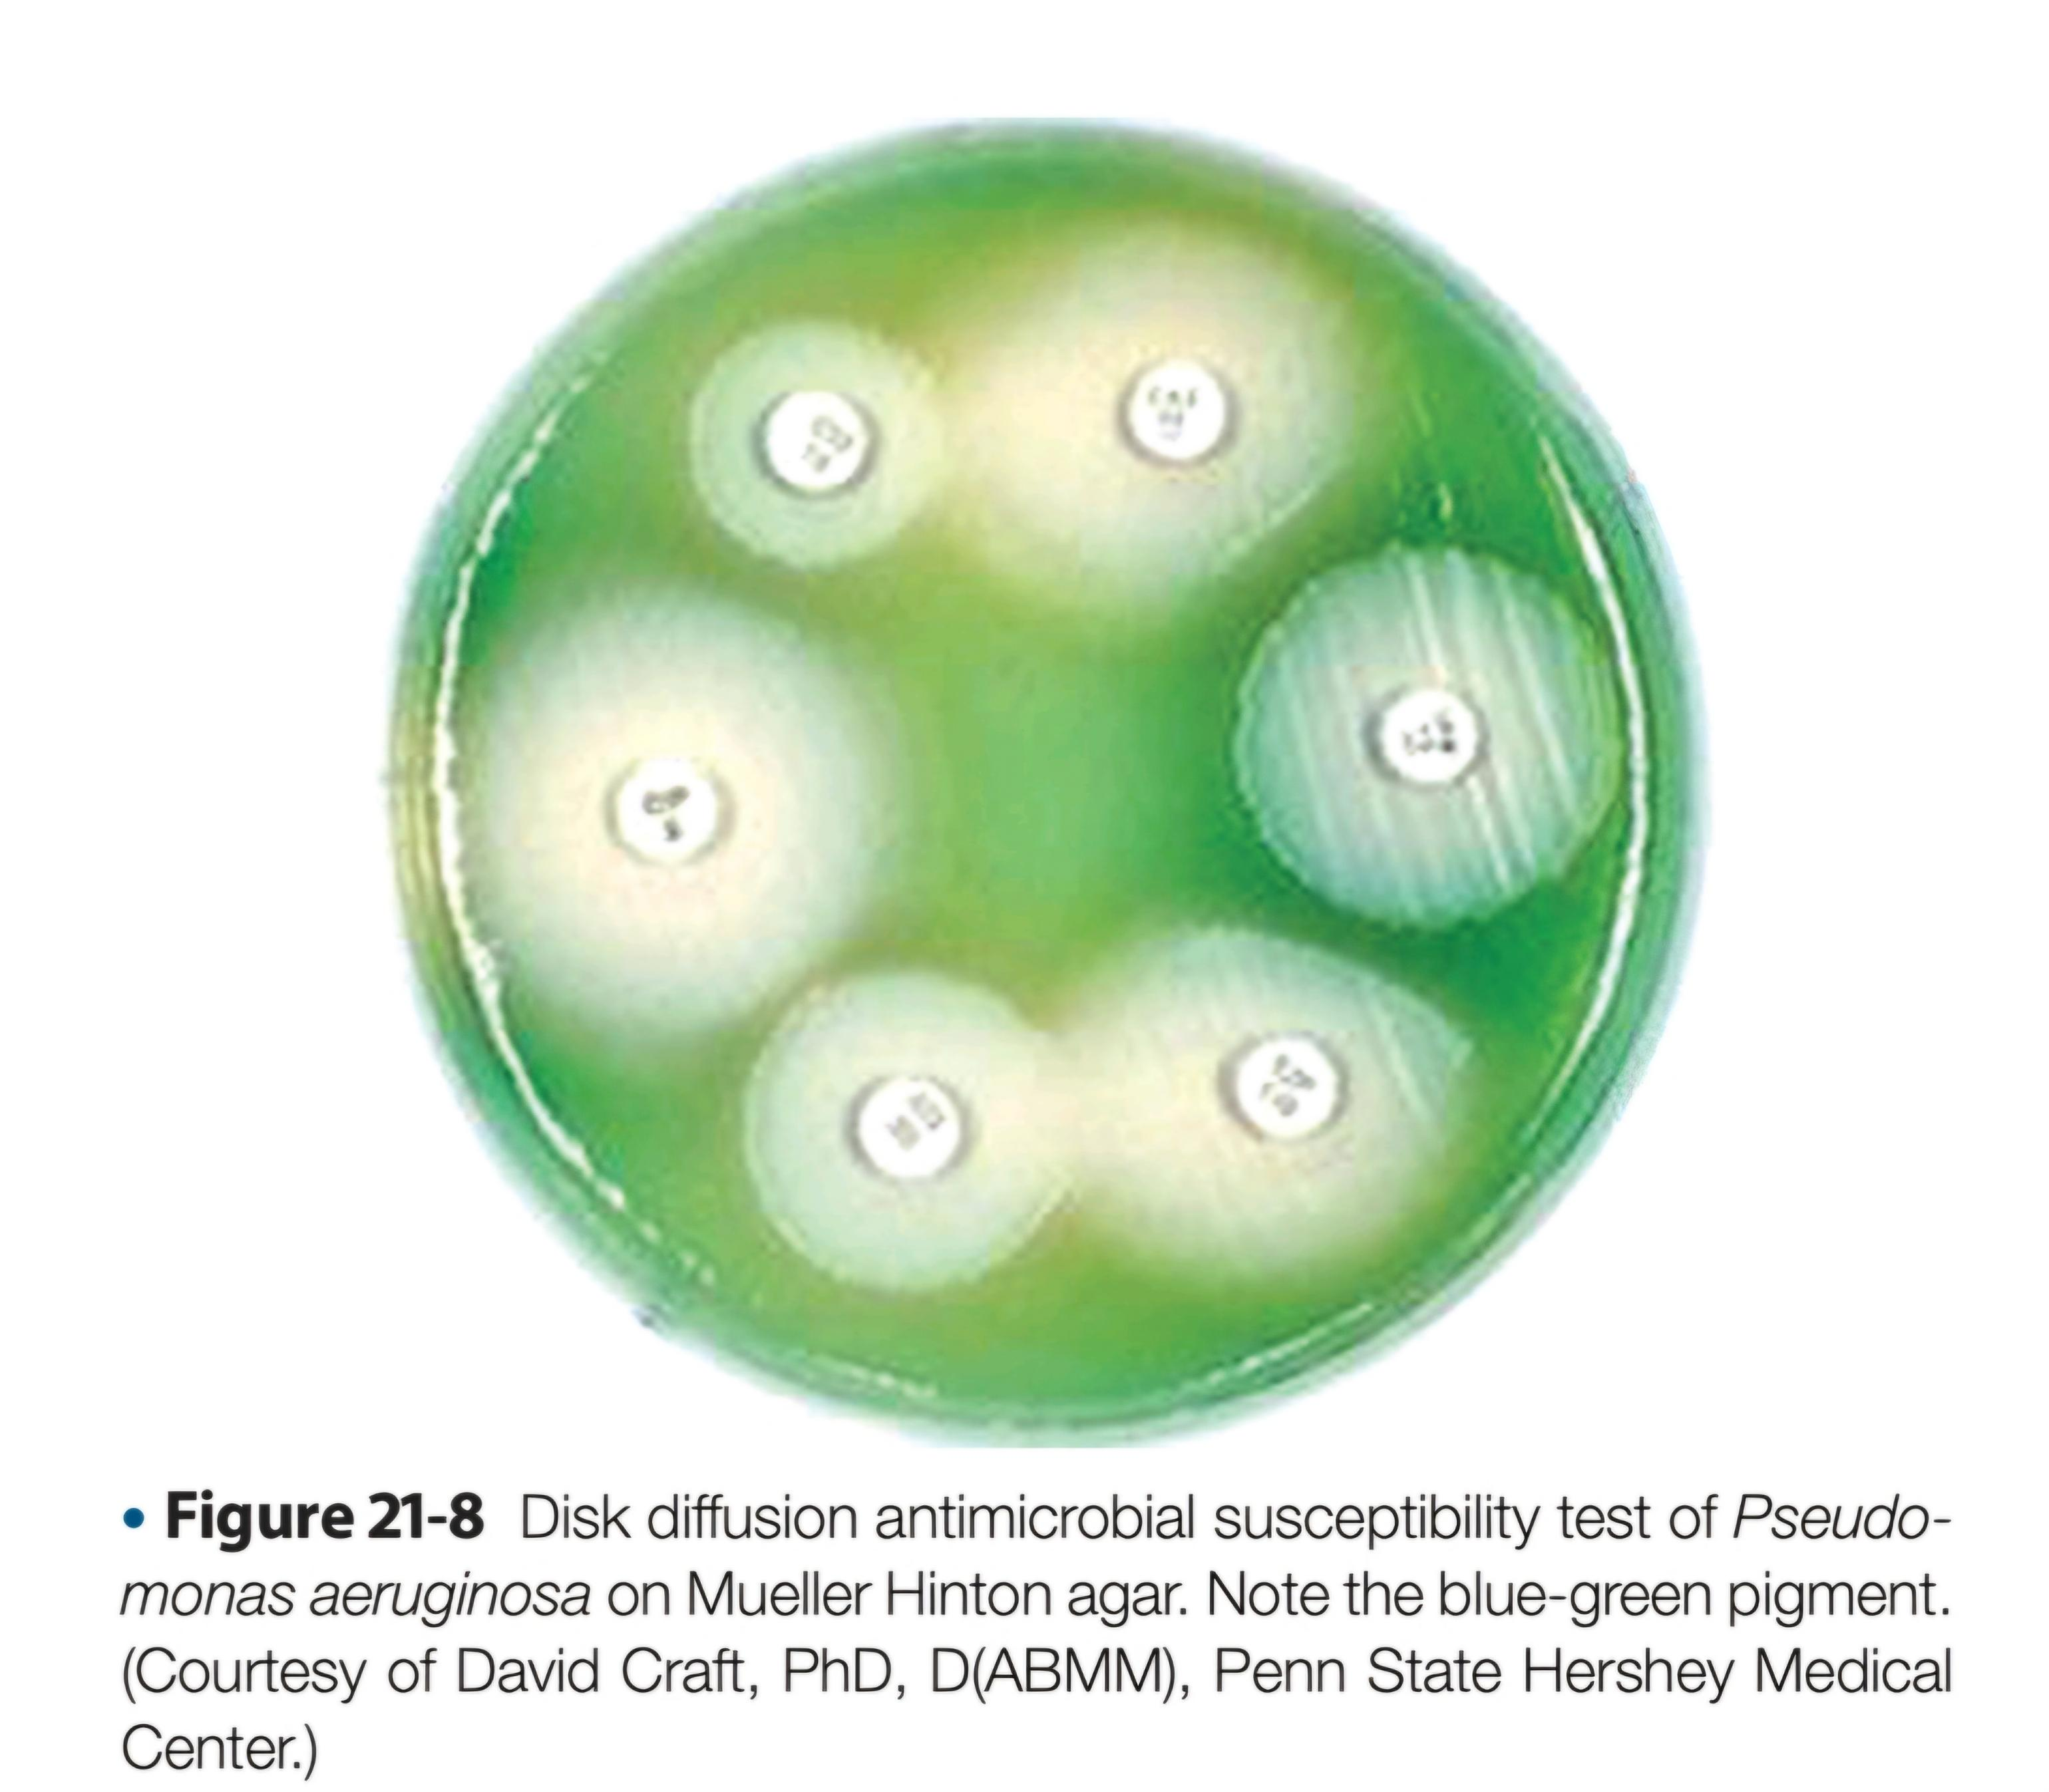
Pseudomonas aeuginosa
growth occurs in a variety of culture media, forming smooth round colonies with a characteristic grapelike or “corn-taco” odor and a green-blue coloration
  coloration is due to the production of pyocyanin (blue) and pyoverdin (green)
  Production of bright bluish (pyocyanin), green (pyoverdin), red (pyrorubrin), or brown (pyomelanin) diffusible pigment on Mueller-Hinton agar or trypticase soy agar

Slide 9
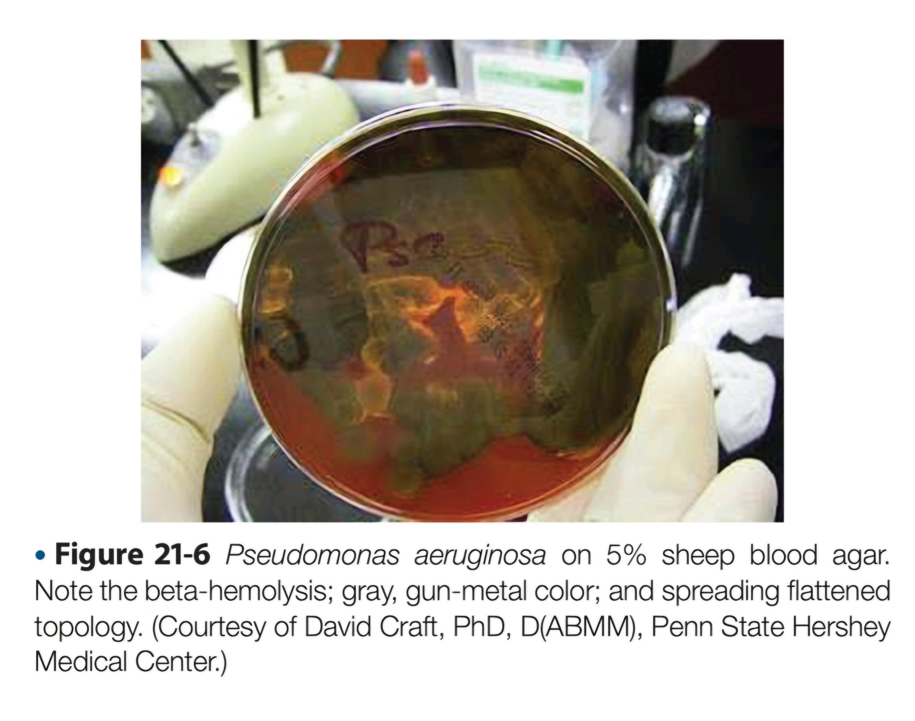
Pseudomonas aeruginosa
colonies have flat, spreading, serrated edges
may appear with metallic sheen
usually beta-hemolytic
non-lactose fermenter in MacConkey

Slide 10
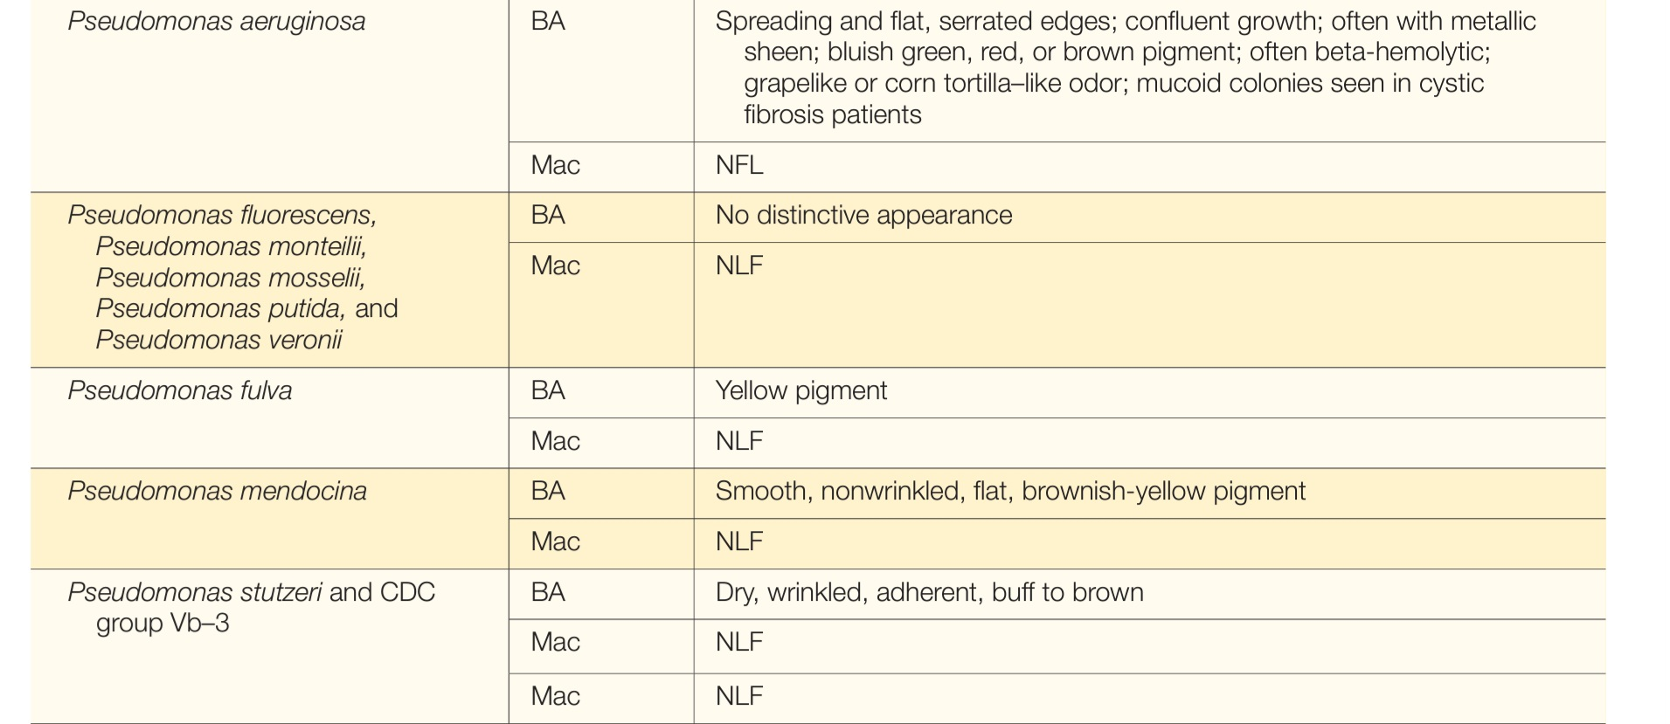

Slide 11
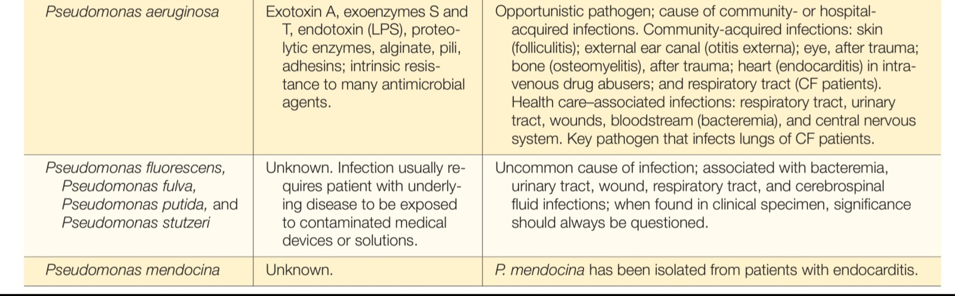

Slide 12

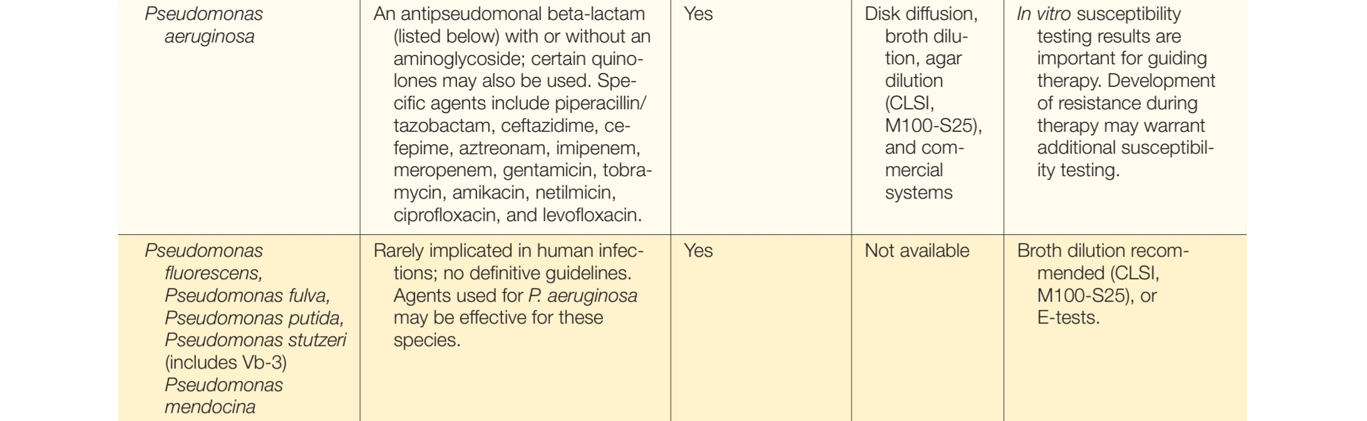

Slide 13
References
Mandell, Douglas & Bennett’s Principles and Practice of Infectious Diseases 9th Edition.
Bailey & Scott’s Diagnostic Microbiology 14th Edition

