Slide 1

Philippine Society for Microbiology & Infectious Diseases
Standing Committee on Training & Curriculum Development
Laboratory Module:
BACTERIOLOGY
Staphylococci
Notes:
Welcome to bacteriology laboratory module. In this part, we will focus on Staphylococci, and we will be exploring their characteristics, identification in the lab, and clinical relevance.

Slide 2
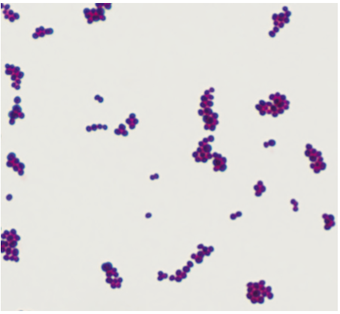
Staphylococci
GENERAL CHARACTERISTICS
Gram positive
Grapelike or cocci in clusters
Non-motile
Aerobic or facultative anaerobic
Resistant to heat, drying or high salt concentration
Catalase positive
Notes:
Staphylococci are gram-positive organisms, meaning they retain the crystal violet stain and appear purple under the microscope.
They characteristically appear in grape-like clusters, and are non-motile. They are either aerobic (requiring oxygen to grow) or facultative anaerobes, meaning they can grow with or without oxygen.
These bacteria are highly resistant to environmental stress. They can survive heat, drying, and even high salt concentrations, which allows them to persist in various environments—including on the skin.
Lastly, they are catalase-positive —a useful trait in distinguishing them from other genera, such as Streptococcus.

Slide 3
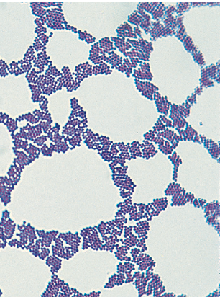
Staphylococcus spp. Identification
Microscopy
    Appear as gram (+) cocci
    Cells divide along multiple axes, which results in a cluster of cells
    GS should be performed on young cultures
        Very old cells may lose their ability to retain crystal violet and may appear gram-variable or gram-negative
Notes:
Under the microscope, Staphylococci appear as gram-positive cocci, usually in clusters.
During cell division, staphylococci divide along both longitudinal and horizontal planes, forming pairs, tetrads, and, ultimately, irregular clusters (as shown in the right side of the screen).
Gram stains should be performed on young cultures, because very old cells may lose their ability to retain crystal violet and may appear gram variable or gram negative.

Slide 4
Staphylococcus spp. Identification
Cultivation
    Grow well on 5% SBA and CAP
    Broth-blood culture systems
    Nutrient broth (thioglycollate, Dextrose, BHI)
    PEA (Phenyl ethyl Alcohol Agar)
    CNA (Columbia Colistin-Nalidixic Acid)
Notes:
Staphylococci grow well on 5% sheep blood and chocolate agars.
They also grow well in broth-blood culture systems and common nutrient broths, such as thioglycollate, dextrose, and brain-heart infusion broth.
Selective media can also be used to isolate staphylococci from clinical material. Phenylethyl alcohol (PEA) or Columbia colistin-nalidixic acid (CNA) agars may be used to eliminate contamination by gram-negative organisms in heavily contaminated specimens such as feces.

Slide 5
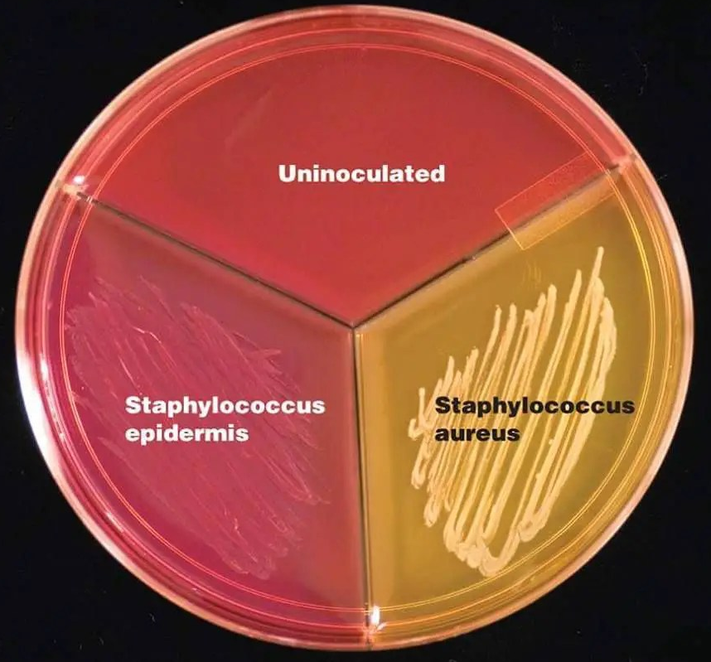
Staphylococcus spp. Identification
Cultivation
    MSA – (10% salt)
      high concentration of salt (10%)
      mannitol
      phenol red - pH indicator
      S. aureus ferments mannitol and produces a yellow halo on this media
Notes:
Mannitol salt agar may be used for this purpose.
This agar contains a high concentration of salt (10%), the sugar mannitol, and phenol red as the pH indicator. S. aureus ferments mannitol and produces a yellow halo on this media as a result of acid production altering the pH.
Although mannitol salt agar is not typically used in clinical identification, it may still be useful to purify staphylococci from contaminating organisms for further characterization.

Slide 6
Staphylococcus spp. Identification
Cultivation
    CHROM agar
        Selective and differential media for identification of MRSA (contains cefoxitin)
        (+) is mauve – colored colonies
Notes:
CHROMagar is a selective and differential media for the identification of MRSA.
These media are becoming more widely used for the direct detection of nasal colonization.
The medium is selective because it contains cefoxitin, and MRSA is resistant to this antibiotic.
The addition of chromogenic substrates hydrolyzed by the organisms produce a mauve-colored colony, allowing for the identification of the organisms.
Other organisms will hydrolyze various chromogenic substances within the media, resulting in a variety of colored colonies from white to blue to green

Slide 7
Staphylococcus spp. Identification
Incubation
    Grows on 5% sheep blood and chocolate agar
        Incubate at 35°C, in CO₂ or ambient air
        Visible growth in ~24 hours
    On mannitol salt agar or selective media:
        Slower growth – 48 to 72 hours
Notes:
Visible growth on 5% sheep blood and chocolate agars incubated at 35°C in carbon dioxide (CO2) or ambient air
usually occurs within 24 hours of inoculation.
Mannitol salt agar and other selective media may require incubation for at least 48 to 72 hours before growth is detected.

Slide 8
Staphylococcus spp. Identification
Automated machine may not correctly identify nutritionally variant forms such as small colony variants.
Follow up testing may be required for more specific identification of the isolates
Gram stains - used as the initial presumptive identification for gram-positive cocci
Notes:
Automated systems may not correctly identify nutritionally variant forms such as small colony variants and other unusual isolates, and therefore follow-up testing may be required for more specific identification of the isolates.
Gram stains are used in the clinical laboratory as the initial presumptive identification method for all gram-positive cocci.
Microscopic along with macroscopic colonial morphology provides a presumptive identification.

Slide 9
Staphylococcus spp. Identification
Gram-positive, catalase-positive, cocci
  Further ID includes:
      (1) Atmospheric requirements
      (2) Resistance to bacitracin (0.04 U) and furazolidone
      (3) Microdase test for cytochrome C
  Coagulase test:
      Differentiates S. aureus (positive) from coagulase-negative staphylococci (CoNS)
Notes:
Once an organism has been characterized as a gram-positive, catalase-positive, coccoid bacterium, complete identification may involve a series of tests, including (1) atmospheric requirements, (2) resistance to bacitracin and furazolidone, and (3) possession of cytochrome C as determined by the microdase test.
Once an isolate is identified as, or strongly suspected to be, a species of staphylococci, a test for coagulase production is performed to separate S. aureus from the other species collectively referred to as coagulase-negative staphylococci

Slide 10
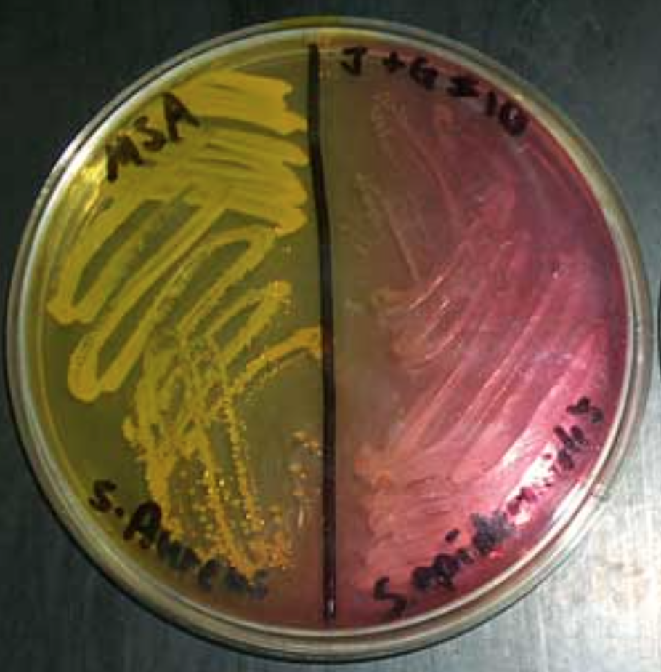
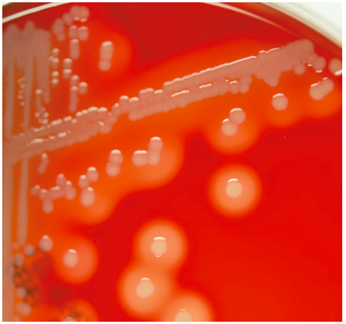
Staphylococcus aureus
Coagulase positive
Ferments glucose and mannitol (unlike S. epidermidis)
Gray to deep yellow colonies (due to carotenoid pigments) on nutrient agar
β-hemolytic
Notes:
Staphylococcus aureus harbors some unique features.
These include the production of coagulase, which can discriminate between coagulase-positive and coagulase-negative staphylococci.
Unlike staphylococcus epidermidis, staphylococcus aureus can ferment glucose and mannitol.
Colonies are grey to deep yellow in color on nutrient agar, and they are beta hemolytic.

Slide 11
S. aureus
Structural components
Capsule
inhibits phagocytosis and chemotaxis; facilitates attachment to synthetic materials
Protein A
  enhances affinity for IgG Fc receptor and prevents complement activation
Peptidoglycan
  for osmotic stability; stimulates production of endogenous pathogens; inhibits phagocytosis; activates complement, IL-1, chemotactic to PMNs
Teichoic acid
  species specific; mediate binding to fibronectin; regulates cationic concentration at the cell membrane
Notes:
"Let’s look at the key structural components of Staphylococcus aureus and their roles in virulence:
The capsule helps the bacteria evade phagocytosis and chemotaxis, and also adheres to synthetic surfaces, like medical implants.
Protein A binds to the Fc region of IgG, blocking complement activation and helping the organism avoid immune detection.
Peptidoglycan provides osmotic stability but also stimulates immune responses like IL-1 and complement activation, contributing to inflammation.
Lastly, teichoic acids are species-specific, help bind to host fibronectin, and regulate cationic concentration at the cell membrane.
These structures are essential to the survival and pathogenicity of S. aureus.

Slide 12
S. aureus
Toxins:
1. Cytotoxin – cytolytic or membrane-damaging toxins
  Alpha – disrupts the smooth muscle in the blood vessels
  Beta – cell lysis
  Delta – cytolytic to erythrocytes
Notes:
Staphylococcus aureus produces a variety of cytotoxins that damage host cells.
The alpha toxin disrupts smooth muscle in blood vessels, contributing to tissue damage and inflammation.
Beta toxin is responsible for direct cell lysis, while delta toxin is cytolytic to erythrocytes, contributing to hemolysis.

Slide 13
S. aureus
2. Exotoxins:
  Leukocidins (e.g. Panton-Valentine Leukocidin) – β-pore forming toxin, associated with Community-Acquired MRSA
  Exfoliative Toxins – cause desquamation; production of serine protease (able to split the intercellular bridge of the stratum granulosum for epidermolysis)
  Toxic Shock Syndrome Toxin (TSST-1) – pyrogenic exotoxin C; associated with tampon use or wound infection
  Enterotoxins – heat stable; unaffected by gastrointestinal enzymes; causes food poisoning
Notes:
S. aureus also releases potent exotoxins.
Leukocidins (such as Panton-Valentine leucocidin) is a Beta-pore-forming toxin. This is commonly associated with Community-Acquired MRSA.
Exfoliative toxins are serine proteases that split the skin's stratum granulosum, leading to peeling or desquamation—seen in conditions like scalded skin syndrome.
TSST-1, or toxic shock syndrome toxin, is a pyrogenic exotoxin often linked to tampon use or wound infections.
Enterotoxins are heat-stable and resist digestion, making them the primary cause of staphylococcal food poisoning.

Slide 14
S. aureus
Enzymes:
Catalase – Breaks down hydrogen peroxide
Coagulase – binds to prothrombin; distinguishes S. aureus
Hyaluronidase
Fibrinolysin
Lipase
Nuclease
Penicillinase
Notes:
S. aureus also secretes enzymes that enhance its ability to invade and persist in host tissues.
It produces catalase, which converts hydrogen peroxide into water and oxygen, allowing the organism to evade oxidative killing by phagocytes.
It also produces coagulase, an enzyme-like protein that clots oxalated or citrated plasma. Coagulase binds to prothrombin; together they become enzymatically active and initiate fibrin polymerization. Coagulase may deposit fibrin on the surface of staphylococci, perhaps altering their ingestion by phagocytic cells or their destruction within such cells. Coagulase production is considered synonymous with invasive pathogenic potential.
Hyaluronidase and fibrinolysin aid tissue penetration and spread.
Lipase and nuclease support infection by breaking down host cell components, while penicillinase gives S. aureus resistance to penicillin by disrupting the β-lactam ring.

Slide 15
Clinical Conditions
CLINICAL CONDITION | Mechanism (Pathophysiology) | Clinical Features | Key Diagnostic Features | Management
Staphylococcal Food Poisoning | Ingestion of preformed S. aureus enterotoxins (superantigens) → stimulates gut receptors → vomiting/diarrhea | Rapid-onset nausea, vomiting, diarrhea (1–6 hours) | Rapid onset after contaminated food (e.g., creamy dishes) | Supportive; self-limited
SSSS (Staphylococcal Scalded Skin Syndrome) | Exfoliative toxins A/B cleave desmoglein-1 in epidermis → intraepidermal splitting | Blistering skin, positive Nikolsky sign | Fragile blisters, superficial peeling, especially in infants/children | Supportive care; resolves in 4–5 days
TSS (Toxic Shock Syndrome); Menstrual and Non-menstrual | TSST-1 or enterotoxins act as superantigens → massive T-cell activation → cytokine storm | Fever, rash, desquamation, hypotension | Negative cultures (toxin-mediated); multisystem involvement | Supportive, remove focus, antibiotics
Notes:
This summary table shows the clinical conditions associated with Staphylococcus aureus, which range from mild skin infections to life-threatening sepsis and endocarditis. Knowing the mechanisms, clinical clues, key diagnostics, and treatment approaches is essential for managing patients effectively.
Staphylococcal food poisoning results from ingesting preformed enterotoxins produced by S. aureus. These heat-stable toxins cause rapid-onset nausea, vomiting, and diarrhea within 1–6 hours of consuming contaminated food, such as mayonnaise-based dishes, ham, or cream-filled pastries. The illness is self-limited and resolves with supportive care.
SSSS, or Ritter disease, is caused by S. aureus strains producing exfoliative toxins (ETA/ETB) that cleave desmoglein-1 in the epidermis. It presents with superficial blistering and a scalded appearance of the skin, primarily affecting infants and young children. A positive Nikolsky sign is characteristic. Despite dramatic presentation, it resolves within 4–5 days with supportive care.
TSS is caused by TSST-1 or enterotoxins produced by S. aureus, leading to massive cytokine release. There are 2 main types of TSS – Menstrual and Nonmenstrual TSS. Menstrual TSS is linked to tampon use and presents with high fever, hypotension, rash, and desquamation. Nonmenstrual TSS can arise from surgical wounds or chronic infections, presenting similarly with systemic involvement. Blood cultures are usually negative, and management includes supportive care and antibiotics.

Slide 16
CLINICAL CONDITION | Mechanism (Pathophysiology) | Clinical Features | Key Diagnostic Features | Management
Impetigo | Exfoliative toxins disrupt keratinocyte adhesion (desmoglein-1) → localized epidermal infection | Honey-colored crusts, vesicles/pustules | Classic appearance in children | Topical antibiotics, hygiene
Folliculitis | S. aureus infects hair follicles → localized inflammation | Pustules at follicles, mild erythema; Sycosis barbae | Superficial skin infection | Local antiseptics, hygiene
Furuncles (boils); Carbuncles | Deep follicular infection → abscess formation; carbuncles involve multiple follicles | Painful nodules with central necrosis, systemic symptoms (carbuncles) | Centered necrosis, may drain pus | Drainage, systemic antibiotics if needed
Hidradenitis Suppurativa | Chronic occlusion of apocrine glands → secondary bacterial infection (S. aureus) | Recurrent furuncles in axillae/groin | Hypertrophic scarring post-drainage | Local care, hygiene
Mastitis | Milk stasis and ductal blockage → secondary S. aureus infection | Breast tenderness, fever, malaise (puerperium) | Clinical; during lactation | Analgesics, continued breastfeeding, antibiotics if needed
Notes:
Impetigo is a superficial epidermal infection caused by S. aureus that leads to honey-colored crusted lesions, primarily in children. It begins as macules evolving into vesicles or pustules, often in areas of broken skin. Topical antibiotics and hygiene are typically sufficient for treatment.
Folliculitis is a superficial infection of hair follicles, presenting as small, red, pus-filled bumps with mild tenderness. It often arises in areas prone to friction or moisture and is treated with local antiseptics. In men, recurrent cases in the beard area are called sycosis barbae.
Furuncles (boils) are deep infections of hair follicles, while Carbuncles are interconnected furuncles with systemic symptoms like fever. They present as painful, indurated nodules with central necrosis and pus. They often occur in hairy areas (like the neck and thighs). Management involves drainage and antibiotics if systemic signs are present.
Hidradenitis suppurativa is a chronic infection of apocrine sweat glands, presenting as recurrent, painful furuncles in areas like the axillae and groin. Lesions drain spontaneously and heal with hypertrophic scarring. Management includes local care, hygiene, and sometimes long-term antibiotics.
Mastitis is an infection of the breast tissue, often occurring during breastfeeding due to milk stasis and ductal obstruction. It presents with localized breast tenderness, redness, swelling, and systemic symptoms like fever. Treatment includes continued breastfeeding, analgesics, and antibiotics if necessary.

Slide 17
CLINICAL CONDITION | Mechanism (Pathophysiology) | Clinical Features | Key Diagnostic Features | Management
Erysipelas | S. aureus invade upper dermis/lymphatics → acute inflammation | Tender, bright red, sharply demarcated plaque | Localized infection with systemic symptoms | Oral/IV antibiotics
Cellulitis | Bacterial invasion of deep dermis/subcutis → spreading inflammation | Red, warm, tender swelling; may progress to necrosis or bullae | Severe cases show violaceous discoloration, anesthesia | Empiric antibiotics; blood cultures if systemic
Necrotizing Fasciitis | Rapid spread of bacteria (often S. aureus, anaerobes) in fascial planes → ischemia, necrosis | Severe pain, crepitus, bullae, systemic toxicity | Wooden-hard tissue, rapid progression | Emergency debridement, IV antibiotics
SSI (Surgical Site Infection) | Bacterial contamination (often endogenous S. aureus) at incision site → local inflammation | Erythema, edema, fever at surgical site | Timing (≤30 days; ≤90 if implant); nasal carriage risk | Drainage if superficial; IV antibiotics for deep infections
Notes:
Erysipelas is a superficial skin infection of the upper dermis and lymphatics. It presents as a bright red, tender, sharply demarcated plaque with systemic symptoms. Treatment involves oral or IV antibiotics.
Cellulitis is an infection of the deep dermis and subcutaneous tissue, presenting with warm, red, tender swelling that may progress to necrosis or bullae. Severe cases can show violaceous discoloration or anesthesia. Management includes empiric antibiotics and blood cultures if systemic signs are present.
Necrotizing fasciitis is life-threatening infection involves rapid spread of S. aureus and anaerobes in fascial planes, causing tissue ischemia and necrosis. Clinical features include severe pain, crepitus, bullae, and systemic toxicity. Immediate surgical debridement and IV antibiotics are crucial for management.
Surgical site infections occur due to S. aureus contamination during surgery, presenting with localized erythema, edema, and sometimes fever at the incision site. Early identification and drainage, along with targeted antibiotics, are essential for management, especially in deep infections.

Slide 18
CLINICAL CONDITION | Mechanism (Pathophysiology) | Clinical Features | Key Diagnostic Features | Management
Bloodstream Infections (BSIs) | Direct entry of bacteria (S. aureus) into blood → bacteremia, possible seeding of distant sites | Fever, chills, hypotension; from catheters, wounds, etc. | Positive blood cultures; nosocomial vs. community onset | Remove source, targeted antibiotics
Infective Endocarditis (IE) | Bacteremia → colonization of valves/prostheses → vegetation formation (fibrin, platelets, bacteria) | Fever, murmur, embolic signs (Janeway lesions, CNS) | TEE; new murmur; blood cultures | IV antibiotics; surgery if needed
Pneumonia (S. aureus) | Airborne/aspiration or hematogenous seeding → necrotizing pneumonia (tissue destruction, cavitation) | Rapid-onset pneumonia, hemoptysis, high CRP, leukopenia | Multilobar cavitating infiltrates; preceding flu-like illness | Vancomycin/Linezolid; adjust duration per severity
Acute Osteomyelitis | Hematogenous spread of bacteria to bone → acute infection with inflammatory response | High fever, localized bone pain/swelling | Bone probe, imaging, biopsy | IV antibiotics (4–6 wks); cultures to guide
Chronic Osteomyelitis | Chronic infection with necrosis, sequestra, fistulas (often post-acute or contiguous spread) | Low-grade inflammation, recurrent drainage | Deep tissue cultures, imaging | Long-term antibiotics; surgery if needed
Notes:
Bloodstream infections result from S. aureus entering the bloodstream, often via catheters or wounds. Patients present with fever, chills, and hypotension. Diagnosis involves blood cultures, and management focuses on removing the source and providing targeted antibiotics.
Infective endocarditis involves S. aureus bacteremia seeding cardiac valves, leading to vegetation formation. Patients exhibit fever, murmurs, embolic signs, and systemic symptoms. Diagnosis is via TEE and blood cultures. Treatment includes prolonged IV antibiotics and surgery if warranted.
S. aureus pneumonia can result from aspiration, airborne spread, or hematogenous seeding, often following influenza virus infection. It presents with rapid-onset pneumonia, hemoptysis, leukopenia, and cavitary infiltrates. Management includes IV vancomycin or linezolid.
Acute osteomyelitis is caused by hematogenous spread of S. aureus to bone, resulting in high fever and localized pain. Diagnosis involves imaging, biopsy, and cultures. Management requires IV antibiotics for 4–6 weeks, guided by culture results.
Chronic osteomyelitis arises from unresolved acute infection or contiguous spread, featuring persistent drainage and low-grade inflammation. Imaging and deep tissue cultures confirm diagnosis. Long-term antibiotics and surgery may be needed.

Slide 19
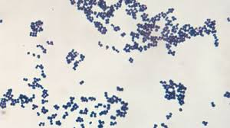
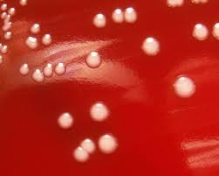

Staphylococcus epidermidis
Coagulase-negative, gram-positive cocci
Catalase-positive and facultative anaerobe
Colonies:
  Blood Agar: Gray to white colonies
  Mannitol Sugar Agar: red or pink
  Columbia CNA Agar: White or off white
Pyrrolidonyl Aminopeptidase positive
Novobiocin susceptible
Alkaline phosphatase negative
Most common CONS species live on human skin
Notes:
Staphylococcus epidermidis is a coagulase-negative, gram-positive cocci that form clusters. It is also catalase-positive and a facultative anaerobe.
They form gray to white colonies on blood agar. S. epidermidis grows on Mannitol Sugar Agar but does not ferment mannitol, so the colonies remains red or pink. Columbia CNA agar is a selective medium that inhibits Gram-negative bacteria, allowing Gram-positive bacteria like S. epidermidis to grow. S. epidermidis colonies on CNA agar typically appear white or off-white.
They are positive for Pyrrolidonyl Aminopeptidase and they are Novobiocin susceptible and Negative for Alkaline phosphatase
They are the most common coagulase-negative Staphylococcus species that live on the human skin.

Slide 20
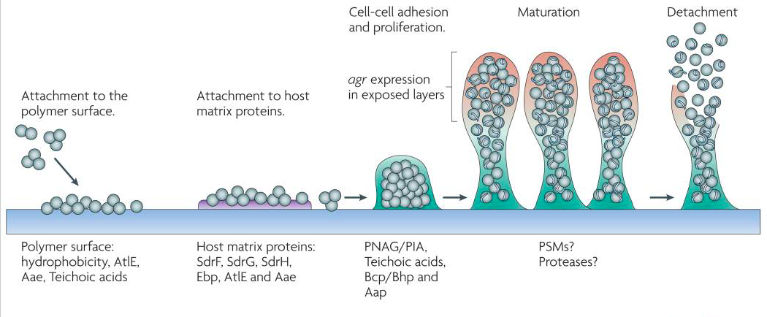
Virulence
Notes:
For the Virulence of Staphylococcus epidermidis, Biofilm formation proceeds via initial adhesion and subsequent aggregation into multicellular structures. Thus, the development of a biofilm requires adhesive forces for the colonization of surfaces and the interaction of cells among each other. Disruptive forces are needed for the formation of fluid-filled channels that are important for nutrient delivery to all biofilm cells and give the mature biofilm its typical three-dimensional structure.
Attachment to uncoated material is mainly dependent on cell surface hydrophobicity, while dedicated surface proteins mediate adhesion to host matrix-covered devices. Afterwards, exopolysaccharide, specific proteins, and accessory macromolecules provide intercellular aggregation. Mechanisms of biofilm maturation, structuring, and detachment are poorly understood, but possibly involve quorum-sensing controlled expression of detergent-like peptides and proteolytic activity in exposed layers of the biofilm. Genome-wide gene expression is significantly different in the biofilm compared to the planktonic mode of growth and includes down-regulation of basic cell processes.

Slide 21
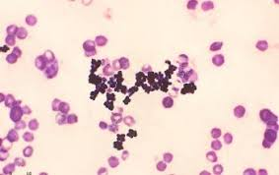
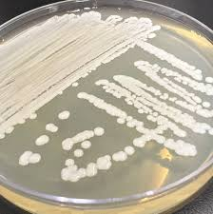
Staphylococcus haemolyticus
Gram-positive, coccus-shaped bacterium
non-motile, non-sporulating, and facultatively anaerobic
Colonies: white, circular, convex and opaque, non hemolytic
part of the human skin flora
Opportunistic Pathogen
Antibiotic Resistance
Ability to form Biofilm
Notes:
S. haemolyticus is a Gram-positive, coccus-shaped bacterium, and it is non-motile, non-sporulating, and facultatively anaerobic.
On blood agar, S. haemolyticus colonies typically exhibit the following characteristics: White in color, Circular, convex, and opaque in shape and are Non-hemolytic, meaning they do not break down red blood cells.
Staphylococcus haemolyticus is a coagulase-negative staphylococcus (CoNS) species that is commonly found as part of the human skin flora, particularly in areas like the axillae, perineum, and inguinal areas.
It can cause infections, especially in individuals with weakened immune systems or those with medical devices
Clinical isolates of S. haemolyticus are often multidrug-resistant, meaning they are resistant to multiple antibiotics.
S. haemolyticus has the ability to form biofilms, which can help it colonize medical devices and contribute to infections.

Slide 22
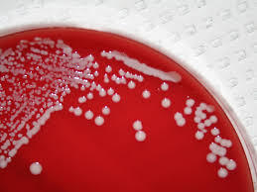
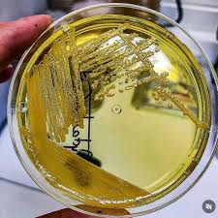
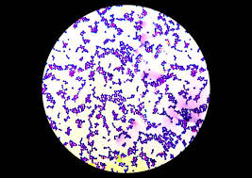
Staphylococcus saprophyticus
Round, gram-positive, non-motile cocci
round, convex, smooth, and shiny opaque colonies, lacking surrounding hemolysis.
Catalase-positive, coagulase-negative
Novobiocin-resistant
Facultative anaerobe
Urease-positive
Notes:
S. saprophyticus are round, gram-positive bacteria that typically appear as single cells, in pairs, or in clusters.
S. saprophyticus typically produces round, convex, smooth, and shiny opaque colonies, often lacking surrounding hemolysis.
It produce catalase, an enzyme that converts hydrogen peroxide to water and oxygen, and does not produce coagulase, an enzyme that clots plasma
They are resistant to novobiocin, a key characteristic for differentiating it from other coagulase-negative staphylococci. This resistance is linked to mutations in the gyrB gene, specifically altering amino acid residues near the ATP-binding pocket of the GyrB protein.
S. saprophyticus can grow with or without oxygen, making it a facultative anaerobe.
S. saprophyticus produces urease, an enzyme that breaks down urea into ammonia and carbon dioxide.

Slide 23
Staphylococcus saprophyticus
Colonizes the rectum and urogenital tracts (5 to 10% of women)
Uncomplicated UTI in young, sexually active women
  Dysuria, Frequency, urgency, pyuria, hematuria
Adhesion protein (UafA)
  Adhere to human uroepithelial cells and mediates hemagglutination
Urease – promotes proliferation in the urine
Notes:
Staphylococcus saprophyticus is a frequent causative cause of uncomplicated urinary tract infection in young sexually active women.
It may present as dysuria, frequency, urgency, hematuria, or pyuria.
It possessed unique adhesion protein, which allows it to adhere to human uroepithelial cells and mediates hemagglutination. .
This bacterium also encodes several transport proteins that enables it to adjust rapidly to osmotic and PH changes and it also produces abundant UREASE, allowing it to proliferate in urine.

Slide 24
Pathogenesis and Spectrum of Disease
Organism | Virulence Factors | Spectrum of Diseases and Infections
Staphylococcus epidermidis | Exopolysaccharide “slime” or biofilm; antiphagocytic Exotoxins: delta toxin | Normal flora; nosocomial infections: bacteremia associated with indwelling vascular catheters; endocarditis involving prosthetic cardiac valves (rarely involves native valves); infection at intravascular catheter sites, commonly leading to bacteremia; and other infections associated with CSF shunts, prosthetic joints, vascular grafts, postsurgical ocular infections, and bacteremia in neonates under intensive care
Staphylococcus haemolyticus | Uncertain; probably similar to those described for S. epidermidis | Endocarditis, Bacteremia, Peritonitis, Urinary tract Wound, bone, and joint infections
Staphylococcus saprophyticus | Uncertain | Urinary tract infections in sexually active, young women; infections in sites outside urinary tract are not common
Notes:
This table summarizes the clinical conditions associated with Coagulase negative Staphylococci.
S. epidermidis is the most commonly encountered, are substantially less virulent than S. aureus and are opportunistic pathogens. Their prevalence as health care–associated pathogens are related to medical procedures and practices than to the organism’s capacity to establish an infection. Infections with S. epidermidis and, less commonly, S. haemolyticus, usually involve implantation of medical devices. This kind of medical intervention improves the ability of these normally noninvasive organisms to cause infection. Two organism characteristics that enhance the likelihood of infection include production of a slime layer or biofilm, facilitating attachment to implanted medical devices, and the ability to acquire resistance to most of the antimicrobial agents used in health care environments.
Although most coagulase-negative staphylococci are primarily associated with health care–associated infections (HAIs), urinary tract infections caused by S. saprophyticus are clear exceptions. This organism is most frequently asso- ciated with community-acquired urinary tract infections in young, sexually active females but is not commonly associated with HAIs or any infections at non–urinary tract sites. It is the second most common (after Escherichia coli) as the cause of urinary tract infections in young females.

Slide 25
Appearance and Characteristics in 5% Sheep Blood Agar
ORGANISM | APPEARANCE
S. aureus | Medium to large (0.5-1.5ųm); smooth, entire; slightly raised; low convex; opaque; most colonies pigmented creamy yellow; most colonies Beta Hemolytic
S. epidermidis | Small to medium; opaque; gray-white colonies; most colonies non-hemolytic; slime- producing strains are extremely sticky and adhere to the agar surface.
S. saprophyticus | Large, entire, very glossy, smooth, opaque, butyrous, convex, usually white but colonies can be yellow to orange.
Staphylococcus haemolyticus | Medium; smooth, butyrous, and opaque; beta-hemolytic
S. lugdunensis | Medium to large; smooth; glossy; entire edge with slightly domed center; unpigmented or cream to yellow-orange, may be Beta Hemolytic
S. schleiferi | Medium to large, smooth, glossy, slightly convex with entire edges, unpigmented
Notes:
This table describes the colonial appearance and other distinguishing characteristics of various staphylococcal species on 5% sheep blood agar. Let me highlight those organism mentioned in this module.
For Staphylococcus aureus are Medium to large around 0.5-1.5ųm; are smooth, entire; slightly raised; low convex; opaque; most colonies are pigmented creamy yellow and are Beta Hemolytic
Staph epidermidis – are Small to medium; opaque; gray; white colonies; most colonies are non-hemolytic; slime- producing strains are extremely sticky and adhere to the agar surface.
Staph saprophyticus – are Large, very glossy, smooth, opaque, butyrous, convex, usually white but colonies can be yellow to orange.
For Staphylococcus haemolyticus - Medium; smooth, butyrous, and opaque; and most colonies are beta-hemolytic

Slide 26
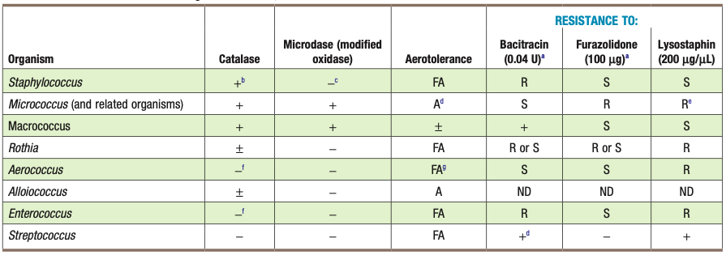
Notes:
This table shows the differentiation among Gram positive, Catalase positive cocci.
The Catalase Test demonstrates the presence of Catalase, which is an enzyme that catalyzes the release of oxygen from hydrogen peroxide. This differentiates those bacteria that produces catalase which is staphylococci from non producing bacteria such as streptococci.
The microdase test is the rapid method to differentiate staphylococcus from micrococcus specie by detection of the enzyme oxidase.
Bacitracin sensitivity test is used to distinguish staphylococci specie, which are resistant to Bacitracin and micrococci specie which are susceptible to bacitracin. It is also used for presumptive identification and differentiation of Beta Hemolytic group A streptococci from other beta hemolytic streptococci.
FURAZOLIDONE, this test is performed as a disk susceptibility procedure. It is one of the commonly used methods for the differentiation of staphylococci from micrococci. Staphylococci are inhibited by furazolidone, but micrococci and related specie are resistant.
Lysostaphin test skin is recommended for use in qualitative procedures to differentiate between staphylocci specie and micrococci species. Lysostaphin is an endopeptidase, which cleaves the interpeptidin glycan bridges in the cell wall of staphylococcal peptidoglycan, so this cell lyses the cell wall of staphylococcal specie but not the micrococcus specie

Slide 27
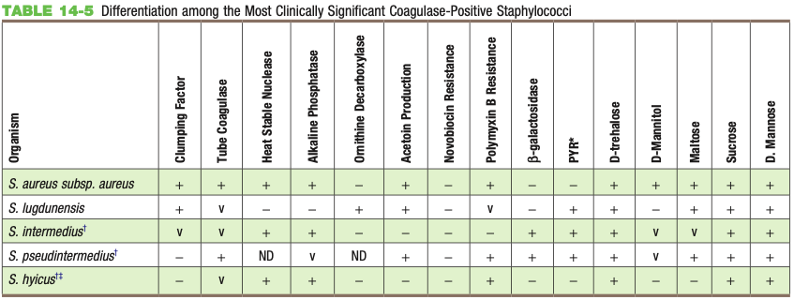
Notes:
This table provides the results of various tests used to differentiate the coagulase positive staphylococci. It is noted to mention that staphylococcus intermedius, which is an important agent that can be isolated from dog bite and be misidentified as staphylococcus aureus. Confirmatory tests in cases in which coagulase positive staphylococci are isolated from dog bite infections. Otherwise, a catalase positive, gram positive cocci in clusters from a white to yellow, creamy, opaque colony on blood agar that is coagulase positive and positive in four hours may presumptively identified as staphylococcus aureus

Slide 28
References
Mandell, Douglas & Bennet’s Principles and Practice of Infectious Diseases 9th Edition
Koneman’s Color Atlas and Textbook of Diagnostic Microbiology 7th Edition
Jawetz, Melnick & Adelberg’s Medical Microbiology 28th Edition
Bailey & Scott’s Diagnostic Microbiology 13th Edition

